Slide 1

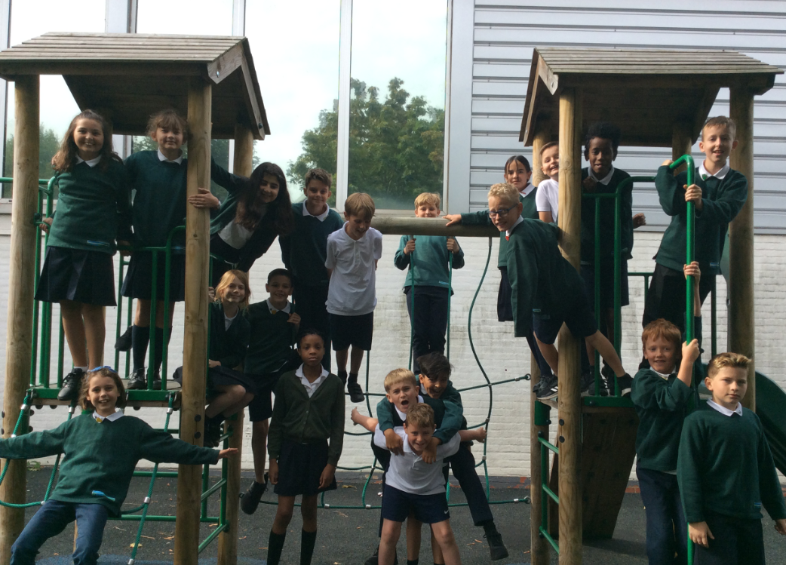
Welcome to Lion Class’
Meet the Teacher
Year 6

Slide 2
Overview of the evening
Timetable
Topics & Trips
What’s New in Year 6
Head’s Award
PGL
SATS
RSE
Homelearning
Behaviour
PATHS
E-safety
10. Useful websites & information
11. Handouts
12. Questions
Meet the teacher
September 2019

Slide 3
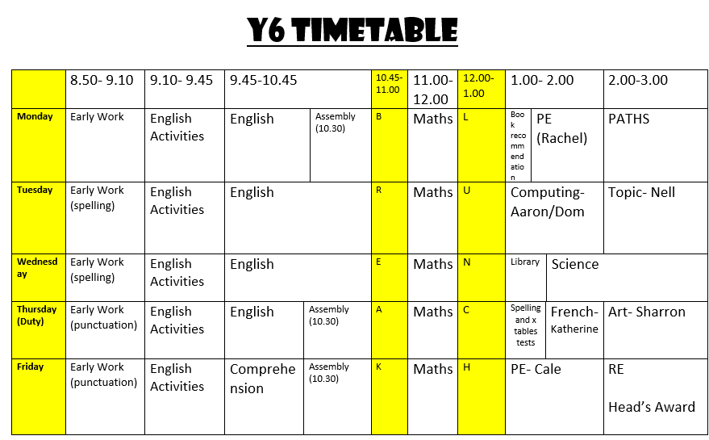
Notes:
3
Motivate Sessions are on Monday and Tuesday afternoons. Please ensure your child comes with a complete kit both days.
Science will be taught by our deputy-head, Sonia. Our first topic is “Earth, Sun and Moon.”
Music will be taught by Marinus on Thursday afternoons.
Children will be given some class time to work on Heads Awards, but will also need to work on them outside of school as well. Options follow on Friday Afternoon.

Slide 4
Topics & Trips
Term | Topic | Trip
Autumn 1 | Victorians | Holly Lodge
Autumn 2 | Victorians | Talk on a local Workhouse
Spring 1 | World War 2 | Blitz Experience
Spring 2 | World War 2 | Air raid Shelter
Summer 1 | India | PGL Osmington Bay
Summer 2 | India | Hindu Mandir

Slide 5
What’s New in Lions
Some lessons taught with a different teacher:
Music - Holly, Art- Sharron PE- Cale
Nell- Ben Computing- Aaron and Dom
SATS- week beginning 11th of May
Osmington Bay- week beginning 18th May
Cycling proficiency- week beginning 2nd June

Slide 6
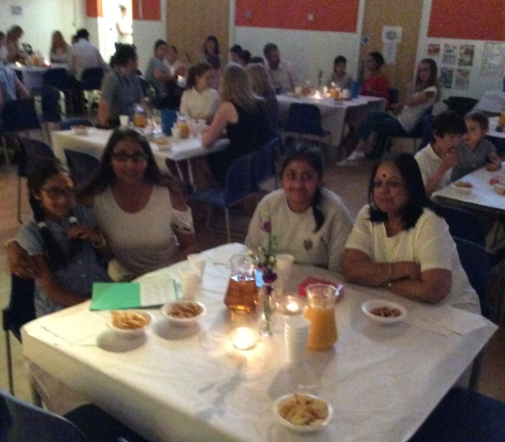

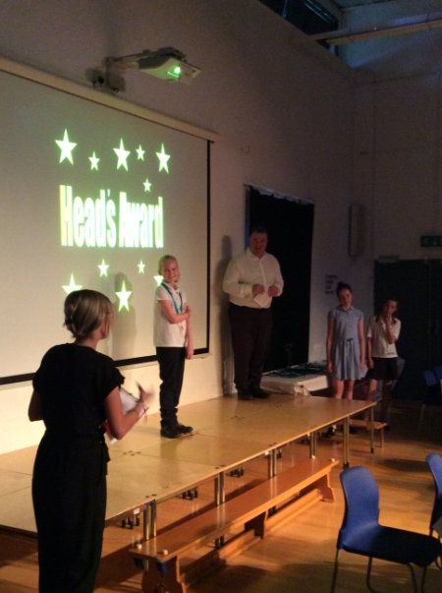



Headteacher’s
Award
Bronze, Silver, Gold and Platinum Award (with distinction for mentoring)
Two celebration evenings a year
Encourage a growing independence

Slide 7
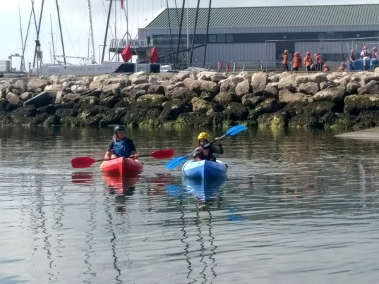
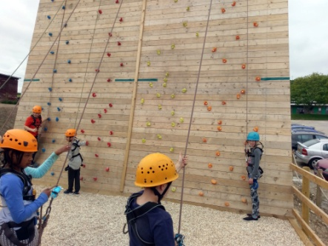
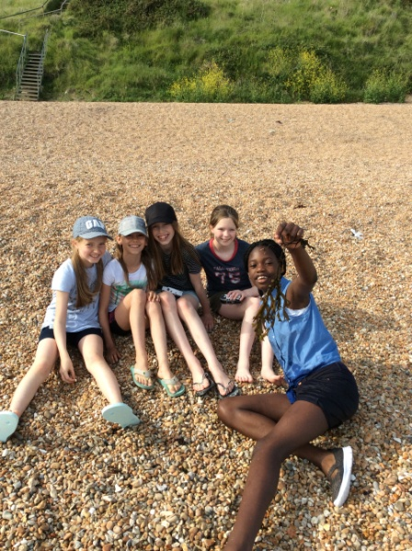
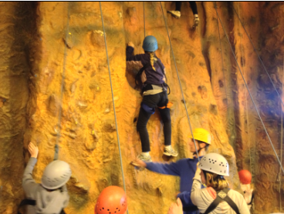
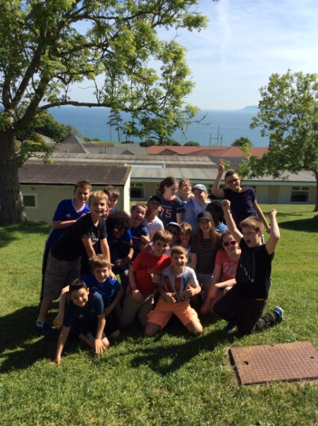
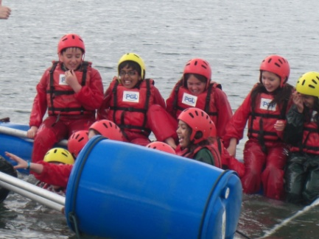
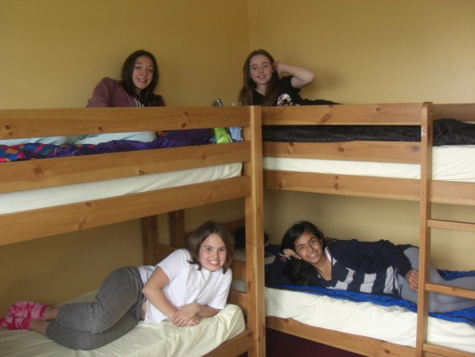
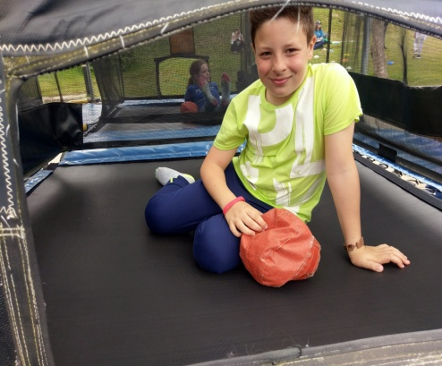

Slide 8
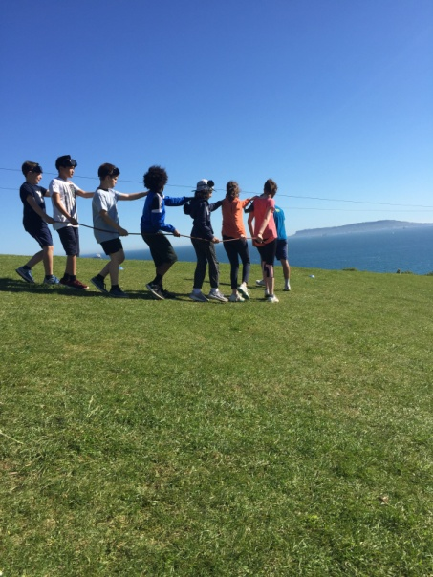
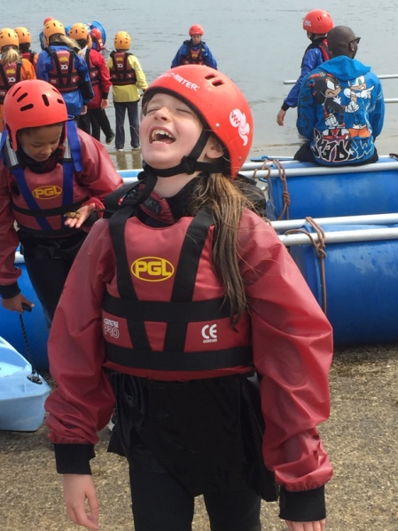
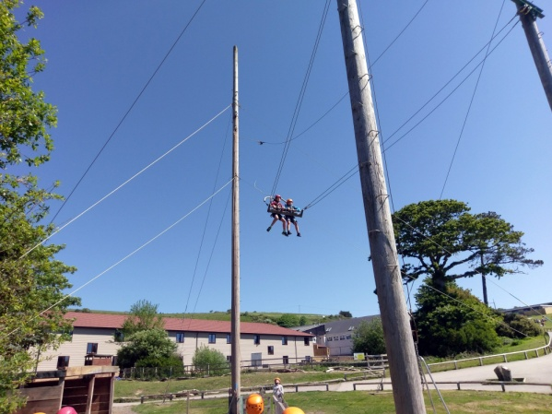
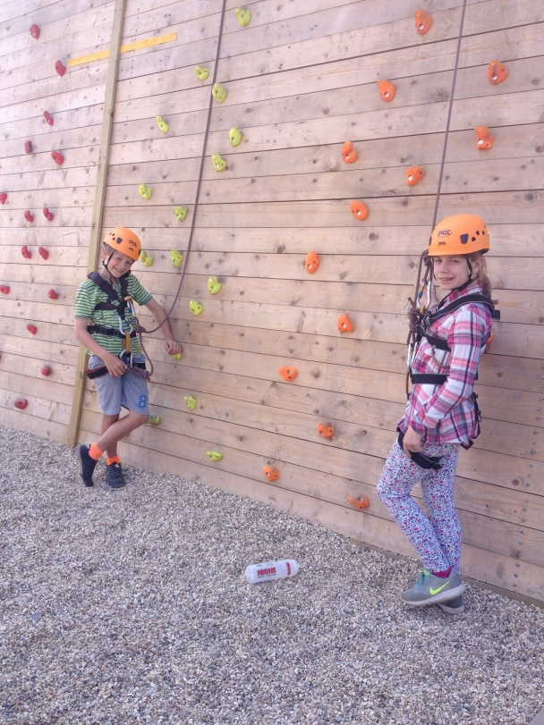
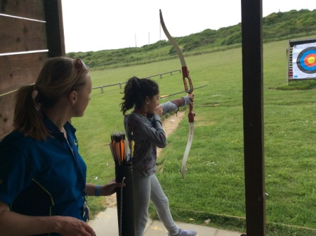
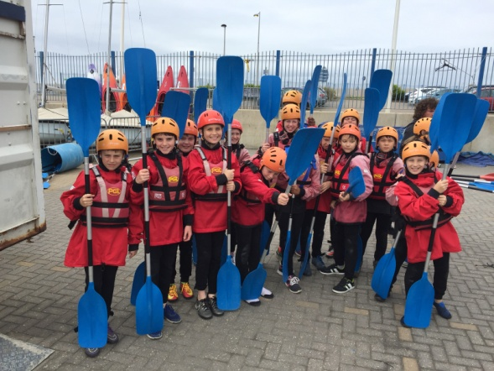
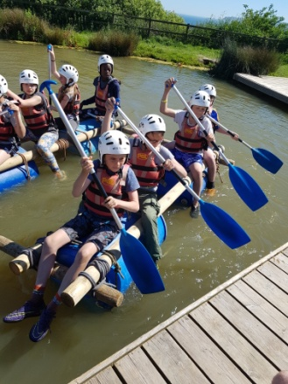

Slide 9
Sats
Week beginning: 11th May 2020.
All week
Timed tests
Externally marked (except writing)
Reading, Maths, grammar & spelling.
No levels
No Greater Depth- only in writing

Slide 10
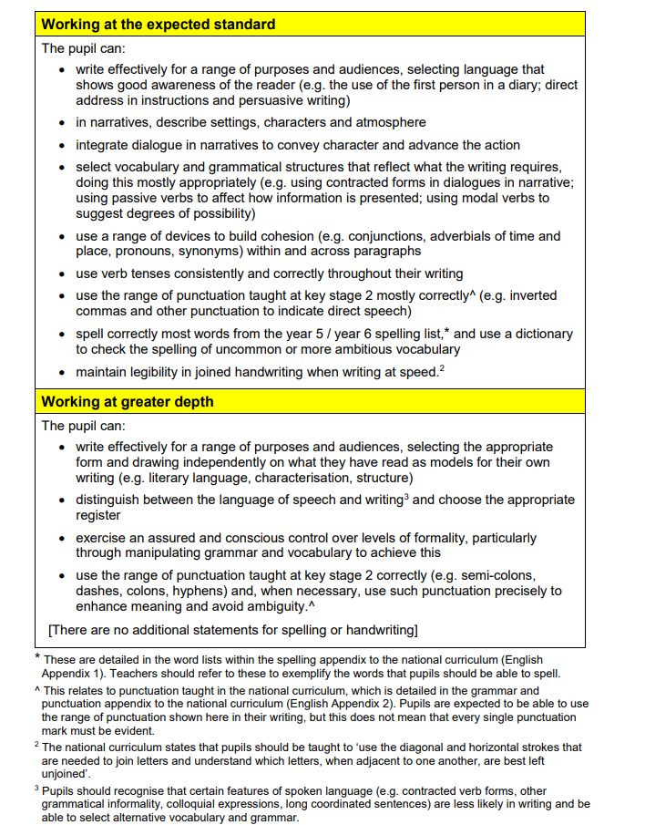
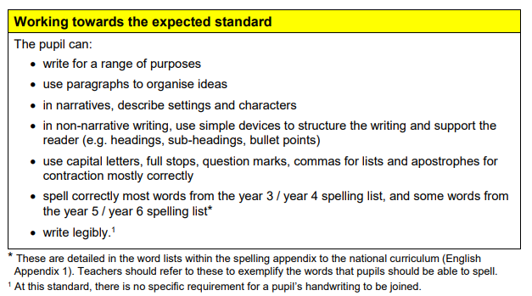

Slide 11
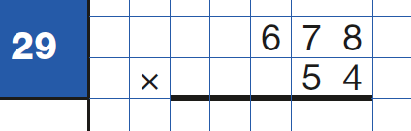
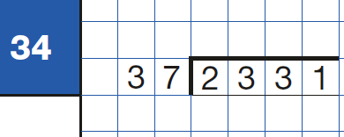
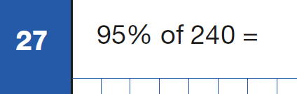
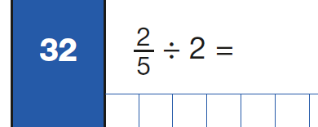
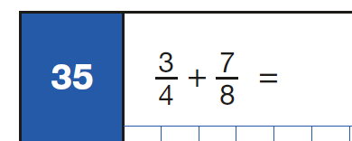
KS2- Paper 1

Slide 12
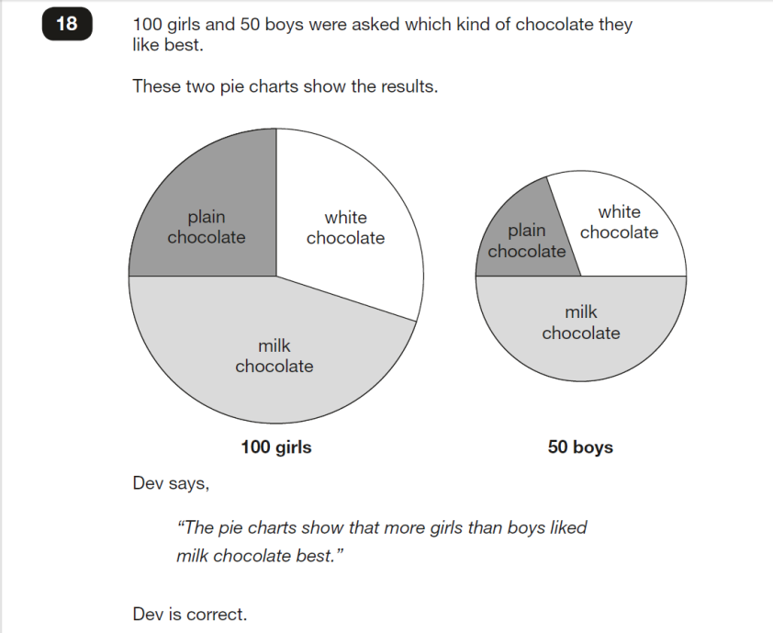
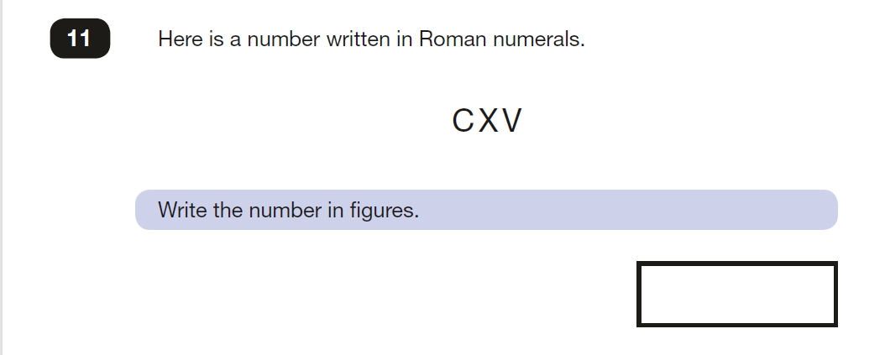
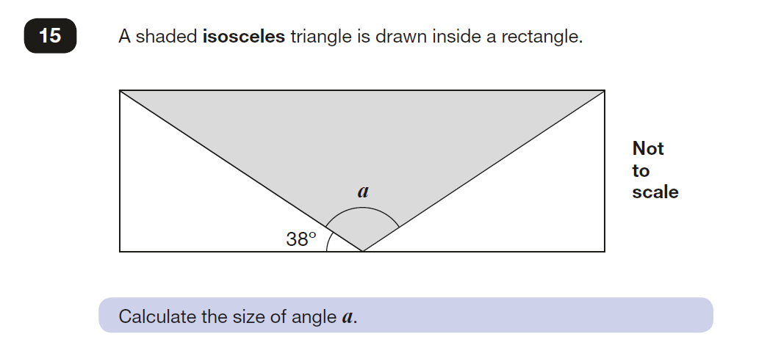
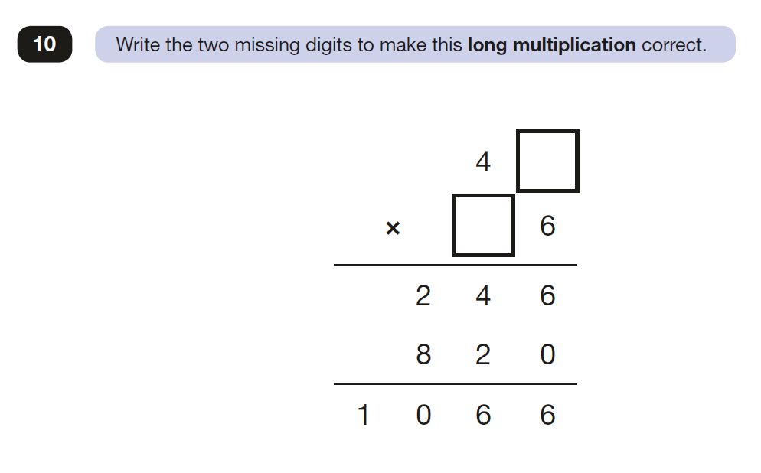
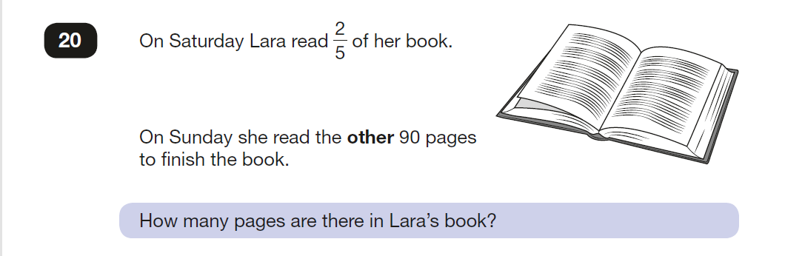
KS2- Paper 2-

Slide 13
RSE
Session 1
Aims
To consider puberty and reproduction
learning outcomes
Describe how and why the body changes during puberty in preparation for reproduction
Talk about puberty and reproduction with confidence
Session 2
Aims
To consider reproduction in the context of relationships
learning outcomes
Discuss different types of adult relationships with confidence
Explain how babies are made
Session 3
Aims
To explore the process of conception and pregnancy
learning outcomes
Describe the decisions that have to be made before having a baby
Know some basic facts about pregnancy and conception

Slide 14
Session 4
Aims
To learn about the roles and responsibilities of carers and parents
Learning outcomes
Identify some of the skills and qualities needed to be a parent and carer
Understand the variety of ways in which parents and carers meet the needs of babies and children
Recognise that both men and women can take on these roles and responsibilities
Session 5: Egg Babies!
Lesson 6
Your Questions Answered
Learning Intention
To answer each others questions about sex and relationships with confidence and find support and advice

Slide 15
Home Learning
Home Learning will go out on a Thursday, reading records will be collected on a Tuesday, spelling tests will be on a Thursday.
Home Learning will include:
Spellings sent home weekly to be learned. .
Children should complete the assigned Mathletics activity weekly.
It is very important that children continue to read at home on a daily basis for 20 minutes. Reading Records must be completed each day and given in on Tuesdays with Home Learning.
Creative home learning tasks.
If you wish to do additional work with your children use the KPIs on the school website.

Slide 16
Behaviour
Policy available on the website, please have a look.
We monitor and log all behaviour incidents
You will be contacted if your child is sent to a linked class or is involved in a serious incident.
Feel free to make an appointment with me or with Leadership if you have any concerns about a child’s behaviour.

Slide 17
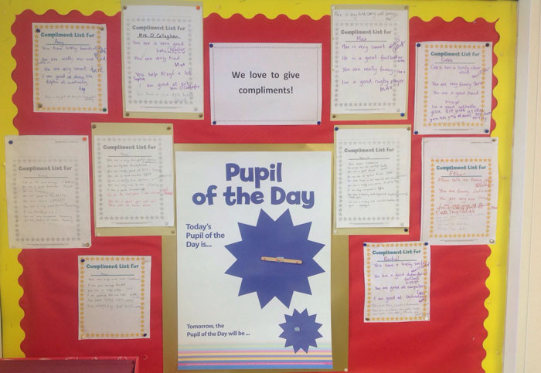
Focus on the positive

Slide 18
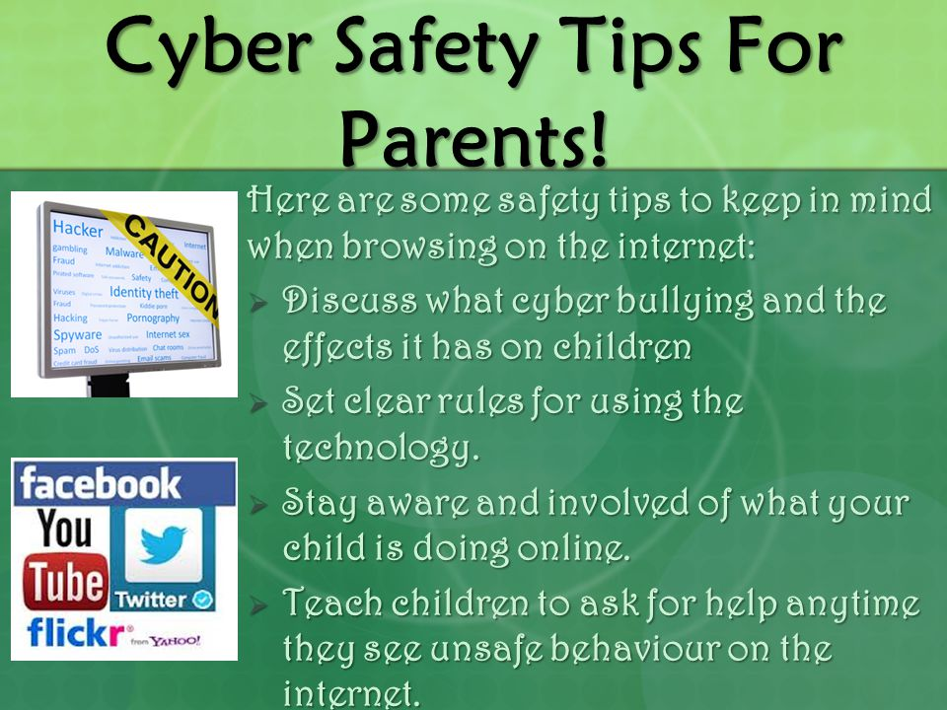
Internet Safety
Also check the school websites for updates and links from the borough

Slide 19


Mobile Phones
In year 5 and 6 children are allowed to bring their mobile phones in at their own risk.
Phones are to be locked away at 9am and returned at 3.00pm
Bike Helmets
As the children are permitted to cycle to school unaccompanied, we ask that all parents/ carers ensure that they are wearing their helmets.
Children will not be permitted to leave school with their bikes if they do not have adequate headwear.

Slide 20

Cakes on Birthdays
Due to allergies and time constraints, we ask that if you wish to give out birthday cakes or party bags on your child’s birthday you do
this after school on
the playground so
that parents/ carers
can give consent.

Slide 21
Useful websites and information
http://www.bbc.co.uk/bitesize/ks2/
http://resources.woodlands-junior.kent.sch.uk/maths/
http://www.compare4kids.co.uk/literacy.php
http://webarchive.nationalarchives.gov.uk/20110809101133/nsonline.org.uk/node/20683
http://durham.schooljotter.com/coxhoe/Curriculum+Links

Slide 22
Website:
Presentation slides
Class timetable
Secondary School Slides
Spelling strategies
Statutory spellings
Book List
TAFS

Slide 23
Any Questions?
Please do come and see me or make an appointment to discuss anything on Tuesdays after school

