Slide 1



LIFE/work balance
We have started a #LIFEworkbalance campaign and we need your help to complete our LIFE/work balance survey.
We hope to publish the results soon, so please give 15 minutes of your time to help us get a true picture of school life.
Want to be a part of this campaign? Take the survey on our website and share it with your colleagues!
© Classroom Secrets Limited 2019

Slide 2
Year 5 – Autumn Block 1 – Place Value – Counting in Powers of 10
About This Resource:
This PowerPoint has been designed to support your teaching of this small step. It includes a starter activity and an example of each question from the Varied Fluency and Reasoning and Problem Solving resources also provided in this pack. You can choose to work through all examples provided or a selection of them depending on the needs of your class.
National Curriculum Objectives:
Mathematics Year 5: (5N1) Count forwards or backwards in steps of powers of 10 for any given number up to 1,000,000
Mathematics Year 5: (5N5) Interpret negative numbers in context, count forwards and backwards with positive and negative whole numbers, including through zero
Mathematics Year 5: (5N6) Solve number problems and practical problems that involve 5N1 - 5N5
More Year 5 Place Value resources.
Did you like this resource? Don’t forget to review it on our website.
© Classroom Secrets Limited 2018

Slide 3
Year 5 – Autumn Block 1 – Place Value
Step 8: Counting in Powers of 10
© Classroom Secrets Limited 2018

Slide 4
Introduction
Complete each sequence.
240
+10
4,200
+100
34,500
+1,000
980
– 10
© Classroom Secrets Limited 2018

Slide 5
Introduction
Complete each sequence.
240
250
260
270
280
+10
4,200
4,300
4,400
4,500
4,600
+100
34,500
35,500
36,500
37,500
38,500
+1,000
980
970
960
950
940
– 10
© Classroom Secrets Limited 2018

Slide 6
Varied Fluency 1
Starting at 993,456, count backwards through the maze to reach 977,456.
993,456 | 983,456 | 987,456 | 986,456 | 985,456
992,456 | 982,456 | 988,456 | 979,456 | 978,456
991,456 | 990,456 | 989,456 | 980,456 | 977,456
990,456 | 985,456 | 984,456 | 981,456 | 922,456
989,456 | 986,456 | 983,456 | 982,456 | 932,456
988,456 | 987,456 | 982,456 | 981,456 | 991,456
© Classroom Secrets Limited 2018

Slide 7
Varied Fluency 1
Starting at 993,456, count backwards through the maze to reach 977,456.
993,456 | 983,456 | 987,456 | 986,456 | 985,456
992,456 | 982,456 | 988,456 | 979,456 | 978,456
991,456 | 990,456 | 989,456 | 980,456 | 977,456
990,456 | 985,456 | 984,456 | 981,456 | 922,456
989,456 | 986,456 | 983,456 | 982,456 | 932,456
988,456 | 987,456 | 982,456 | 981,456 | 991,456
© Classroom Secrets Limited 2018

Slide 8
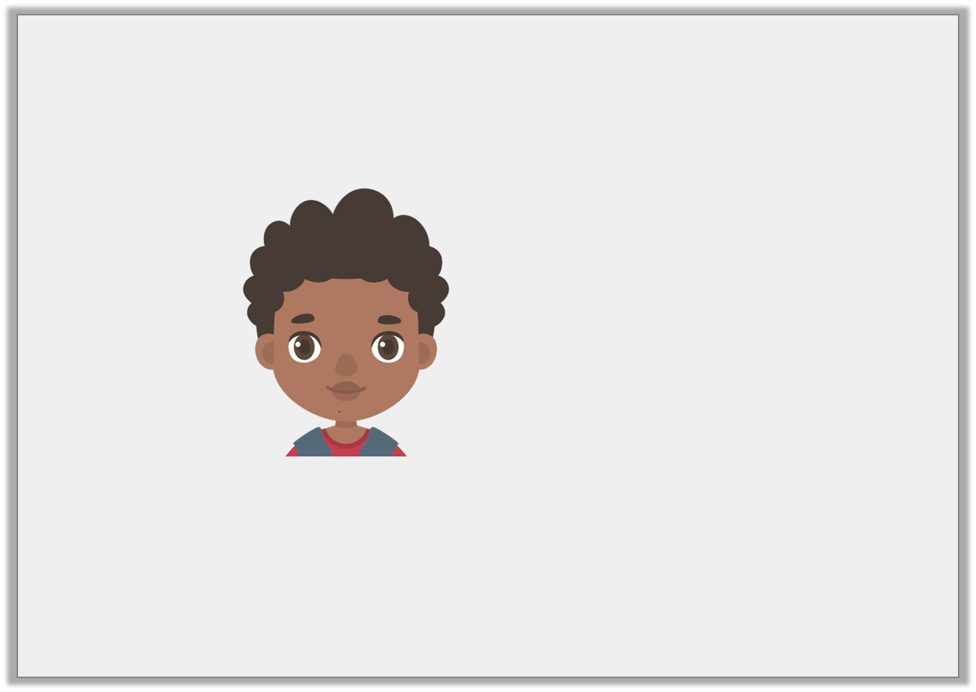
Varied Fluency 2
Archie is counting backwards.
Find and correct any mistakes.
345,678
445,678
455,678
655,678
755,678
855,678
© Classroom Secrets Limited 2018

Slide 9
Varied Fluency 2
Archie is counting backwards.
Find and correct any mistakes.
Archie began counting in 100,000s then switched to counting in 10,000s for the third number, returning to count in 100,000s.
To continue counting in 100,000s he should have counted 445,678; 545,678; 645,678; 745,678; 845,678
345,678
445,678
455,678
655,678
755,678
855,678
© Classroom Secrets Limited 2018

Slide 10
Varied Fluency 3
Put the numbers in ascending order and identify the power of 10 they have increased by.
78,345
78,445
78,145
78,245
© Classroom Secrets Limited 2018

Slide 11
Varied Fluency 3
Put the numbers in ascending order and identify the power of 10 they have increased by.
78,145; 78,245; 78,345; 78,445;
They have increased by 100.
78,345
78,445
78,145
78,245
© Classroom Secrets Limited 2018

Slide 12
Varied Fluency 4
What rule does this function machine follow?
Find the next 3 terms in this sequence.
3,964 |  | 2,964
?
© Classroom Secrets Limited 2018

Slide 13
Varied Fluency 4
What rule does this function machine follow? – 1,000
Find the next 3 terms in this sequence.
1,964; 964; -36
3,964 |  | 2,964
?
© Classroom Secrets Limited 2018

Slide 14
Problem Solving 1
Here are 3 numbers of a sequence:
1,764; 11,764; 21,764; 31,764
Use the digit cards to create a number which will be in this sequence.
4
1
7
3
6
5
© Classroom Secrets Limited 2018

Slide 15
Problem Solving 1
Here are 3 numbers of a sequence:
1,764; 11,764; 21,764; 31,764
Use the digit cards to create a number which will be in this sequence.
Various answers, for example: 41,764; 51,764; 341,764; 541,764 (any number ending in 1,764).
4
1
7
3
6
5
© Classroom Secrets Limited 2018

Slide 16
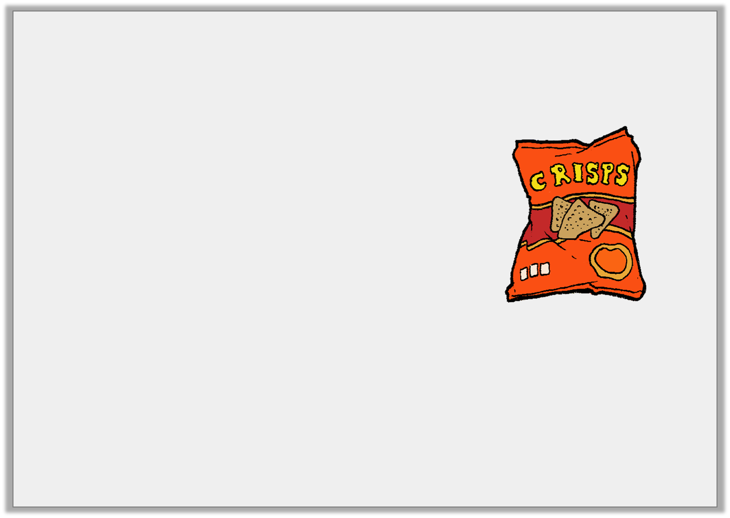
Problem Solving 2
A supermarket is ordering boxes of crisps. Each of the boxes holds 1,000 packets of sharing packs.
They have 16,009 packets of crisps but they
need 35,000 to replenish their stocks.
How many boxes should they order?
If they ordered 20 boxes, how many packets would they have?
© Classroom Secrets Limited 2018

Slide 17
Problem Solving 2
A supermarket is ordering boxes of crisps. Each of the boxes holds 1,000 packets of sharing packs.
They have 16,009 packets of crisps but they
need 35,000 to replenish their stocks.
How many boxes should they order?
19 boxes: 19 x 1,000 = 19,000; 19,000 + 16,009 = 35,009
If they ordered 20 boxes, how many packets would they have?
36,009
© Classroom Secrets Limited 2018

Slide 18
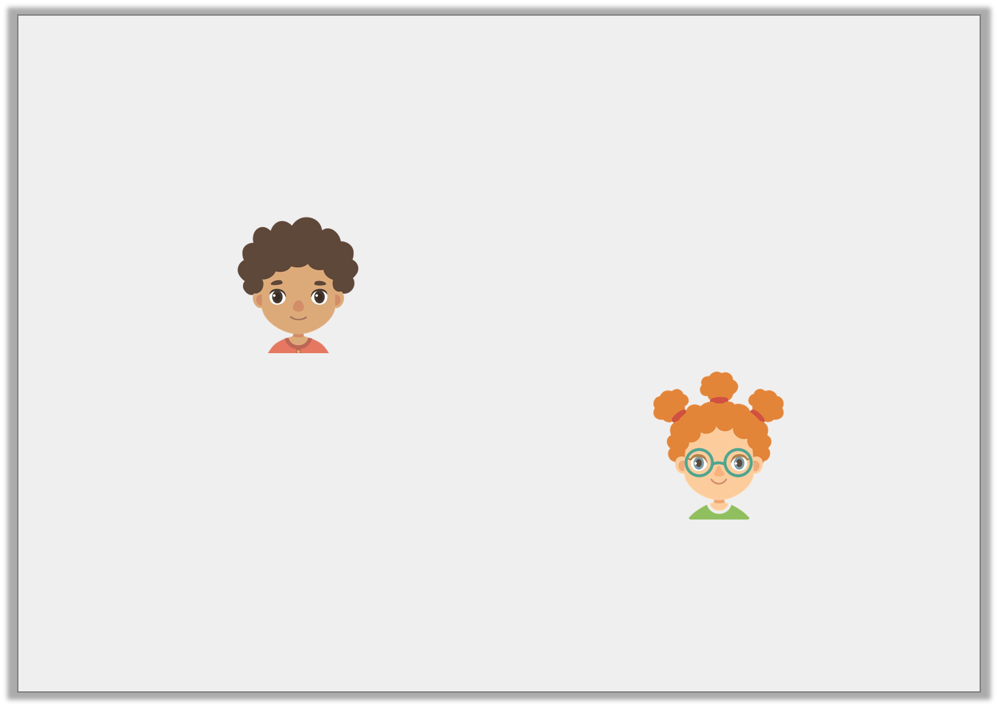
Reasoning 1
The children are discussing this sequence:
87,034; 86,034; 85,034; 84,034
Who is correct? Explain your answer.
The number 134 will be in this sequence.
Errol
There will be no hundreds in this number sequence.
Saffie
© Classroom Secrets Limited 2018

Slide 19
Reasoning 1
The children are discussing this sequence:
87,034; 86,034; 85,034; 84,034
Who is correct? Explain your answer.
Saffie is correct because…
The number 134 will be in this sequence.
Errol
There will be no hundreds in this number sequence.
Saffie
© Classroom Secrets Limited 2018

Slide 20
Reasoning 1
The children are discussing this sequence:
87,034; 86,034; 85,034; 84,034
Who is correct? Explain your answer.
Saffie is correct because the numbers are decreasing by 1,000 so only numbers in the 1,000s or above will change. (Correct for positive integers).
The number 134 will be in this sequence.
Errol
There will be no hundreds in this number sequence.
Saffie
© Classroom Secrets Limited 2018

