Slide 1

Welcome to Rhino Class’
Meet the Teacher
Please sign beside
your child’s name ☺
Year 5

Slide 2
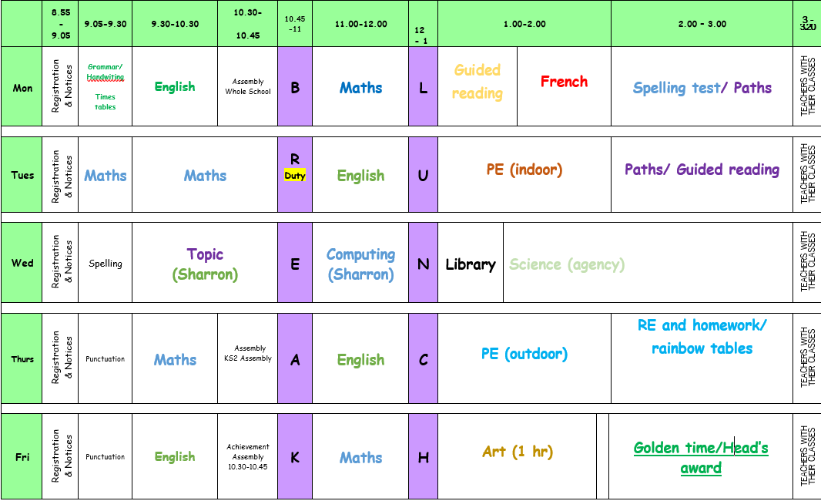
Timetable

Slide 3
Topics & Trips
Term | Topic | Trip
Autumn 1 | Tudor Richmond | Juniper Hall
Autumn 2 | The Big Apple - New York | National Archives
Spring 1 | Earthquakes and volcanoes | Natural History Museum
Spring 2 | Amazon Basin | The Buddhist Temple
Summer 1 | Ancient Aztecs | The British Museum
Summer 2 | Mexico | Space Dome

Slide 4
What’s New in Rhinos
Some lessons taught with a different teacher:
Topic and computing - Sharron
Science – cover teacher
Swimming – Pools on the Park
Children can walk home by themselves with permission.

Slide 5

The Worry Box

Slide 6
Behaviour
Policy available on the website, please have a look.
We monitor and log all behaviour incidents
You will be contacted if your child is sent to a linked class or is involved in a serious incident.
Feel free to make an appointment with me or with Leadership if you have any concerns about a child’s behaviour.

Slide 7
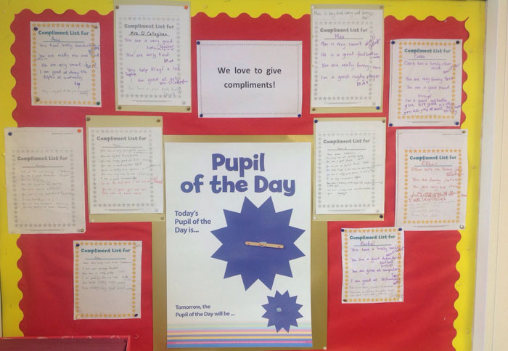
Focus on the positive

Slide 8
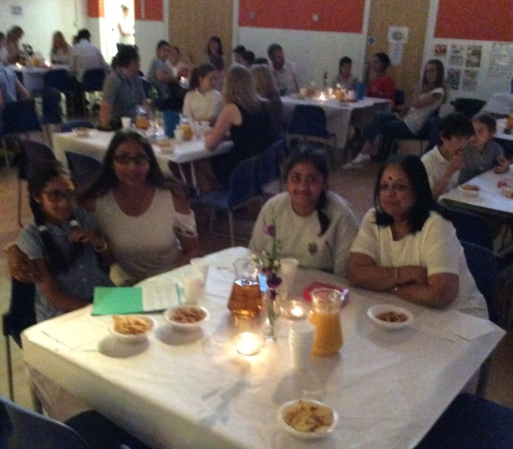

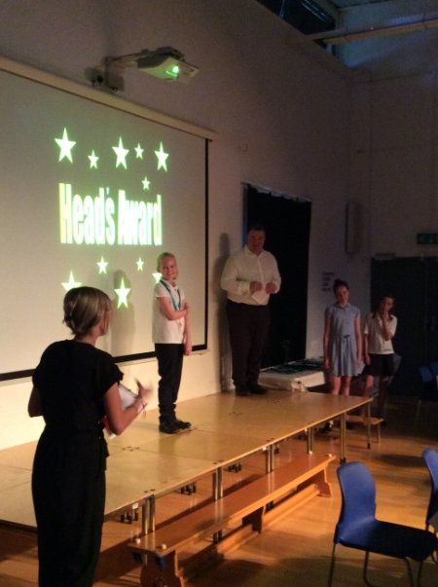



Headteacher’s
Award
Bronze, Silver, Gold and Platinum Award (with distinction for mentoring)
Two celebration evenings a year
Encourage a growing independence

Slide 9
Home Learning
Home Learning will go out on a Thursday, reading records will be collected on a Tuesday, spelling tests will be on a Thursday.
Home Learning will include:
Spellings sent home weekly to be learned. .
Children should complete the assigned Mathletics activity weekly.
It is very important that children continue to read at home on a daily basis for 20 minutes. Reading Records must be completed each day and given in on Tuesdays with Home Learning.
Creative home learning tasks.
If you wish to do additional work with your children use the KPIs on the school website.

Slide 10

Internet Safety
Also check the school websites for updates and links from the borough

Slide 11


Mobile Phones
In year 5 and 6 children are allowed to bring their mobile phones in at their own risk.
Phones are to be locked away at 9am and returned at 3.00pm
Bike Helmets
As the children are permitted to cycle to school unaccompanied, we ask that all parents/ carers ensure that they are wearing their helmets.
Children will not be permitted to leave school with their bikes if they do not have adequate headwear.

Slide 12

Cakes on Birthdays
Due to allergies and time constraints, we ask that if you wish to give out birthday cakes or party bags on your child’s birthday you do
this after school on
the playground so
that parents/ carers
can give consent.

Slide 13
Any Questions?
Please do come and see me or make an appointment to discuss anything on Tuesdays after school

