Slide 1
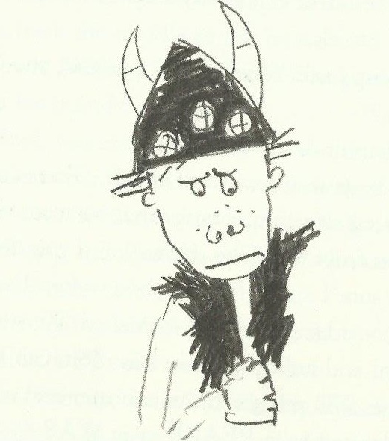
Pronouns
How to Train Your Dragon
Hiccup knew that he was not a typical Viking hero. They might think he was useless now, but the Hairy Hooligans might see him differently in the future. He would have to use imagination and cunning to lead them to victory.

Slide 2
Definition: A pronoun replaces a noun or noun phrase.
A pronoun goes in the sentence in the place of the noun.
Hiccup was very good at watching dragons. He was fascinated by them.
Hiccup was very good at watching dragons. Hiccup was fascinated by dragons.
Without the pronouns the text is repetitive and hard to say.

Slide 3
There are different types of pronoun:
Personal pronouns – I, me, you, he, she, it, him, her, they
2. Possessive pronouns – mine, yours, ours, theirs, his, hers
Notes:
Possessive pronouns and determiners.
Possessive pronouns are slightly tricky
If they stand on their own to preplace a noun, they are possessive pronouns. E.g. The book was his. (his replaces ‘Tom’s.)
If they precede a noun, e.g. his book, then, strictly, these are possessive determiners as they behave like adjectives.
There are also relative pronouns which appear in Y5 NC so are not tackled here.

Slide 4
1. Personal pronouns
These refer to a missing name of a person, creature, place or thing.
Hiccup called his dragon.
He called it.
Gobber fears the chief.
I fear you.
Dogsbreath loved the bad weather.
He loved it.
Dragons know how to cross the lake.
They know how to cross it.
The cave is where the dragon sleeps.
It is where he sleeps.
Gobber is pleased with Snotlout.
He is pleased with him.
Notes:
Occasionally ‘it’ is a ‘dummy pronoun’ when it refers not to anything specific but to an undetermined actor or subject.
Because of this function, ‘it’ is sometimes called a place holder. E.g. It is raining. It all depends...

Slide 5
2. Possessive pronouns
These refer to the possession of someone or something
by someone or something.
Possessive pronouns stand in place of the noun
If it doesn’t replace the noun or noun phrase, then it is not a pronoun.
The dragon is yours.
Hiccup’s
The cave is mine.
the dragon’s
The tribe is ours.
the Hooligan’s
Notes:
Possessive pronouns and determiners.
If they stand on their own to preplace a noun, they are possessive pronouns. E.g. The book was his. (his replaces ‘Tom’s.)
If they precede a noun, e.g. his book, then, strictly, these are possessive determiners as they behave like adjectives.

Slide 6
Can you replace the underlined words with pronouns?
Hiccup worried that his dragon was too small. His dragon would make Hiccup a laughing stock with the other boys.
Old Wrinkly said that all the dragons were small compared to a Sea Dragon. Sea Dragons were big enough to swallow ten boats and Sea Dragons wouldn’t even notice doing it.
Hiccup wished Hiccup was more like the rest of the Hairy Hooligans but it was clear to the Hairy Hooligans that Hiccup was different .
His
him
They
they
he
them
Much less repetitive!
ANSWERS

