Slide 1
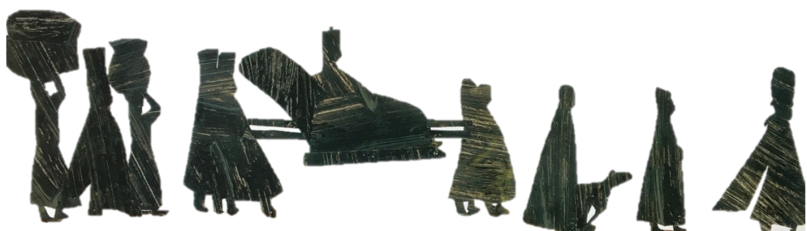
Pronouns
her
she
mine
he
they
ours
it
Notes:
All these slides are based on the teaching outlined in the document ‘Teaching_1_Pronouns’ available from Hamilton.
It is essential to read the teaching before using this powerpoint presentation.

Slide 2
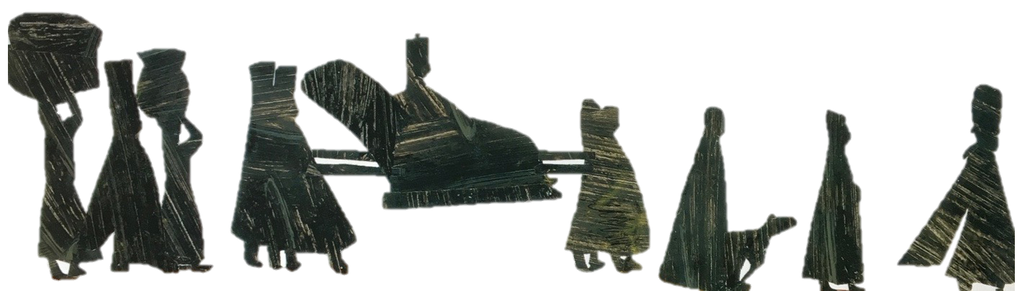
We are learning about
two
types of pronoun:
Personal pronouns – I, me, you, he, she, him, her, etc.
2. Possessive pronouns – mine, yours, his, hers, its, etc.
Notes:
Possessive pronouns and determiners.
Possessive pronouns are slightly tricky
If they stand on their own to preplace a noun, they are possessive pronouns. E.g. The book was his. (his replaces ‘Tom’s.)
If they precede a noun, e.g. his book, then, strictly, these are possessive determiners as they behave like adjectives.
It is NOT necessary to make this distinction with children in Y5 or Y6.

Slide 3
What nouns and noun phrases could go with this picture?
it
hopeful prince
hat
royal procession
he
it
them
tired feet
leader
him
them
pots
them
it
she
cloaks
baskets on the head
carriage
them
faithful dog
them
servants
Pronouns can take the place of nouns and noun phrases
Notes:
Possessive pronouns and determiners.
Possessive pronouns are slightly tricky
If they stand on their own to preplace a noun, they are possessive pronouns. E.g. The book was his. (his replaces ‘Tom’s.)
If they precede a noun, e.g. his book, then, strictly, these are possessive determiners as they behave like adjectives.
It is NOT necessary to make this distinction with children in Y5 or Y6.

Slide 4
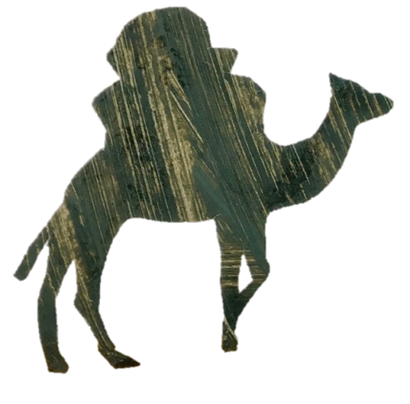
1. Personal pronouns
These replace nouns and noun phrases.
The leader called his camel.
He called her.
Camels know how to survive in the desert.
They know how to survive in it.
Al Sharif, the camel loved to drink water.
He loved to drink it.
The prince is pleased with the new camel.
He is pleased with him.
By the tents is where the camels sleep.
It is where they sleep.
The crazy new camel with floppy ears ran excitedly.
She ran excitedly.
Notes:
Occasionally ‘it’ is a ‘dummy pronoun’ when it refers not to anything specific but to an undetermined actor or subject.
Because of this function, ‘it’ is sometimes called a place holder. E.g. It is raining. It all depends...

Slide 5
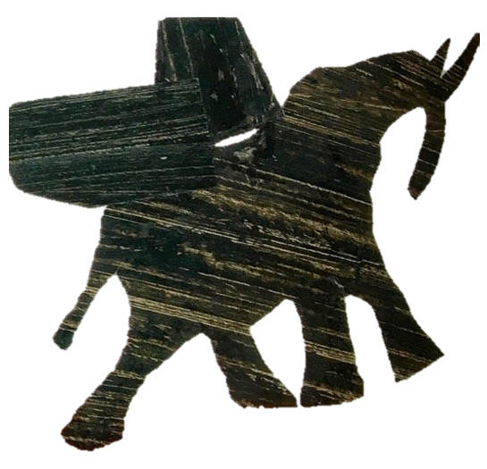
2. Possessive pronouns
These refer to the possession of someone or something
by someone or something.
Possessive pronouns stand in place of the noun.
The elephant is yours.
The baskets are mine.
The tusks are his.
NOTE: In ‘That is your elephant.’, ‘your’ is not a pronoun but a determiner. See slide 6
Notes:
Possessive pronouns and determiners.
If they stand on their own to preplace a noun, they are possessive pronouns. E.g. The book was his. (his replaces ‘Tom’s.)
If they precede a noun, e.g. his book, then, strictly, these are possessive determiners as they behave like adjectives.
It is NOT necessary to make this distinction with children in Y5 or Y6.

Slide 6
Read the sentences below. Can you spot the pronouns?
Juma wanted to get a dog but he knew it had to be the right type.
I did not like the tent; it was horrible but it was mine.
The camel proceeded slowly through the desert where she was careful to guide her owner around the boulders.
ANSWERS

Slide 7
Talk about the type of each pronoun.
Juma wanted to get a dog but he knew it had to be the right type.
I did not like the tent; it was horrible but it was mine.
The camel proceeded slowly through the desert where she was careful to guide her owner around the boulders.
Key: personal possessive
Notes:
Possessive pronouns and determiners.
Possessive pronouns are slightly tricky
If they stand on their own to preplace a noun, they are possessive pronouns. E.g. The book was his. (his replaces ‘Tom’s.)
If they precede a noun, e.g. his book, then, strictly, these are possessive determiners as they behave like adjectives.
It is NOT necessary to make this distinction with children in Y5 or Y6.

Slide 8
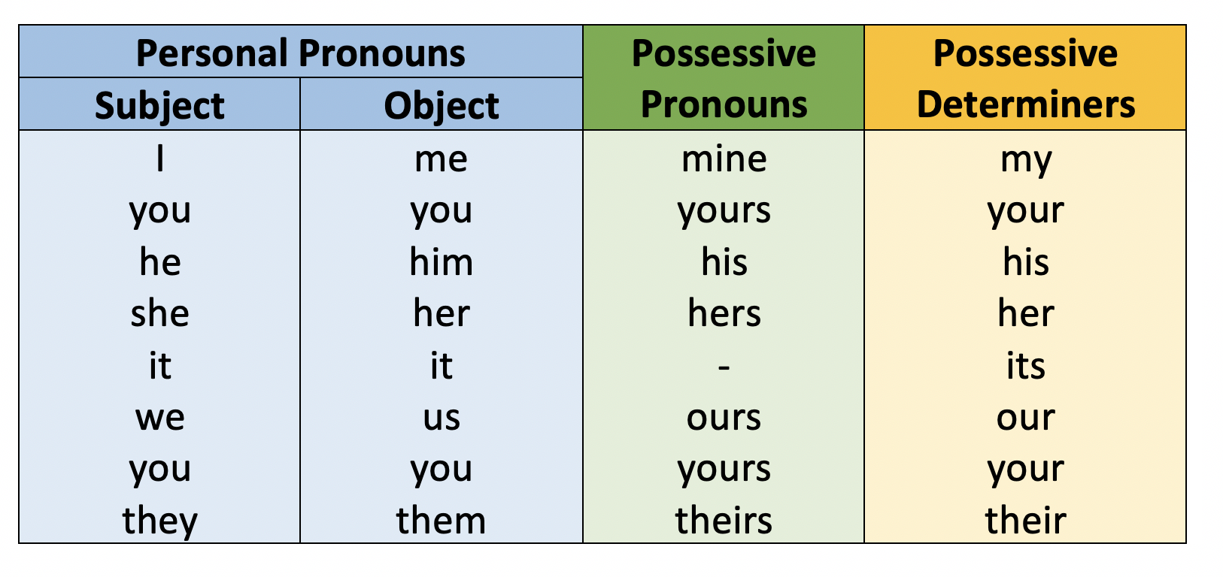

Slide 9
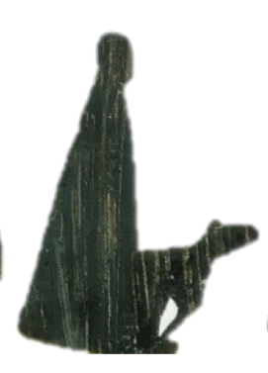
Determiners
These are words which go before a noun.
They can tell us more about a noun.
There is a dog.
There is the dog.
a dog suggests a dog you have not spoken about before.
the dog suggests it is a specific dog. You have mentioned it before.
What do you notice?
There is a dog eating our dinner.
There is the dog I told you about yesterday.
Notes:
Possessive pronouns and determiners.
If they stand on their own to preplace a noun, they are possessive pronouns. E.g. The book was his. (his replaces ‘Tom’s.)
If they precede a noun, e.g. his book, then, strictly, these are possessive determiners as they behave like adjectives.
It is NOT necessary to make this distinction with children in Y5 or Y6.

Slide 10

Possession
Possession is when a noun owns something.
That dog is Abiola’s.
The possessive pronoun stands in the place of the noun.
That dog is his.
Sometime determiners can show possession too.
That is his dog.
The determiner describes the dog (qualifies it).
It stands next to the noun. It does not replace it.
That was our dinner!
It is your fault.
Notes:
Possessive pronouns and determiners.
If they stand on their own to preplace a noun, they are possessive pronouns. E.g. The book was his. (his replaces ‘Tom’s.)
If they precede a noun, e.g. his book, then, strictly, these are possessive determiners as they behave like adjectives.
It is NOT necessary to make this distinction with children in Y5 or Y6.

Slide 11
Determiner or Possessive Pronoun?
Remember: pronouns stand in the place of a noun
determiners stand next to their noun
determiner - next to the noun
It is his mess.
The mess is his.
It is his mess.
The mess is Talib’s.
Possessive pronoun - replaces the noun.
Possessive pronoun - replaces the noun.
The basket is mine.
It is my basket.
The basket is Mashika’s.
It is my basket.
determiner - next to the noun
Notes:
Possessive pronouns and determiners.
If they stand on their own to preplace a noun, they are possessive pronouns. E.g. The book was his. (his replaces ‘Tom’s.)
If they precede a noun, e.g. his book, then, strictly, these are possessive determiners as they behave like adjectives.
It is NOT necessary to make this distinction with children in Y5 or Y6.

Slide 12
Pronouns
Pronouns go in a sentence instead of a noun.
The princess climbed into bed and she pulled up her covers.
If we keep using the same noun, the story becomes repetitive.
The princess climbed into bed and the princess pulled up the princess’s covers.
We use different pronouns depending on the noun being replaced.
Personal Pronouns
I, me, we, us, you, she, he, it, they
Possessive Pronouns
mine, yours, his, hers, its, ours, theirs
Possessive Determiners
my, your, his, her, its, our, their
Determiners stand NEXT TO their noun. They do not replace it.
Week 1 Friday Grammar 2

Slide 13
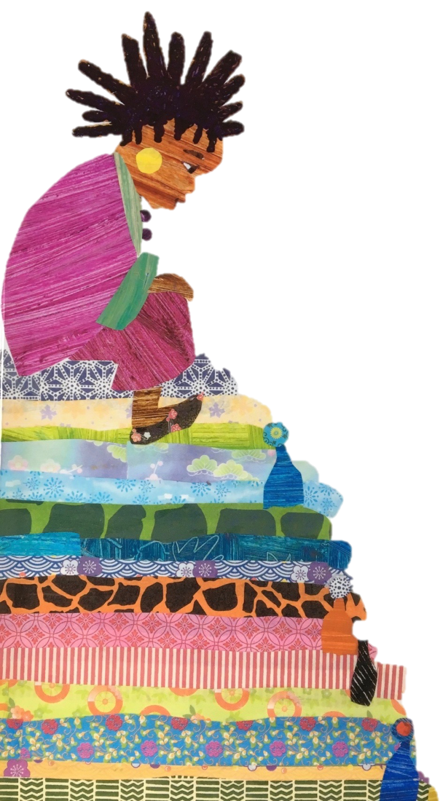
Pronouns help to link ideas in a story
Pronouns make links to what has already been said.
The princess climbed into bed and she pulled up her covers. The bed had twenty mattresses piled high and it towered beneath her. The princess wondered if she might be sick. She was not very good with heights. She closed her eyes and swallowed. Little did she know that far below a small pea was sitting, squashed by all of the bedding. It had been hidden there by the queen and its hard, round body was pushing up towards her.
Which pronouns or determiners relate to the princess?
Which pronouns or determiners relate to the pea?

Slide 14
Pronouns help to link ideas in a story
Pronouns make links to what has already been said.
The princess climbed into bed and she pulled up her covers. The bed had twenty mattresses piled high and it towered beneath her. The princess wondered if she might be sick. She was not very good with heights. She closed her eyes and swallowed. Little did she know that far below a small pea was sitting, squashed by all of the bedding. It had been hidden there by the queen and its hard, round body was pushing up towards her.
determiner
Pronouns help writing flow by making links across the text.

Slide 15
End
Notes:
All these slides are based on the teaching outlined in the document ‘Teaching_1_Pronouns’ available from Hamilton.
It is essential to read the teaching before using this powerpoint presentation.

