Slide 1



LIFE/work balance
We have started a #LIFEworkbalance campaign and we need your help to complete our LIFE/work balance survey.
We hope to publish the results soon, so please give 15 minutes of your time to help us get a true picture of school life.
Want to be a part of this campaign? Take the survey on our website and share it with your colleagues!
© Classroom Secrets Limited 2019

Slide 2
Year 4 – Autumn Block 1 – Place Value – Number Line to 10,000
About This Resource:
This PowerPoint has been designed to support your teaching of this small step. It includes a starter activity and an example of each question from the Varied Fluency and Reasoning and Problem Solving resources also provided in this pack. You can choose to work through all examples provided or a selection of them depending on the needs of your class.
National Curriculum Objectives:
Mathematics Year 4: (4N4a) Identify, represent and estimate numbers using different representations
More Year 4 Place Value resources.
Did you like this resource? Don’t forget to review it on our website.
© Classroom Secrets Limited 2018

Slide 3
Year 4 – Autumn Block 1 – Place Value
Step 7: Number Line to 10,000
© Classroom Secrets Limited 2018

Slide 4
Introduction
What number does each arrow point to?
A
B
C
D
E
0 |  |  |  |  |  |  |  |  |  | 10,000
© Classroom Secrets Limited 2018

Slide 5
Introduction
What number does each arrow point to?
A
B
C
D
E
0 |  | 2,000 | 3,000 |  | 5,000 |  | 7,000 |  | 9,000 | 10,000
© Classroom Secrets Limited 2018

Slide 6
Varied Fluency 1
What is the midpoint of these numbers?
3,220
3,240
© Classroom Secrets Limited 2018

Slide 7
Varied Fluency 1
What is the midpoint of these numbers?
3,220
3,230
3,240
© Classroom Secrets Limited 2018

Slide 8
Varied Fluency 2
Draw a cross to represent the number 6,600 on this number line.
6,000 | 9,000
© Classroom Secrets Limited 2018

Slide 9
Varied Fluency 2
Draw a cross to represent the number 6,600 on this number line.
(intervals of 300)
6,000 | 9,000
© Classroom Secrets Limited 2018

Slide 10
Varied Fluency 3
Circle the letter that represents 6,320.
A
B
C
D
6,200 | 6,600
© Classroom Secrets Limited 2018

Slide 11
Varied Fluency 3
Circle the letter that represents 6,320.
A
B
C
D
6,200 | 6,600
© Classroom Secrets Limited 2018

Slide 12
Varied Fluency 4
Write the letter representing each number on the number lines below.
6,300 is _____ | 6,340 is _____ | 6,250 is _____
A
6,000 | 7,000
B
6,200 | 6,400
C
6,000 | 8,000
© Classroom Secrets Limited 2018

Slide 13
Varied Fluency 4
Write the letter representing each number on the number lines below.
6,300 is C | 6,340 is B | 6,250 is A
A
6,000 | 7,000
B
6,200 | 6,400
C
6,000 | 8,000
© Classroom Secrets Limited 2018

Slide 14
Problem Solving 1
Jade has drawn this number line but has forgotten to include the end point.
She knows that each interval represents a multiple of 10. She also knows that 2,100 fit on the line but 2,250 did not.
What could the end point of the number line be?
2,000
© Classroom Secrets Limited 2018

Slide 15
Problem Solving 1
Jade has drawn this number line but has forgotten to include the end point.
She knows that each interval represents a multiple of 10. She also knows that 2,100 fit on the line but 2,250 did not.
What could the end point of the number line be?
Various answers, for example:
2,120 (intervals of 20); 2,180 (intervals of 30); 2,240 (intervals of 40)
Intervals of 10 would be too small (end point of 2,060) and intervals of 50 would be too large (end of point of 2,300).
2,000
© Classroom Secrets Limited 2018

Slide 16
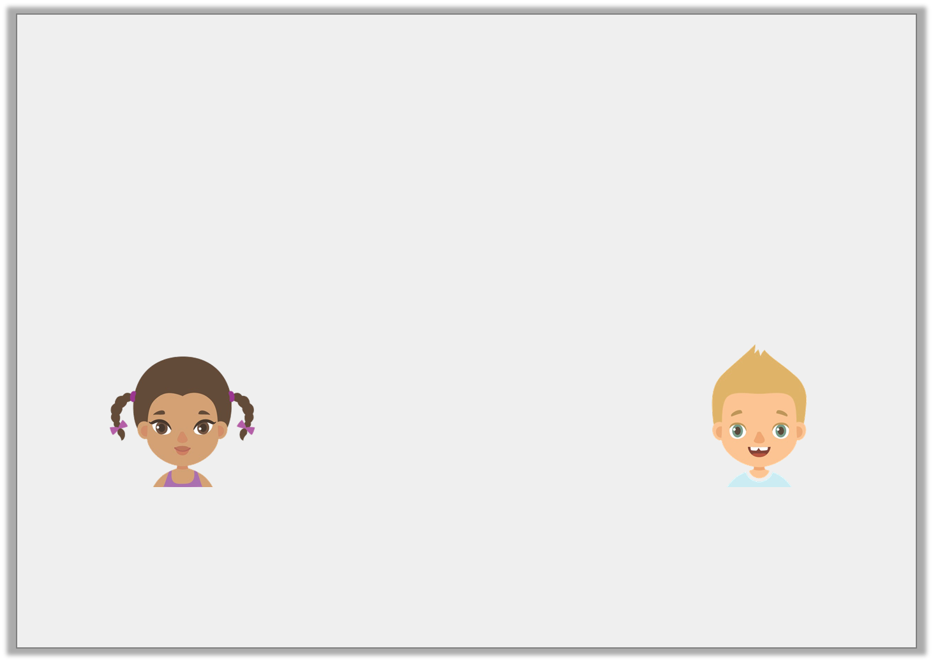
Reasoning 1
Some friends are describing a number on a number line.
Who is correct? Explain your reasoning.
7,800 | 8,000
The number is more than 7,950.
The number is less than 7,925.
Yasmin
Freddie
© Classroom Secrets Limited 2018

Slide 17
Reasoning 1
Some friends are describing a number on a number line.
Who is correct? Explain your reasoning.
Yasmin is correct because…
7,800 | 8,000
The number is more than 7,950.
The number is less than 7,925.
Yasmin
Freddie
© Classroom Secrets Limited 2018

Slide 18
Reasoning 1
Some friends are describing a number on a number line.
Who is correct? Explain your reasoning.
Yasmin is correct because if you divide the number line into 4 parts, you can see that the number is between 7,950 and 8,000.
7,800 | 8,000
The number is more than 7,950.
The number is less than 7,925.
Yasmin
Freddie
© Classroom Secrets Limited 2018

Slide 19
Reasoning 2
Mitchell and Daisy have placed their numbers on these number lines.
Who has the largest number? Convince me.
Mitchell’s number
3,000 | 5,000
Daisy’s number
3,500 | 3,700
© Classroom Secrets Limited 2018

Slide 20
Reasoning 2
Mitchell and Daisy have placed their numbers on these number lines.
Who has the largest number? Convince me.
Daisy’s number is larger because…
Mitchell’s number
3,000 | 5,000
3,500
Daisy’s number
3,580
3,600
3,500 | 3,700
© Classroom Secrets Limited 2018

Slide 21
Reasoning 2
Mitchell and Daisy have placed their numbers on these number lines.
Who has the largest number? Convince me.
Daisy’s number is larger because her number is between 3,580 and 3,600 whereas Mitchell’s number is between 3,000 and 3,500.
Mitchell’s number
3,000 | 5,000
3,500
Daisy’s number
3,580
3,600
3,500 | 3,700
© Classroom Secrets Limited 2018

