Slide 1



LIFE/work balance
We have started a #LIFEworkbalance campaign and we need your help to complete our LIFE/work balance survey.
We hope to publish the results soon, so please give 15 minutes of your time to help us get a true picture of school life.
Want to be a part of this campaign? Take the survey on our website and share it with your colleagues!
© Classroom Secrets Limited 2019

Slide 2

Year 4 – Autumn Block 1 – Place Value – Partitioning
About This Resource:
This PowerPoint has been designed to support your teaching of this small step. It includes a starter activity and an example of each question from the Varied Fluency and Reasoning and Problem Solving resources also provided in this pack. You can choose to work through all examples provided or a selection of them depending on the needs of your class.
National Curriculum Objectives:
Mathematics Year 4: (4N4a) Identify, represent and estimate numbers using different representations
Mathematics Year 4: (4N6) Solve number and practical problems that involve 4N1 - 4N5 and with increasingly large positive numbers
More Year 4 Place Value resources.
Did you like this resource? Don’t forget to review it on our website.
© Classroom Secrets Limited 2018

Slide 3
Year 4 – Autumn Block 1 – Place Value
Step 6: Partitioning
© Classroom Secrets Limited 2018

Slide 4
Introduction
Work out the whole number.
4,000 + 500 + 30 + 8 =
1,000 + 300 + 90 + 2 =
9,000 + 100 + 20 + 7 =
2,000 + 400 +10 + 1 =
8,000 + 700 + 60 + 6 =
© Classroom Secrets Limited 2018

Slide 5
Introduction
Work out the whole number.
4,000 + 500 + 30 + 8 = |  | 4,538
1,000 + 300 + 90 + 2 = |  | 1,392
9,000 + 100 + 20 + 7 = |  | 9,127
2,000 + 400 +10 + 1 = |  | 2,411
8,000 + 700 + 60 + 6 = |  | 8,766
© Classroom Secrets Limited 2018

Slide 6
Varied Fluency 1
What are the missing values?
3,938
2,000
20
18
3,938
3,000
800
28
© Classroom Secrets Limited 2018

Slide 7
Varied Fluency 1
What are the missing values?
3,938
2,000
1,900
20
18
3,938
3,000
800
110
28
© Classroom Secrets Limited 2018

Slide 8

Varied Fluency 2
True or false? The Base 10 shows the number 8,201.
© Classroom Secrets Limited 2018

Slide 9
Varied Fluency 2
True or false? The Base 10 shows the number 8,201.
True because 7 thousands + 11 hundreds + 8 tens + 21 ones = 8,201.
© Classroom Secrets Limited 2018

Slide 10
Varied Fluency 3
Which bar model shows 7,283 correctly partitioned?
A.
B.
.
7,283
7,000 | 200 | 50 | 33
7,283
6,000 | 1,200 | 63
© Classroom Secrets Limited 2018

Slide 11
Varied Fluency 3
Which bar model shows 7,283 correctly partitioned?
A.
B.
A shows 7,283 correctly partitioned because 7 thousands + 2 hundreds + 5 tens + 33 ones = 7,283.
.
7,283
7,000 | 200 | 50 | 33
7,283
6,000 | 1,200 | 63
© Classroom Secrets Limited 2018

Slide 12
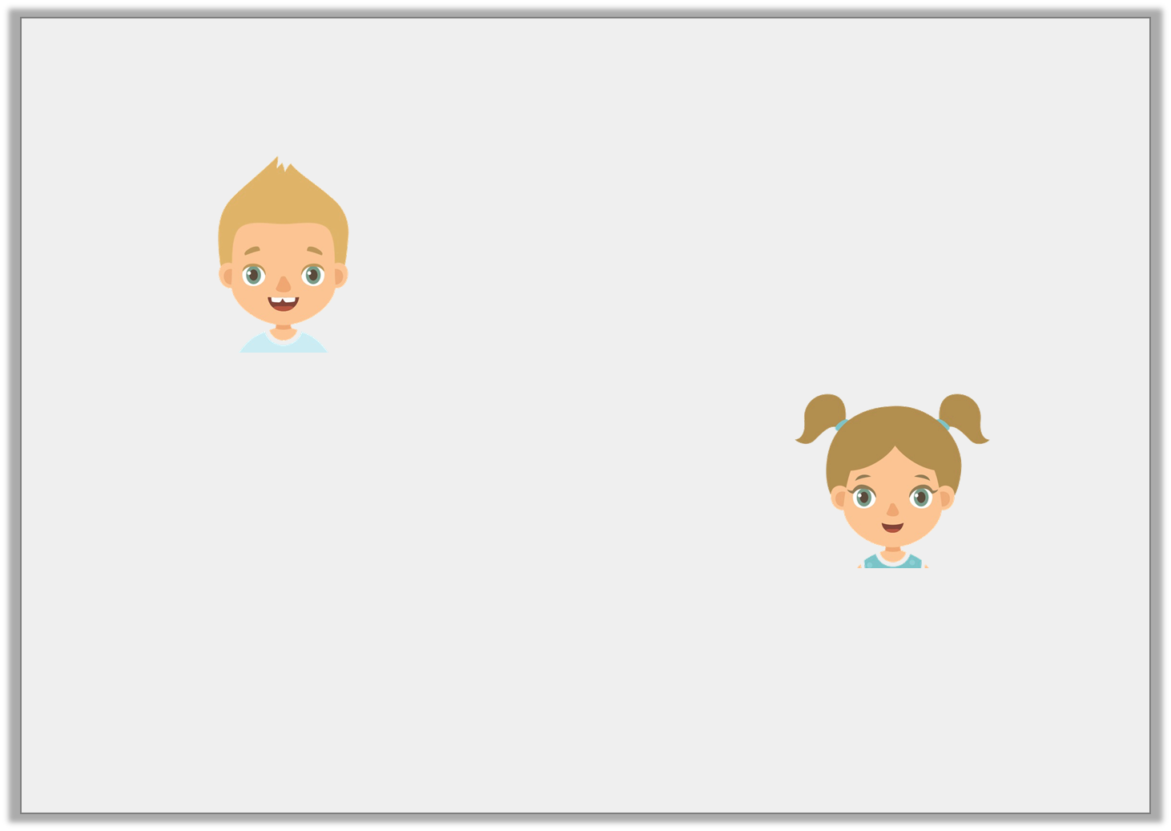
Varied Fluency 4
Jackson and Daria are describing different 4-digit numbers.
Who is describing 4,549?
This number has 45 hundreds, 4 tens and 9 ones.
Jackson
This number has 4 thousands, 54 tens and 9 ones.
Daria
© Classroom Secrets Limited 2018

Slide 13
Varied Fluency 4
Jackson and Daria are describing different 4-digit numbers.
Who is describing 4,549?
They are both describing 4,549, partitioned in different ways.
This number has 45 hundreds, 4 tens and 9 ones.
Jackson
This number has 4 thousands, 54 tens and 9 ones.
Daria
© Classroom Secrets Limited 2018

Slide 14
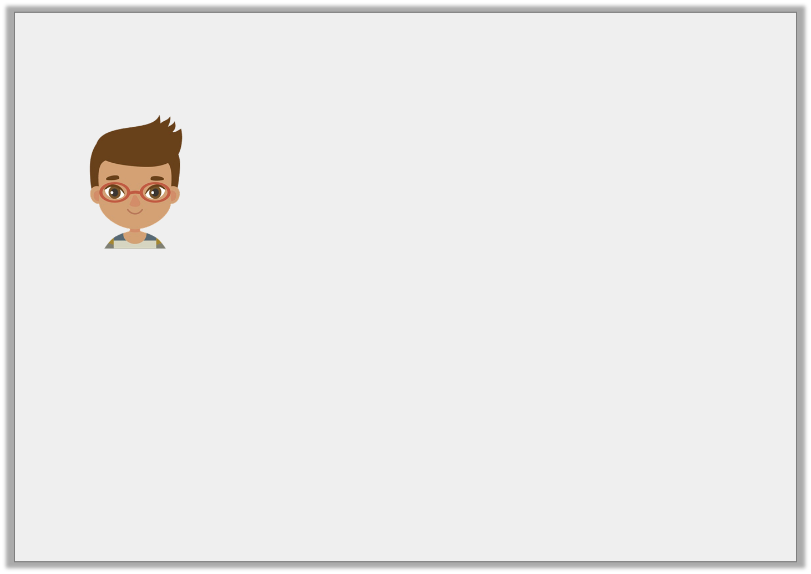
Problem Solving 1
Archie says,
8,000 + 300 + 90 + 2
4,000 + 3,900 + 490 + 2
Prove Archie wrong by finding two more different ways to partition the number.
There are only two ways to partition 8,392.
© Classroom Secrets Limited 2018

Slide 15
Problem Solving 1
Archie says,
8,000 + 300 + 90 + 2
4,000 + 3,900 + 490 + 2
Prove Archie wrong by finding two more different ways to partition the number.
Various answers, for example: 5 thousands + 31 hundreds + 27 tens + 22 ones or 3 thousands + 53 hundreds + 3 tens + 62 ones.
There are only two ways to partition 8,392.
© Classroom Secrets Limited 2018

Slide 16
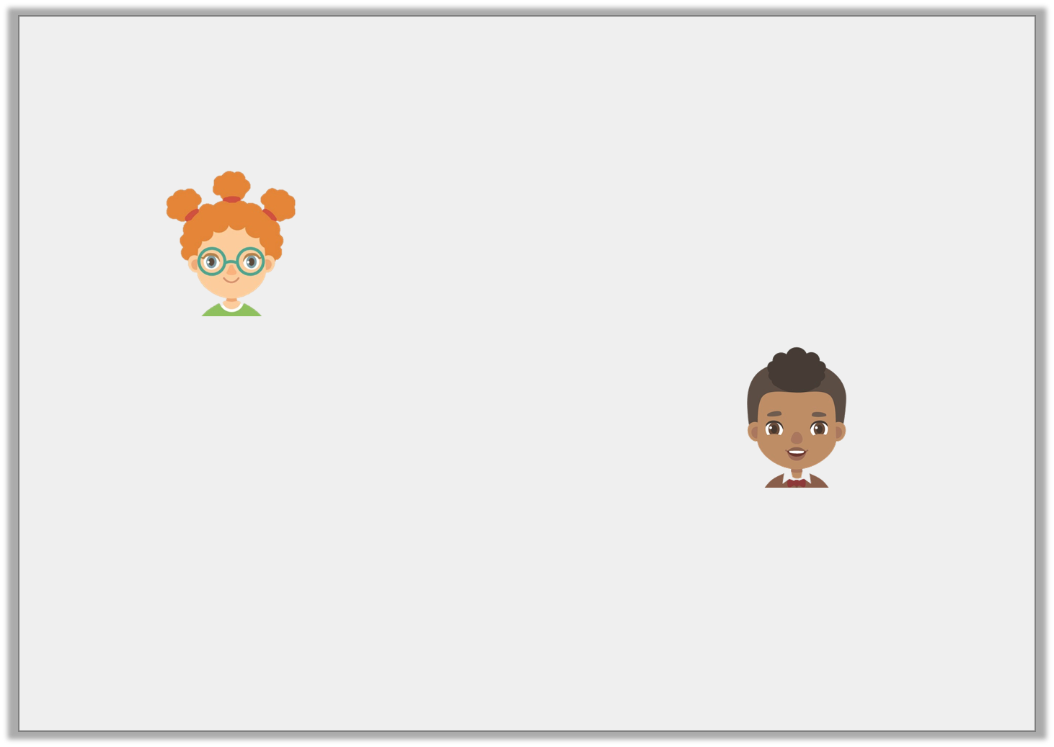
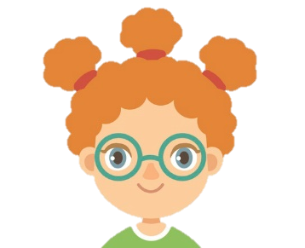
Reasoning 1
These children are making the number 3,321.
Who has partitioned the number correctly? Explain why.
I used 3 thousands and 322 ones.
Georgina
I used 2 thousands, 12 hundreds, 11 tens and 11 ones.
Ramesh
© Classroom Secrets Limited 2018

Slide 17
Reasoning 1
These children are making the number 3,321.
Who has partitioned the number correctly? Explain why.
Ramesh has partitioned the number correctly because…
I used 3 thousands and 322 ones.
Georgina
I used 2 thousands, 12 hundreds, 11 tens and 11 ones.
Ramesh
© Classroom Secrets Limited 2018

Slide 18
Reasoning 1
These children are making the number 3,321.
Who has partitioned the number correctly? Explain why.
Ramesh has partitioned the number correctly because 2 thousands + 12 hundreds + 11 tens + 11 ones makes 3,321.
I used 3 thousands and 322 ones.
Georgina
I used 2 thousands, 12 hundreds, 11 tens and 11 ones.
Ramesh
© Classroom Secrets Limited 2018

Slide 19
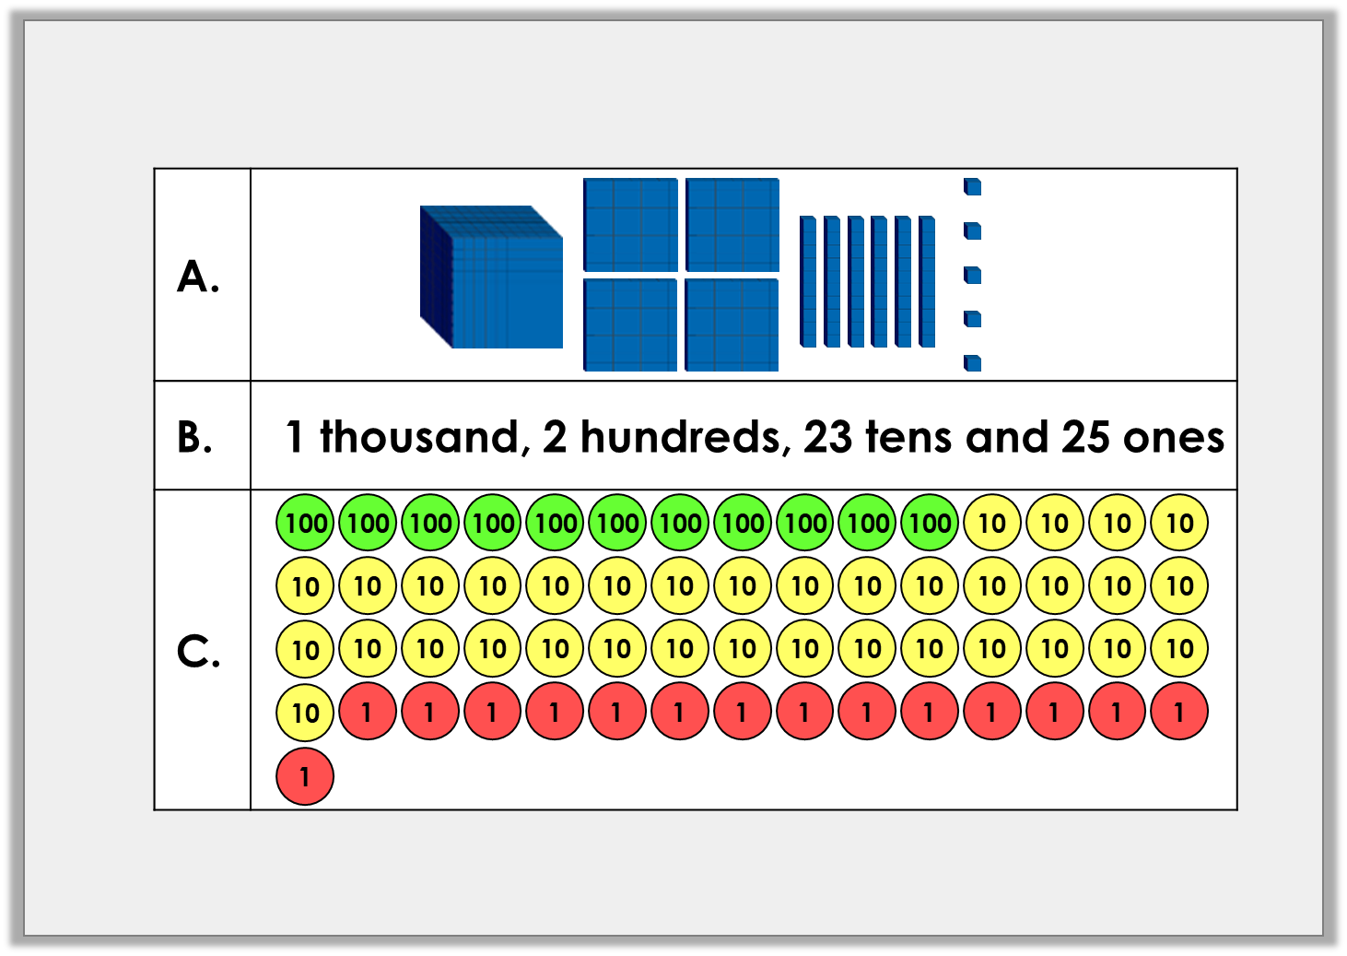
Reasoning 2
Which representation does not show 1,465? Explain why.
© Classroom Secrets Limited 2018

Slide 20
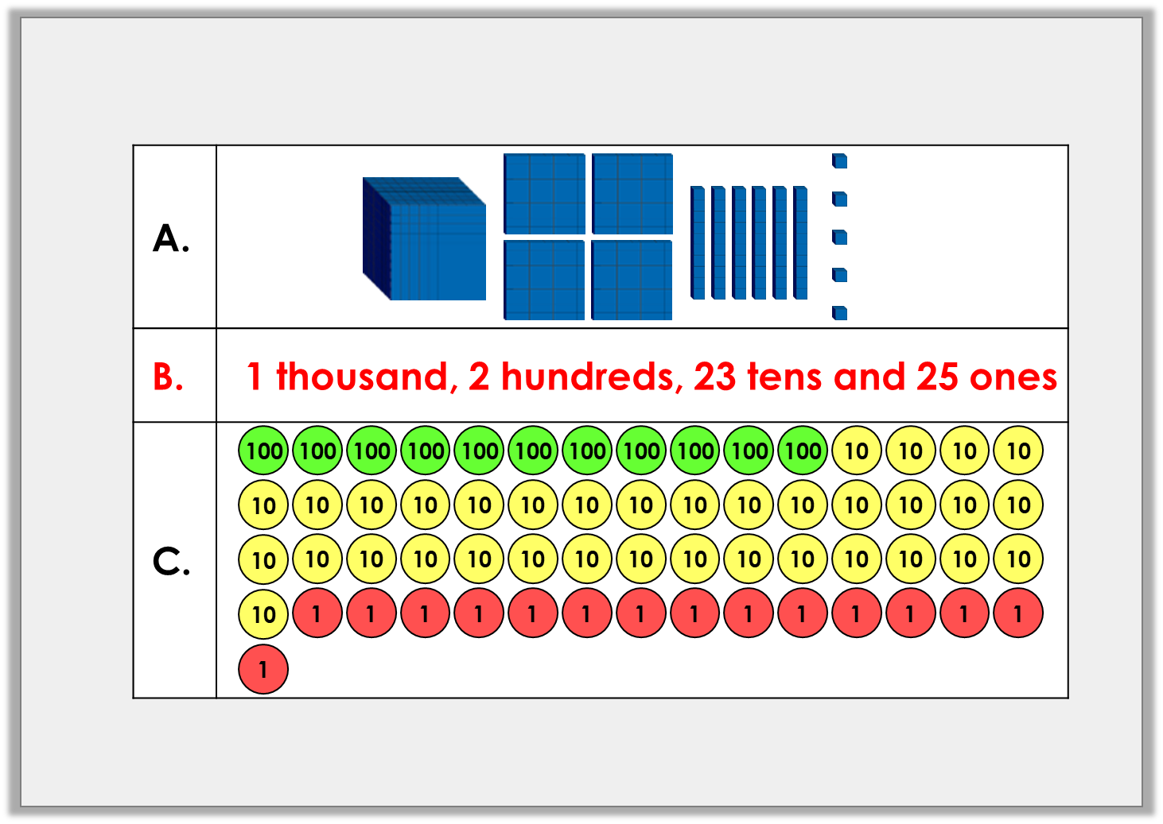
Reasoning 2
Which representation does not show 1,465? Explain why.
B is incorrect because...
© Classroom Secrets Limited 2018

Slide 21
Reasoning 2
Which representation does not show 1,465? Explain why.
B is incorrect because 1 thousand + 2 hundreds + 23 tens + 25 ones = 1,455.
© Classroom Secrets Limited 2018

