Slide 1



LIFE/work balance
We have started a #LIFEworkbalance campaign and we need your help to complete our LIFE/work balance survey.
We hope to publish the results soon, so please give 15 minutes of your time to help us get a true picture of school life.
Want to be a part of this campaign? Take the survey on our website and share it with your colleagues!
© Classroom Secrets Limited 2018

Slide 2
Year 4 – Autumn Block 1 – Place Value – 1,000s,100s, 10s, 1s
About This Resource:
This PowerPoint has been designed to support your teaching of this small step. It includes a starter activity and an example of each question from the Varied Fluency and Reasoning and Problem Solving resources also provided in this pack. You can choose to work through all examples provided or a selection of them depending on the needs of your class.
National Curriculum Objectives:
Mathematics Year 4: (4N3a) Recognise the place value of each digit in a four-digit number (thousands, hundreds, tens, and ones)
Mathematics Year 4: (4N4a) Identify, represent and estimate numbers using different representations
Mathematics 4: (4N6) Solve number and practical problems that involve 4N1 - 4N5 and with increasingly large positive numbers
More Year 4 Place Value resources.
Did you like this resource? Don’t forget to review it on our website.
© Classroom Secrets Limited 2018

Slide 3
Year 4 – Autumn Block 1 – Place Value
Step 5: 1,000s, 100s, 10s,1s
© Classroom Secrets Limited 2018

Slide 4
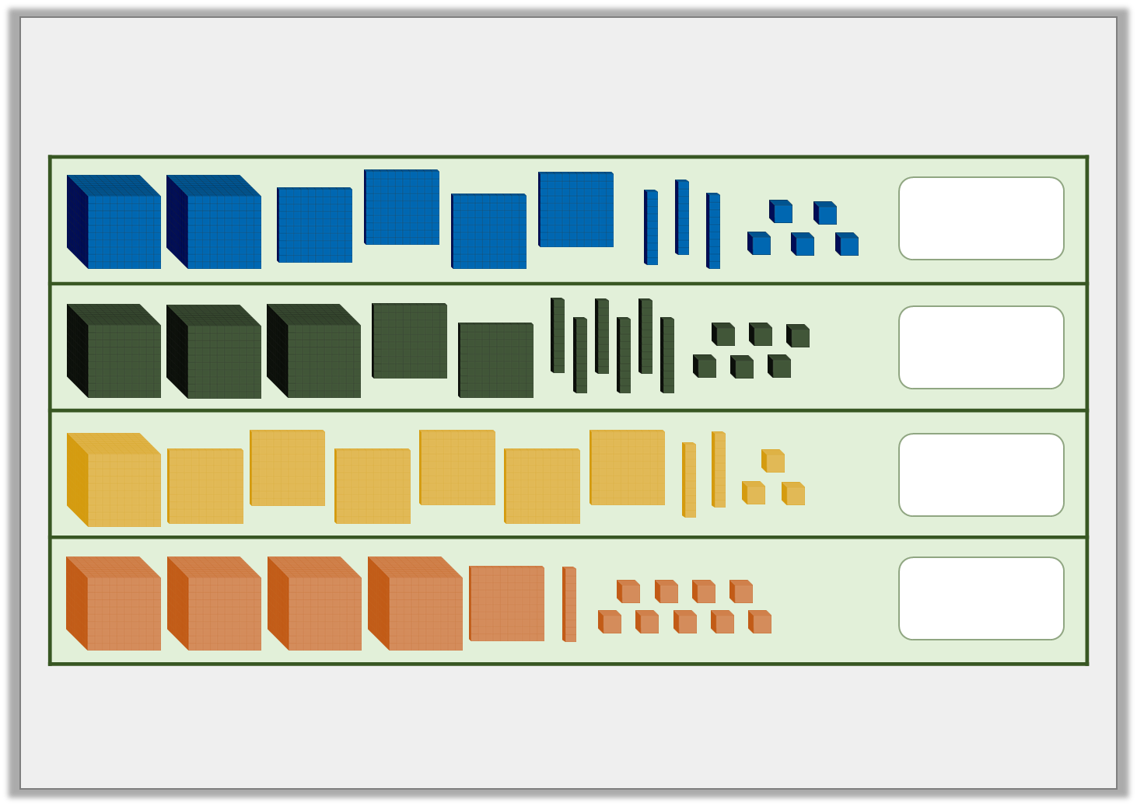
Introduction
Match the number to the correct image.
3,266
4,119
2,435
1,623
© Classroom Secrets Limited 2018

Slide 5
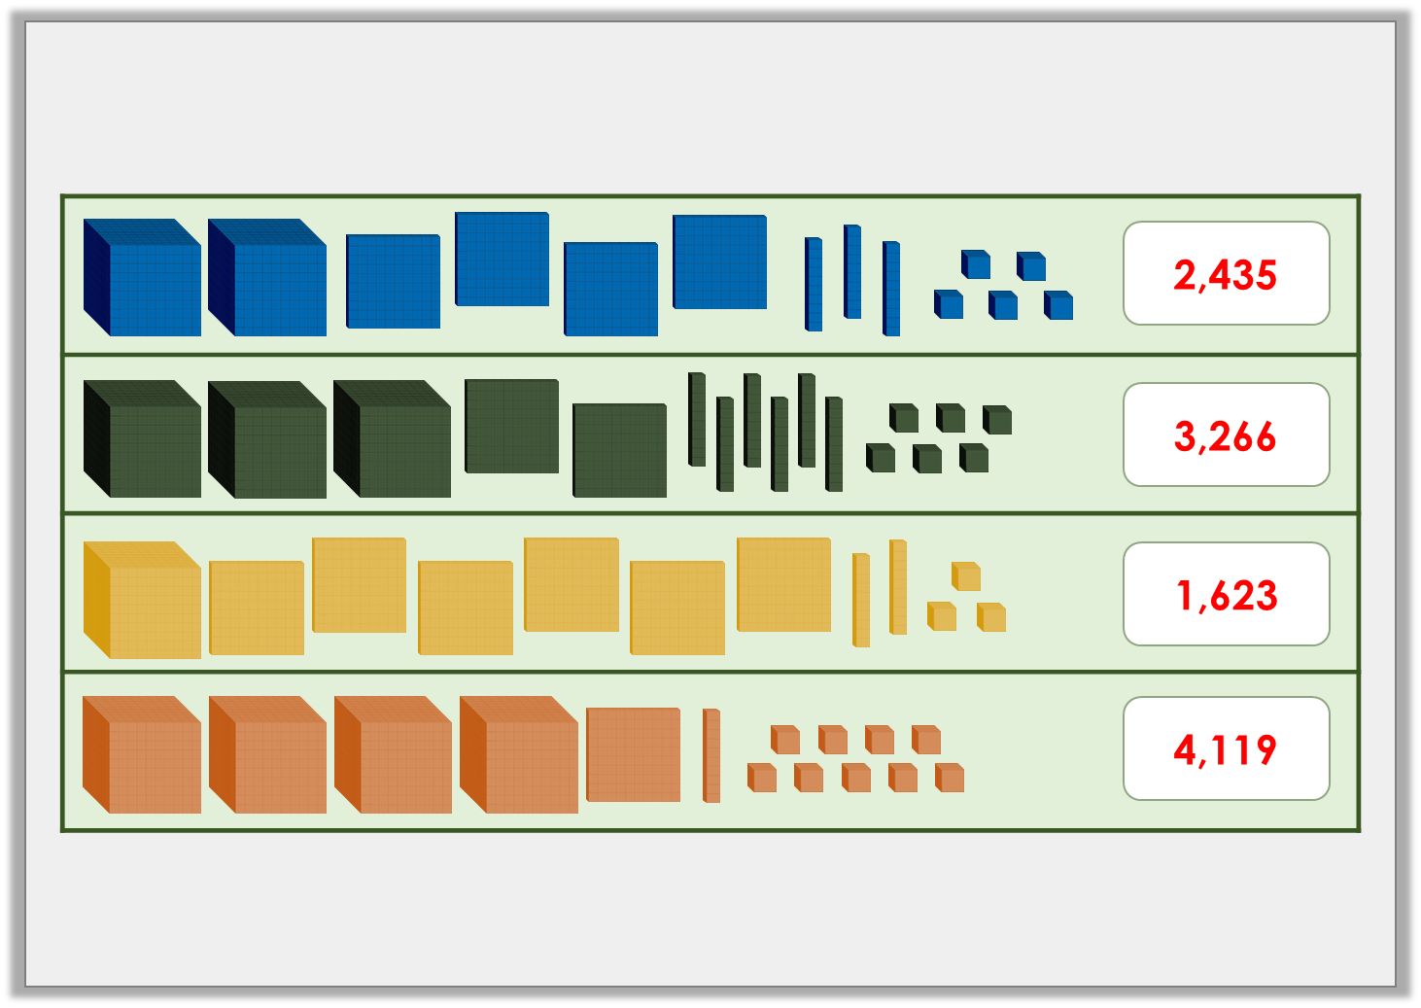
Introduction
Match the number to the correct image.
3,266
4,119
2,435
1,623
© Classroom Secrets Limited 2018

Slide 6
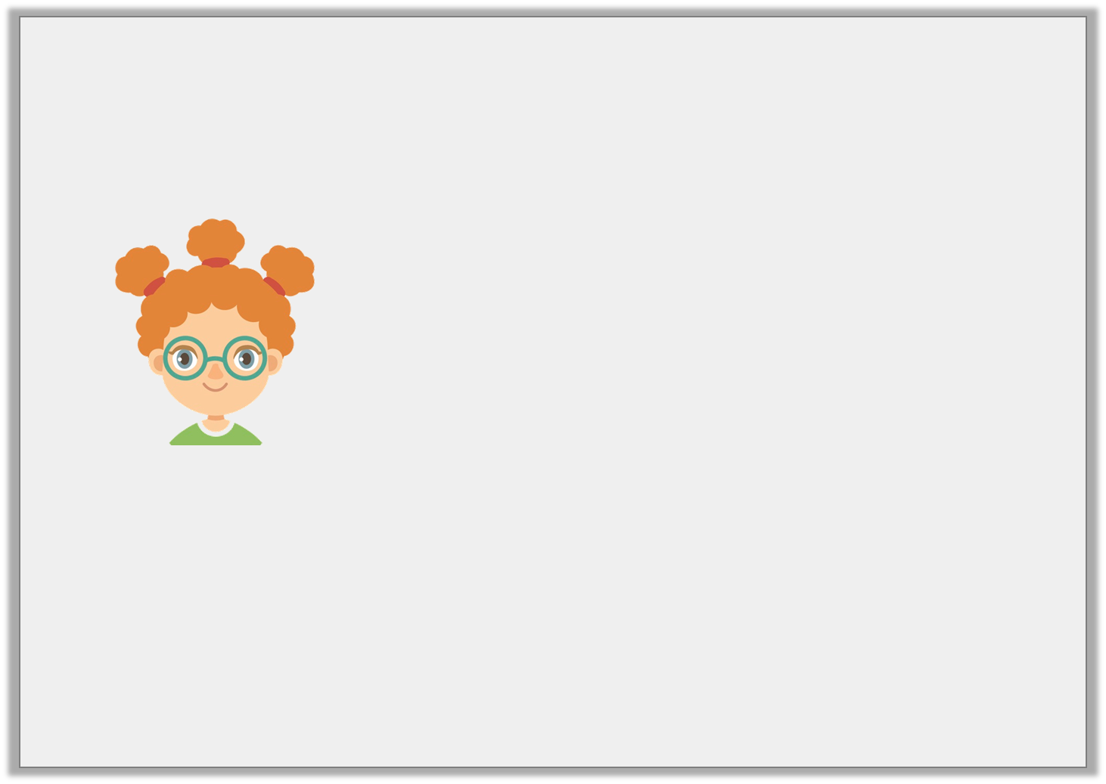
Varied Fluency 1
Which number is Pippa describing?
There are 8 thousands and half this digit in the hundreds. There are no tens and only 2 ones.
© Classroom Secrets Limited 2018

Slide 7
Varied Fluency 1
Which number is Pippa describing?
8,402
There are 8 thousands and half this digit in the hundreds. There are no tens and only 2 ones.
© Classroom Secrets Limited 2018

Slide 8
Varied Fluency 2
Complete the bar model.
7,934
7,000 | ? | 30 | 4
© Classroom Secrets Limited 2018

Slide 9
Varied Fluency 2
Complete the bar model.
7,934
7,000 | 900 | 30 | 4
© Classroom Secrets Limited 2018

Slide 10

Varied Fluency 3
What number is represented by the Base 10?
Write your answer on the place value chart.
1,000s | 100s | 10s | 1s
© Classroom Secrets Limited 2018

Slide 11
Varied Fluency 3
What number is represented by the Base 10?
Write your answer on the place value chart.
1,000s | 100s | 10s | 1s
2 | 1 | 6 | 0
© Classroom Secrets Limited 2018

Slide 12
Varied Fluency 4
Circle the mistakes on the part whole model below.
7,205
7,000
50
20
0
© Classroom Secrets Limited 2018

Slide 13
Varied Fluency 4
Circle the mistakes on the part whole model below.
7,205
7,000
50
20
0
© Classroom Secrets Limited 2018

Slide 14
Problem Solving 1
Find the largest and smallest 4-digit number you can make using these digits. The 3 must be in the tens column.
2
3
0
4
© Classroom Secrets Limited 2018

Slide 15
Problem Solving 1
Find the largest and smallest 4-digit number you can make using these digits. The 3 must be in the tens column.
2
3
0
4
smallest
largest
2
0
3
4
4
2
3
0
© Classroom Secrets Limited 2018

Slide 16
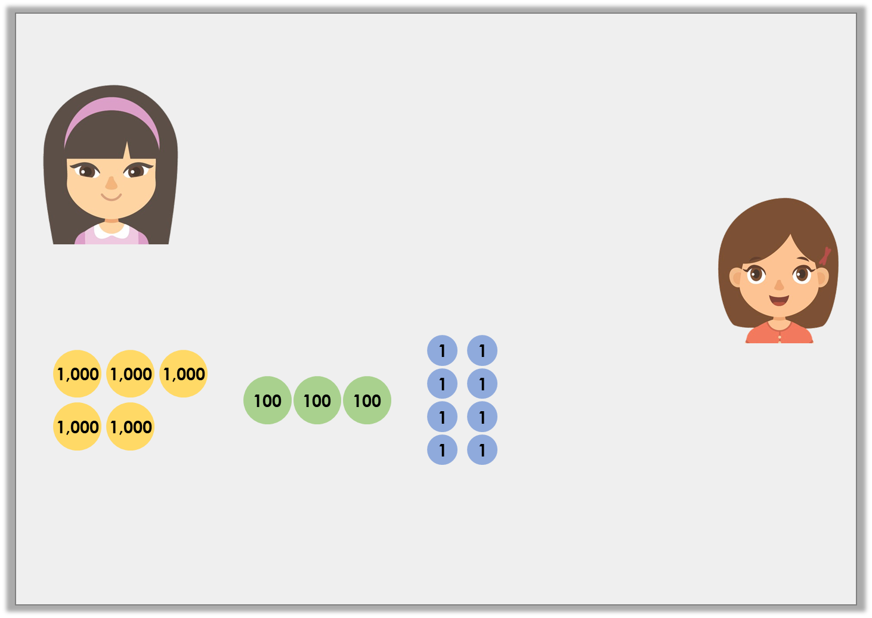
Problem Solving 2
Erika and Kim are discussing place value.
Who is correct? Explain your answer.
The number shown is 5,038.
No, the number shown is 5,308.
Erika
Kim
© Classroom Secrets Limited 2018

Slide 17
Problem Solving 2
Erika and Kim are discussing place value.
Who is correct? Explain your answer.
Kim is correct because…
The number shown is 5,038.
No, the number shown is 5,308.
Erika
Kim
© Classroom Secrets Limited 2018

Slide 18
Problem Solving 2
Erika and Kim are discussing place value.
Who is correct? Explain your answer.
Kim is correct because the counters show 5 thousands, 3 hundreds and 8 ones which makes 5,308.
The number shown is 5,038.
No, the number shown is 5,308.
Erika
Kim
© Classroom Secrets Limited 2018

Slide 19
Reasoning 1
Which number matches the counters?
Explain your answer.
a
b
c
8,830
8,083
8,803
1,000
1,000
1,000
1,000
10
10
10
10
1,000
1,000
1,000
1,000
10
10
10
10
1
1
1
© Classroom Secrets Limited 2018

Slide 20
Reasoning 1
Which number matches the counters?
Explain your answer.
B matches the counters because…
a
b
c
8,830
8,083
8,803
1,000
1,000
1,000
1,000
10
10
10
10
1,000
1,000
1,000
1,000
10
10
10
10
1
1
1
© Classroom Secrets Limited 2018

Slide 21
Reasoning 1
Which number matches the counters?
Explain your answer.
B matches the counters because there are 8 thousands, 8 tens and 3 ones which makes 8,083.
a
b
c
8,830
8,083
8,803
1,000
1,000
1,000
1,000
10
10
10
10
1,000
1,000
1,000
1,000
10
10
10
10
1
1
1
© Classroom Secrets Limited 2018

