Slide 1



LIFE/work balance
We have started a #LIFEworkbalance campaign and we need your help to complete our LIFE/work balance survey.
We hope to publish the results soon, so please give 15 minutes of your time to help us get a true picture of school life.
Want to be a part of this campaign? Take the survey on our website and share it with your colleagues!
© Classroom Secrets Limited 2019

Slide 2
Year 4 – Autumn Block 1 – Place Value – Round to the Nearest 100
About This Resource:
This PowerPoint has been designed to support your teaching of this small step. It includes a starter activity and an example of each question from the Varied Fluency and Reasoning and Problem Solving resources also provided in this pack. You can choose to work through all examples provided or a selection of them depending on the needs of your class.
National Curriculum Objectives:
Mathematics Year 4: (4N4b) Round any number to the nearest 10, 100 or 1,000
More Year 4 Place Value resources.
Did you like this resource? Don’t forget to review it on our website.
© Classroom Secrets Limited 2018

Slide 3
Year 4 – Autumn Block 1 – Place Value
Step 3: Round to the Nearest 100
© Classroom Secrets Limited 2018

Slide 4
Introduction
Which multiples of 100 do these numbers sit between?
356
194
610
990
© Classroom Secrets Limited 2018

Slide 5
Introduction
Which multiples of 100 do these numbers sit between?
300
356
400
100
194
200
600
610
700
900
990
1,000
© Classroom Secrets Limited 2018

Slide 6
Varied Fluency 1
Match the numbers below with their closest
multiple of 100.
Nine hundred and eleven
700
871
658
800
Eight hundred and thirteen
900
982
1,000
Seven hundred and seventy
© Classroom Secrets Limited 2018

Slide 7
Varied Fluency 1
Match the numbers below with their closest
multiple of 100.
Nine hundred and eleven
700
871
658
800
Eight hundred and thirteen
900
982
1,000
Seven hundred and seventy
© Classroom Secrets Limited 2018

Slide 8
Varied Fluency 2
Eight hundred and forty is closer to 800 than 900.
True or false?
800 | 810 | 820 | 830 | 840 | 850 | 860 | 870 | 880 | 890 | 900
© Classroom Secrets Limited 2018

Slide 9
Varied Fluency 2
Eight hundred and forty is closer to 800 than 900.
True or false?
True.
840 rounds down to 800 as there are only 4 tens.
800 | 810 | 820 | 830 | 840 | 850 | 860 | 870 | 880 | 890 | 900
© Classroom Secrets Limited 2018

Slide 10
Varied Fluency 3
Round the number represented below to the
nearest 10 and 100.
A
300
80
4
© Classroom Secrets Limited 2018

Slide 11
Varied Fluency 3
Round the number represented below to the
nearest 10 and 100.
To the nearest 10 is 380
To the nearest 100 is 400
A
300
80
4
© Classroom Secrets Limited 2018

Slide 12
Varied Fluency 4
Complete the function machine by rounding each number to the nearest 100.
seven hundred and eighty-two
Round to the nearest 100
© Classroom Secrets Limited 2018

Slide 13
Varied Fluency 4
Complete the function machine by rounding each number to the nearest 100.
seven hundred and eighty-two
Round to the nearest 100
800
© Classroom Secrets Limited 2018

Slide 14
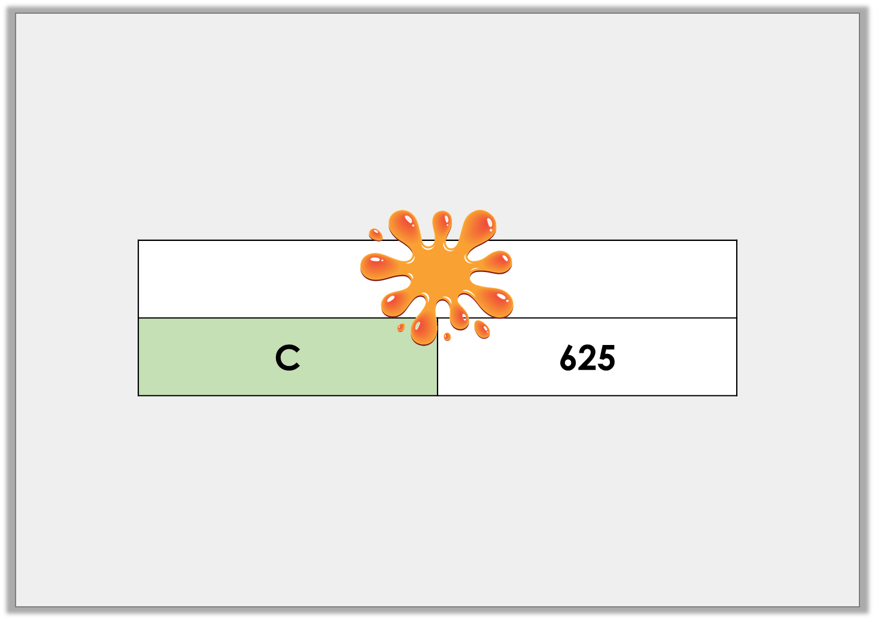
Problem Solving 1
Mateus has represented a number using a bar model.
When rounded to the nearest 100, the number
rounds to 600.
C is a multiple of 5. What could C be?
© Classroom Secrets Limited 2018

Slide 15
Problem Solving 1
Mateus has represented a number using a bar model.
When rounded to the nearest 100, the number
rounds to 600.
C is a multiple of 5. What could C be?
5, 10, 15, 20
© Classroom Secrets Limited 2018

Slide 16
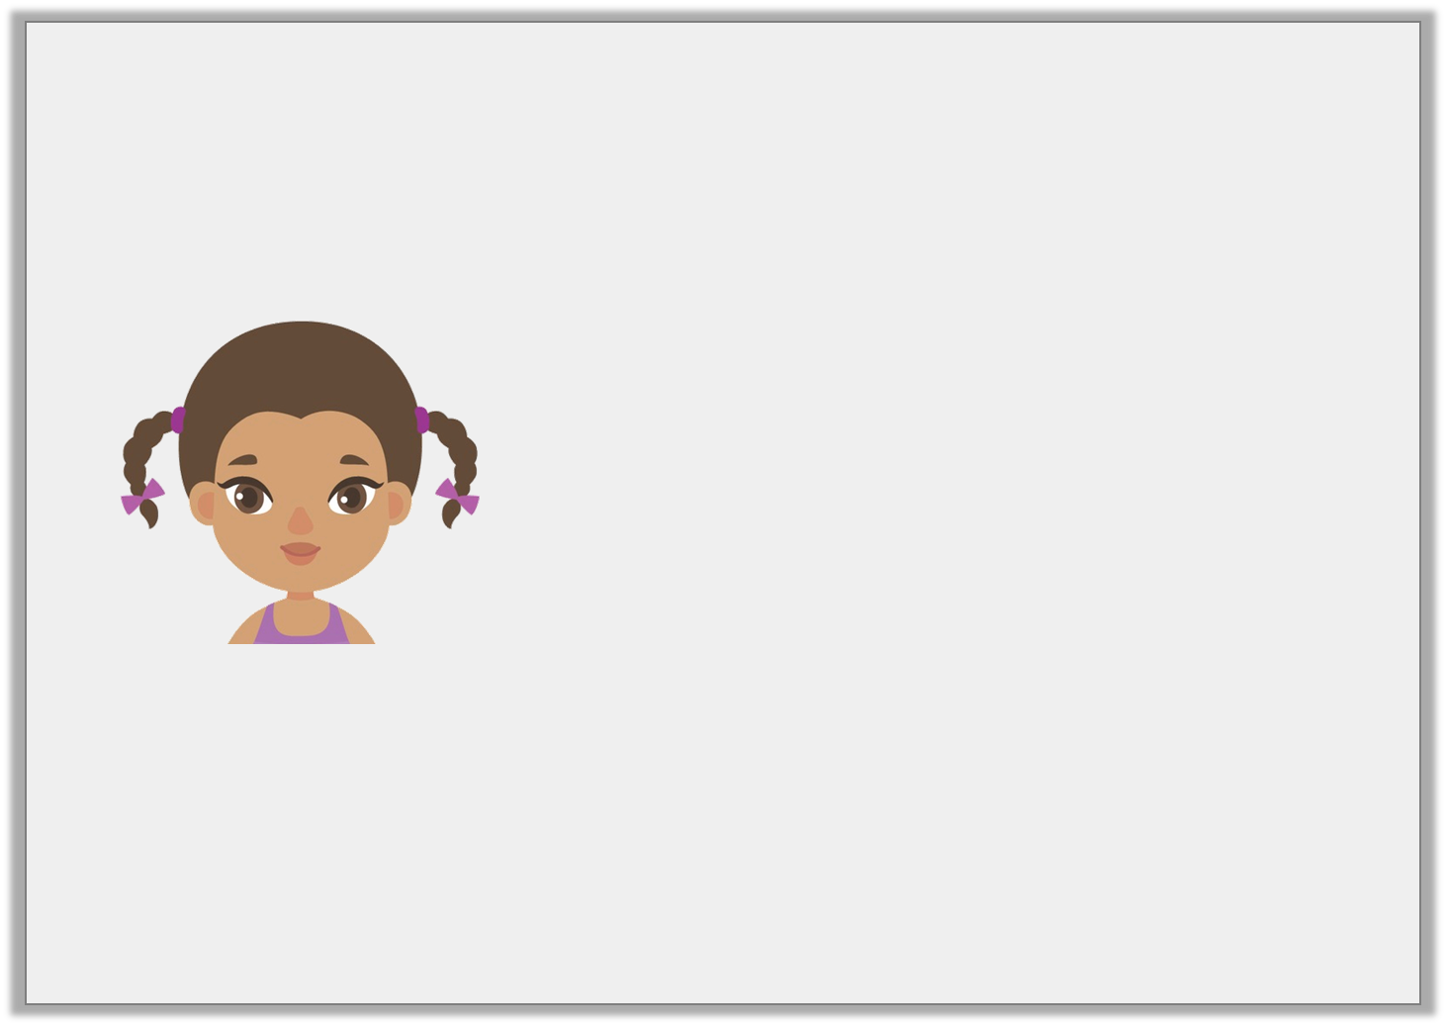
Reasoning 2
Christina says,
Do you agree with her? Explain why.
If I round 499 to the nearest 10, the answer must be 490 because 500 is not a ten. If I round 499 to the nearest 100, the answer is 500.
© Classroom Secrets Limited 2018

Slide 17
Reasoning 2
Christina says,
Do you agree with her? Explain why.
Christina is incorrect because…
If I round 499 to the nearest 10, the answer must be 490 because 500 is not a ten. If I round 499 to the nearest 100, the answer is 500.
© Classroom Secrets Limited 2018

Slide 18
Reasoning 2
Christina says,
Do you agree with her? Explain why.
Christina is incorrect because 499 to the nearest 10 rounds up to 500 as the ones column is greater than 5. (500 is still a multiple of 10).
Christina is correct that 499 to the nearest 100 is 500.
If I round 499 to the nearest 10, the answer must be 490 because 500 is not a ten. If I round 499 to the nearest 100, the answer is 500.
© Classroom Secrets Limited 2018

Slide 19
Problem Solving 3
This part whole model has the whole rounded to the nearest hundred. What could the two missing numbers be?
?
three hundred
?
seven
© Classroom Secrets Limited 2018

Slide 20
Problem Solving 3
This part whole model has the whole rounded to the nearest hundred. What could the two missing numbers be?
Various answers, for example: If the tens are between 0 and 4, the whole number will be 300. If the tens are between 5 and 9, the whole number will be 400.
?
three hundred
?
seven
© Classroom Secrets Limited 2018

