Slide 1



LIFE/work balance
We have started a #LIFEworkbalance campaign and we need your help to complete our LIFE/work balance survey.
We hope to publish the results soon, so please give 15 minutes of your time to help us get a true picture of school life.
Want to be a part of this campaign? Take the survey on our website and share it with your colleagues!
© Classroom Secrets Limited 2019

Slide 2
Year 4 – Autumn Block 1 – Place Value – Round to the Nearest 10
About This Resource:
This PowerPoint has been designed to support your teaching of this small step. It includes a starter activity and an example of each question from the Varied Fluency and Reasoning and Problem Solving resources also provided in this pack. You can choose to work through all examples provided or a selection of them depending on the needs of your class.
National Curriculum Objectives:
Mathematics Year 4: (4N4b) Round any number to the nearest 10, 100 or 1,000
More Year 4 Place Value resources.
Did you like this resource? Don’t forget to review it on our website.
© Classroom Secrets Limited 2018

Slide 3
Year 4 – Autumn Block 1 – Place Value
Step 2: Round to the Nearest 10
© Classroom Secrets Limited 2018

Slide 4
Introduction
Which multiples of 10 are these numbers between?
 |  |  |  | 24
 |  |  |  |  |  |  | 47
 |  | 92
 |  |  |  |  | 65
© Classroom Secrets Limited 2018

Slide 5
Introduction
Which multiples of 10 are these numbers between?
20 |  |  |  | 24 |  |  |  |  |  | 30
40 |  |  |  |  |  |  | 47 |  |  | 50
90 |  | 92 |  |  |  |  |  |  |  | 100
60 |  |  |  |  | 65 |  |  |  |  | 70
© Classroom Secrets Limited 2018

Slide 6
Varied Fluency 1
Circle the numbers that round to 80.
ninety-four |  |  | 83 |  | 68
 | seventy-five |  | 179 |  | 78
85 |  | 65 |  | eight-two
seventy-nine |  |  | 81 |  | 181
© Classroom Secrets Limited 2018

Slide 7
Varied Fluency 1
Circle the numbers that round to 80.
ninety-four |  |  | 83 |  | 68
 | seventy-five |  | 179 |  | 78
85 |  | 65 |  | eighty-two
seventy-nine |  |  | 81 |  | 181
© Classroom Secrets Limited 2018

Slide 8
Varied Fluency 2
True or false?
Four hundred and seventy-eight to the nearest ten is four hundred and seventy.
© Classroom Secrets Limited 2018

Slide 9
Varied Fluency 2
True or false?
Four hundred and seventy-eight to the nearest ten is four hundred and seventy.
False. It is nearest to Four hundred and eighty.
© Classroom Secrets Limited 2018

Slide 10
Varied Fluency 3
Complete the table below.
Number | Nearest 10
841
sixty-three
654
five hundred and fifty-five
© Classroom Secrets Limited 2018

Slide 11
Varied Fluency 3
Complete the table below.
Number | Nearest 10
841 | 840
sixty-three | sixty
654 | 650
five hundred and fifty-five | five hundred and sixty
© Classroom Secrets Limited 2018

Slide 12
Varied Fluency 4
Sort these numbers into the table below.
217 |  | 231 |  | 225
 | 223 |  | 219 |  | 233
Rounds to 220 | Rounds to 230
© Classroom Secrets Limited 2018

Slide 13
Varied Fluency 4
Sort these numbers into the table below.
217 |  | 231 |  | 225
 | 223 |  | 219 |  | 233
Rounds to 220 | Rounds to 230
217 | 231
223 | 225
219 | 233
© Classroom Secrets Limited 2018

Slide 14
Reasoning 1
Which numbers are incorrectly placed in the table below? Explain why.
Nearest ten is 360 | Nearest ten is 370
355 | 373
364 | three hundred and sixty-nine
three hundred and sixty-six | 371
361 | 379
three hundred and fifty-four | three hundred and seventy-two
© Classroom Secrets Limited 2018

Slide 15
Reasoning 1
Which numbers are incorrectly placed in the table below? Explain why.
Three hundred and sixty-six; three hundred and fifty-four and 379 are incorrect because…
Nearest ten is 360 | Nearest ten is 370
355 | 373
364 | three hundred and sixty-nine
three hundred and sixty-six | 371
361 | 379
three hundred and fifty-four | three hundred and seventy-two
© Classroom Secrets Limited 2018

Slide 16
Reasoning 1
Which numbers are incorrectly placed in the table below? Explain why.
Three hundred and sixty-six; three hundred and fifty-four and 379 are incorrect because three hundred and sixty-six rounds to 370, three hundred and fifty-four rounds to 350 and 379 rounds to 380.
Nearest ten is 360 | Nearest ten is 370
355 | 373
364 | three hundred and sixty-nine
three hundred and sixty-six | 371
361 | 379
three hundred and fifty-four | three hundred and seventy-two
© Classroom Secrets Limited 2018

Slide 17
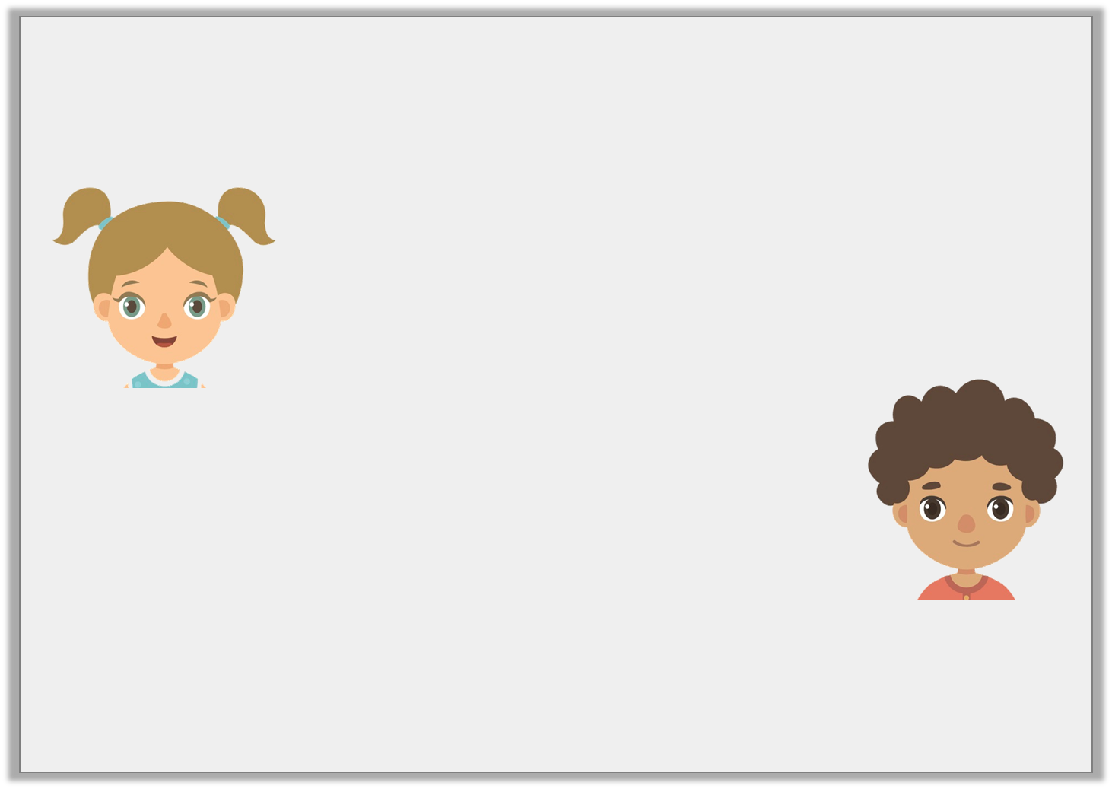
Reasoning 2
Who is correct?
Prove it.
Seven hundred and fifteen to the nearest ten is seven hundred and twenty.
Amanda
Seven hundred and fifteen to the nearest ten is seven hundred and ten.
Philip
© Classroom Secrets Limited 2018

Slide 18
Reasoning 2
Who is correct?
Prove it.
Amanda is correct because…
Seven hundred and fifteen to the nearest ten is seven hundred and twenty.
Amanda
Seven hundred and fifteen to the nearest ten is seven hundred and ten.
Philip
© Classroom Secrets Limited 2018

Slide 19
Reasoning 2
Who is correct?
Prove it.
Amanda is correct because 715 rounds to 720 – 5 rounds up.
Seven hundred and fifteen to the nearest ten is seven hundred and twenty.
Amanda
Seven hundred and fifteen to the nearest ten is seven hundred and ten.
Philip
© Classroom Secrets Limited 2018

Slide 20

Problem Solving 1
The number represented by the place value counters that are hidden behind the splat can be rounded to 150.
There are fewer than 10 counters. What could they be? Show all the possibilities by drawing the place value counters.
© Classroom Secrets Limited 2018

Slide 21
Problem Solving 1
The number represented by the place value counters that are hidden behind the splat can be rounded to 150.
There are fewer than 10 counters. What could they be? Show all the possibilities by drawing the place value counters.
The place value counters could represent 150; 151; 152 or 153.
© Classroom Secrets Limited 2018

