Slide 1

Welcome to Crocodile Class’
Meet the Teacher
Year 4

Slide 2
Overview of the evening
Timetable
Topics & Trips
What’s New in Year 4
Expectations
Homelearning
Behaviour
PATHS
E-safety
Handouts
Questions

Slide 3
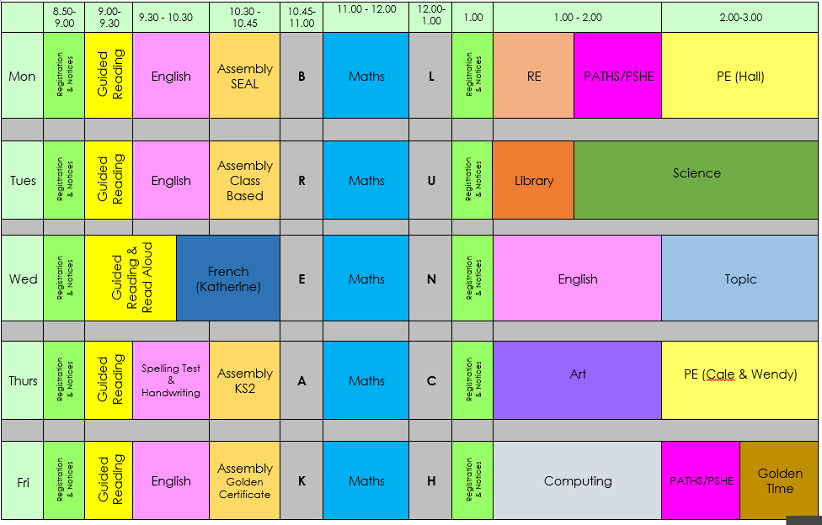
Timetable
Notes:
3
Children will be given some class time to work on Heads Awards, but will also need to work on them outside of school as well.

Slide 4
Some lessons will be taught by a different teacher.
PE- Cale and Wendy
French- Katherine
Art-Sharron

Slide 5
Topics & Trips
Term | Topic | Trip
Autumn 1 | The Roman Empire | Ufton Court (Tutor Manor house in Berkshire)
Autumn 2
Spring 1 | Anglo Saxons | Kingston Museum
Spring 2
Summer 1 | Living Things | TBC
Summer 2
Plus several local trips!

Slide 6

What’s New in Year 4
Brass Lessons will take place during the regular music sessions later in the year. Holly will send home a letter explaining all the details once she becomes available.

Slide 7



What’s New in Year 4
Head’s Award
Year 4 children have the opportunity to
start working towards their Bronze Award
Chance to celebrate with parents and peers
Encourages independence, social responsibility, high standards and emotional intelligence
Children to work on Heads Award at home, will be given some opportunities to work on it at school
Classroom celebration in Spring

Slide 8
What’s New in Year 4
Times Tables Test
Year 4 children complete a times table test in June
Children are expected to be able to recall and use facts up to 12 x 12
No “Pass Mark” or “Fail Mark”
It is expected that children are also practising at home

Slide 9
Swimming
Summer Term
Public Transport

Slide 10
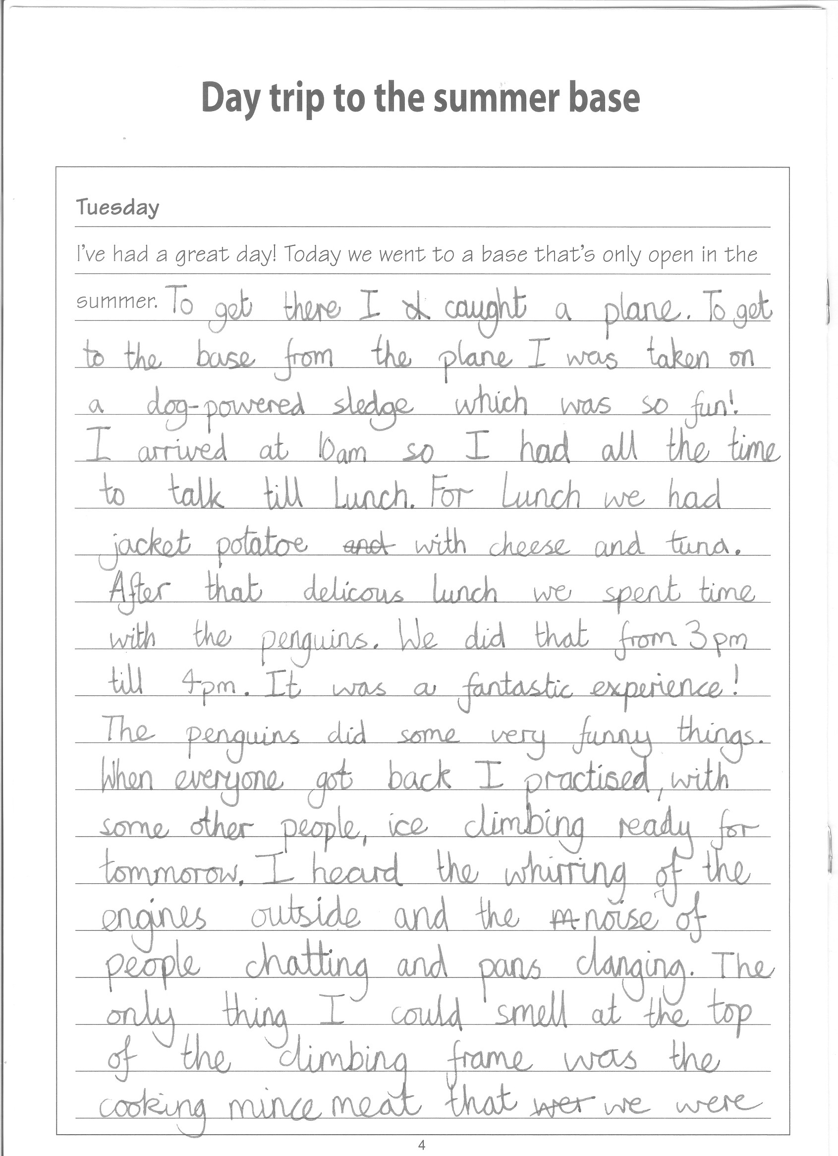
What does a Year 4 writer look like?
Meet the teacher
September 2019

Slide 11
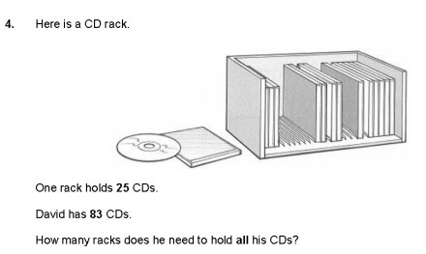
What does Maths look like in Year 4?
Weekly reasoning and problem solving activities to deepen skills

Slide 12
Home Learning
Spellings and times tables as well as a reading record will be sent home on Thursday. Reading Records will be collected on Tuesday. Times tables quizzes will be on Monday and Spelling quizzes will be on Thursdays.
Home Learning will include:
Spellings sent home weekly that support spelling pattern being learned at school. Children should practise spellings at home and be prepared for a Quick Quiz on Thursday morning.
Times Tables sent home weekly. Children should practise this table at home out of order and with matching division facts, to be prepared for Rainbow Maths.
Reading Record will be sent out weekly. Children should read every night for 15-20 mins and record the date, title and a comment in their reading record.
Mathletics task will be set once per week that supports learning at school.
Creative Home Learning open ended, creative tasks based on topic subjects.
Meet the teacher
September 2019

Slide 13
Behaviour
Policy available on the website, please have a look.
We monitor and log all behaviour incidents
You will be contacted if your child is sent to a linked class or is involved in a serious incident.
Feel free to make an appointment with me or with Leadership if you have any concerns about a child’s behaviour.

Slide 14
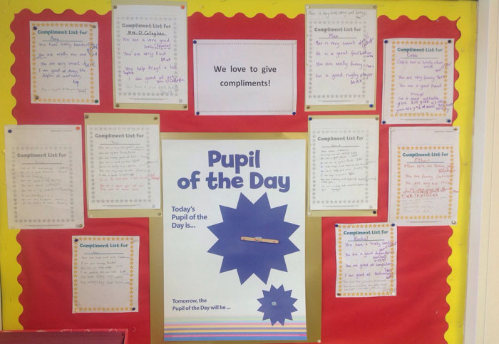
Focus on the Positive

Slide 15

Also check the school websites for updates and links from the borough

Slide 16

Cakes on Birthdays
Due to allergies and time constraints, we ask that if you wish to give out birthday cakes or party bags on your child’s birthday you do
this after school on
the playground so
that parents/ carers
can give consent.

Slide 17
Parent Helpers
We are always looking for volunteers for parent readers!
We are also looking for outdoor area helpers. There will be an upcoming planting day. A parent mail will be sent out with more information.

Slide 18
Handouts
We’re Going (Nearly) Paperless!
On the Website
Spelling Strategies
Key Performance Indicators
Book list
Presentation slides
Handouts
Classlist
Class Timetable

Slide 19
Any Questions?
Please refer to our school website for useful sites and strategies to help with home learning.
Meet the teacher
September 2019

