Slide 1
Phonics Workshop
Wednesday 27th November 2024

Slide 2
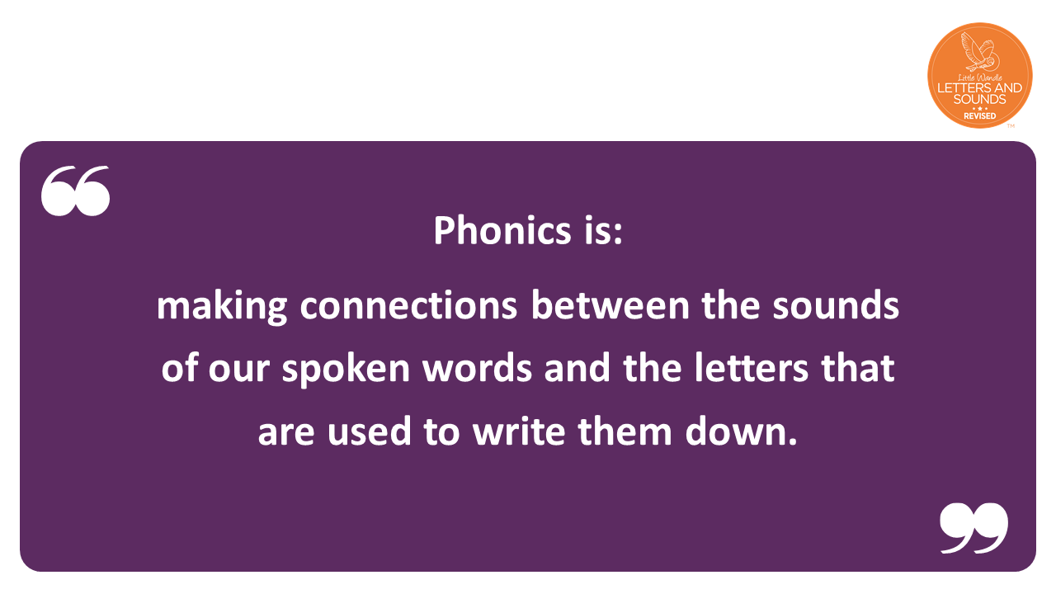
Notes:
Slide purpose:
To provide a simple definition of phonics
Suggested script:
So what is phonics?
Read the slide.
It sounds complicated but it really isn’t!
Let's learn some important words that will help you understand phonics ...

Slide 3


Slide 4

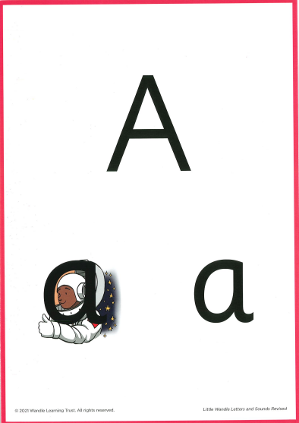

Terminology
Phoneme
Blend
The smallest unit of sound that can be identified in words. We also use the term ‘sound’ but your child may use the word ‘phoneme’. There are 44 phonemes or sounds in the English language.
Grapheme
Segment
A letter or group of letters used to represent a phoneme in writing. The way graphemes are used to represent phonemes in our written language is known as the alphabetic code.
Notes:
Explain what each word means – use our glossary to help: https://www.littlewandlelettersandsounds.org.uk/resources/my-letters-and-sounds/getting-started/

Slide 5




Digraph
Trigraph
Over to you

Slide 6
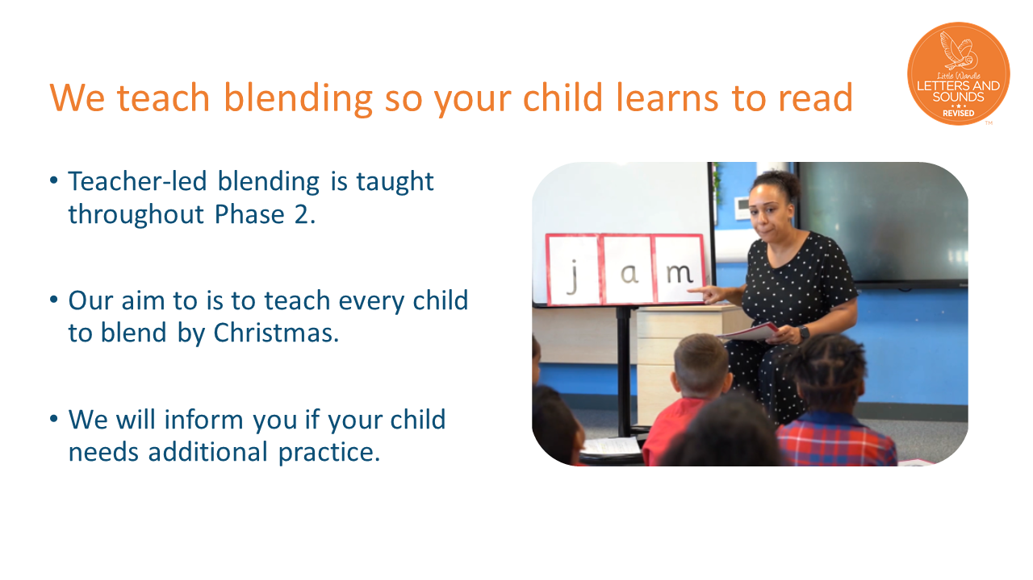
Notes:
Slide purpose:
To introduce blending
Suggested script:
Teacher-led blending is teaching children how to blend, directed and demonstrated by the teacher.
Some children learn to blend really quickly, and others take a little longer.
If your child is finding it difficult, ask your child’s teacher for ways to help at home – playing blending games at home is so helpful!
Show parents the ‘How we teach blending’ video from ‘For parents’ area of the website: https://www.littlewandlelettersandsounds.org.uk/resources/for-parents/

Slide 7
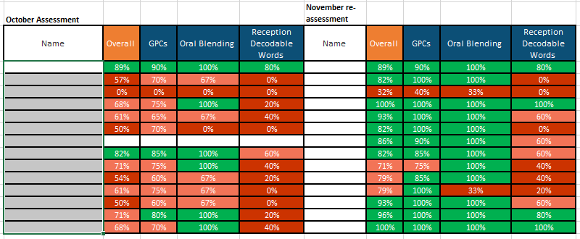

Slide 8


Teaching order
We usually teach four new sounds a week and have a review lesson on a Friday.
Your home learning sheets will inform you of the sounds we have learnt that week for you to practice at home.
Included in your pack will be the formation and pronunciation sheets.

Slide 9
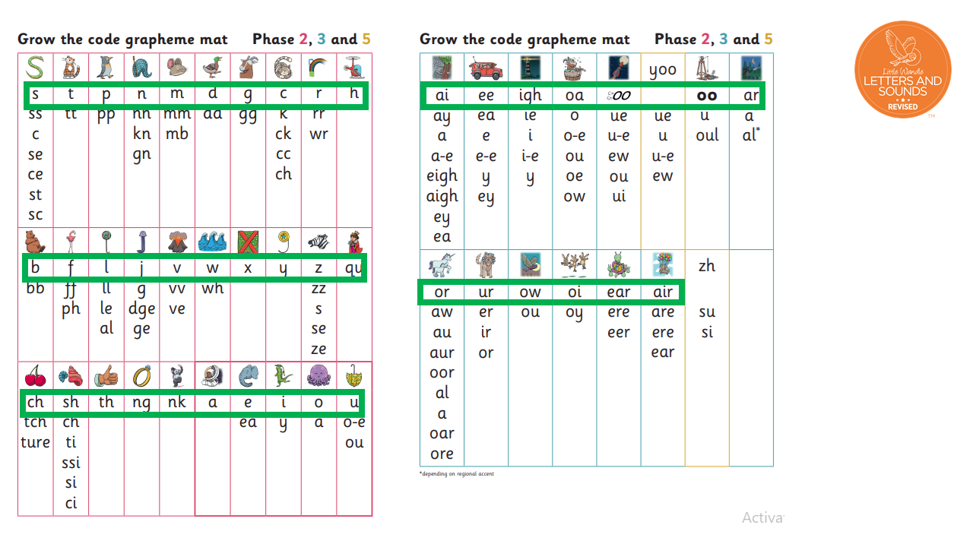

Slide 10
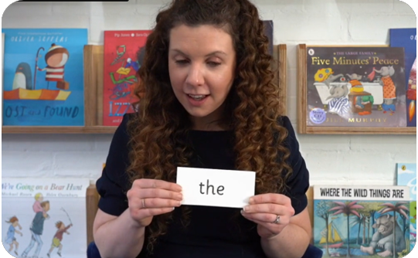
Tricky words
These words have unusual spellings e.g. he, the, was.
They are taught in a systematic way.
Notes:
Slide purpose:
To introduce tricky words
Notes:
Read the slide.
You may wish to give parents a copy of the document ‘Phase 2 tricky words: Reception Autumn term – Information for parents and carers'.

Slide 11
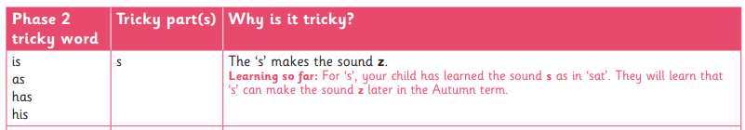
Tricky words
Included in your pack is a list of the tricky words and an explanation of why the word is tricky .

Slide 12
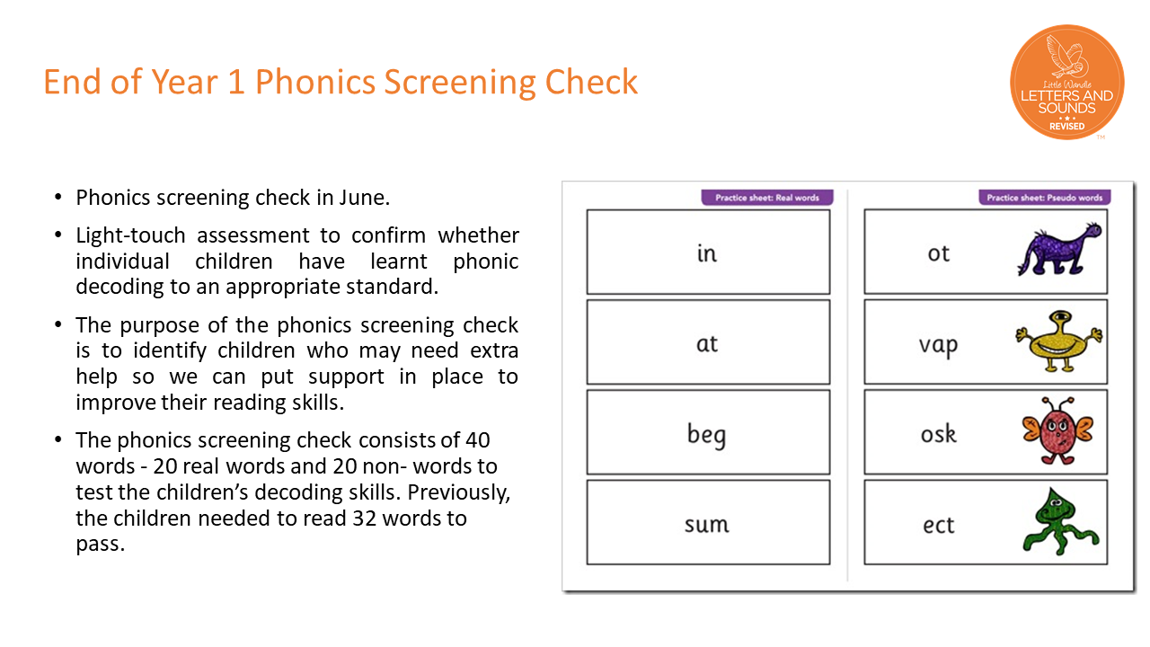

Slide 13
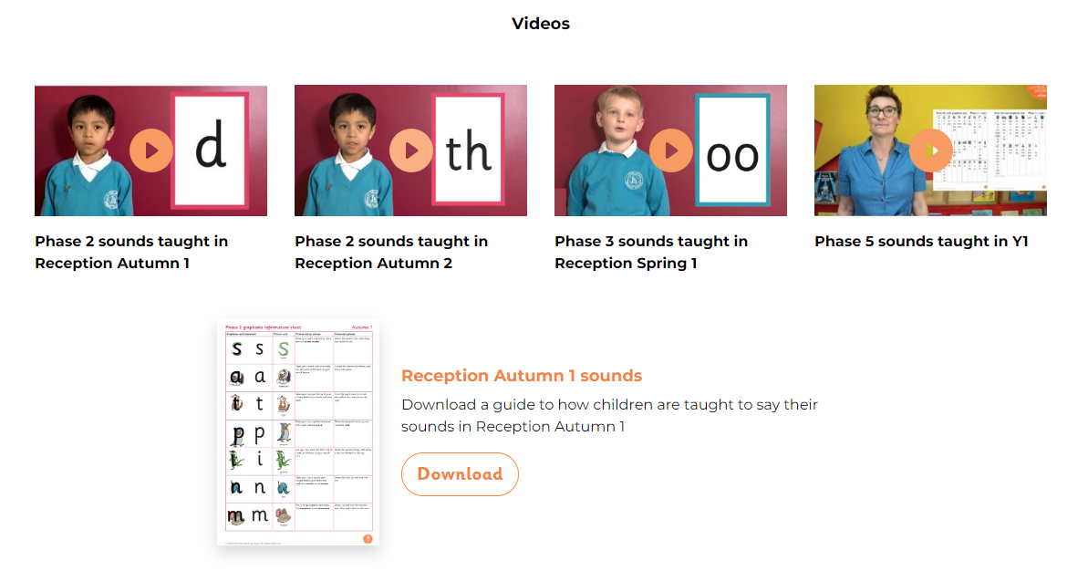
Little Wandle for Parents

Slide 14
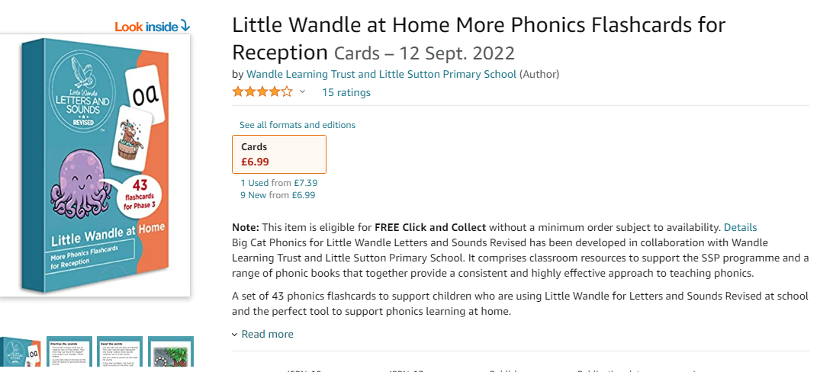
Resources

Slide 15

Thank you!
Thank you for coming today.
Any questions?
RAFFLE!

