Slide 1
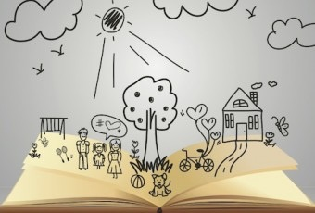
Developing Spelling
Lindsay Pickton
Primary Education Advisor

Slide 2
+
A Simple View of Writing
(Christine Chen, 2006)
Transcribing
spelling and handwriting
_
+
_--
Composition
Ideas + organisation
primaryeducationadvisors.co.uk

Slide 3
+
A Simple View of Writing
(Christine Chen, 2006)
Spelling is crucial
to writing!
Transcribing
spelling and handwriting
_
+
_--
Composition
Ideas + organisation
primaryeducationadvisors.co.uk

Slide 4
+
A Simple View of Writing
(Christine Chen, 2006)
You can’t get
over here
without it!
Spelling is crucial
to writing!
Transcribing
spelling and handwriting
_
+
_--
Composition
Ideas + organisation
primaryeducationadvisors.co.uk

Slide 5
Spelling in English
is particularly hard
26 letters
44 smallest speech sounds (phonemes)
47+ units of sound
170+ spelling alternatives (graphemes)
(double that for rare & unique spellings)

Slide 6
Spelling in English
is particularly hard
m, mm, mb, mn
j, g, ge, dge
a, ai, a-e, ay, eigh, ey, aigh
c, k, ck, ch, q
or, oor, aw, awe, ore, augh
…etc etc…
Children must be able to make these choices!

Slide 7
Spelling in English
is particularly hard
Phonics
Learning rules
Learning words
Tricks for sticking points
Reading

Slide 8
Reading
“Does it look right?”
9 year olds at 90th percentile read 2 million words a year
9 year olds at 10th percentile read 8000 words a year
2 days: 1 year

Slide 9
More Reading
Reading for work
Reading for pleasure
Reading for purpose

Slide 10
Phonic Spelling
‘Hear’ the word (aloud or in your head)
Break it into its constituent parts (phonemes)
Link those sounds to letters (graphemes)
This will give a readable spelling, but it won’t always be correct.
More accurate choices come with knowledge and experience.

Slide 11
Phonemes
Stop
Fist
Strap
Straight
Strong
Bottle
Cat
Dog
Shop
Fish
Watch
Thought

Slide 12
Spell…

Slide 13
I spy with my little eye
….something beginning with…
….something ending with…
….something with … in the middle!

Slide 14
Rules
Prefixes and suffixes
Examples:
hop - hopping
hope - hoping
beauty - beautiful
effective - ineffective
possible - impossible
fortunate - unfortunate

Slide 15
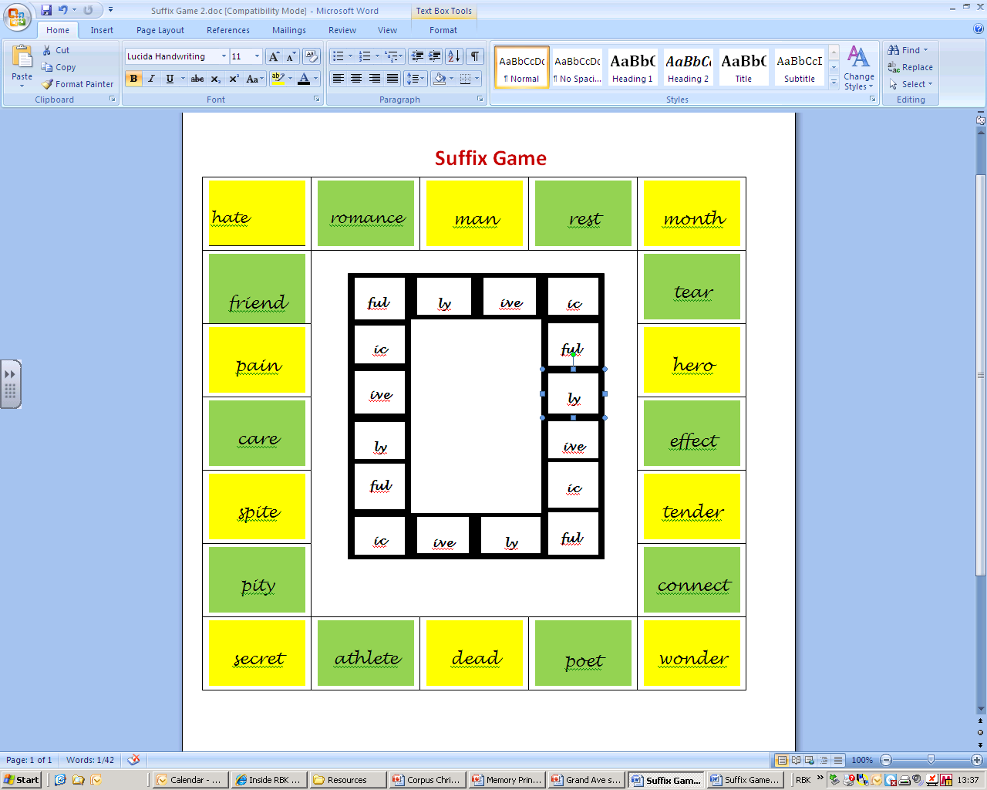
primaryeducationadvisors.co.uk

Slide 16
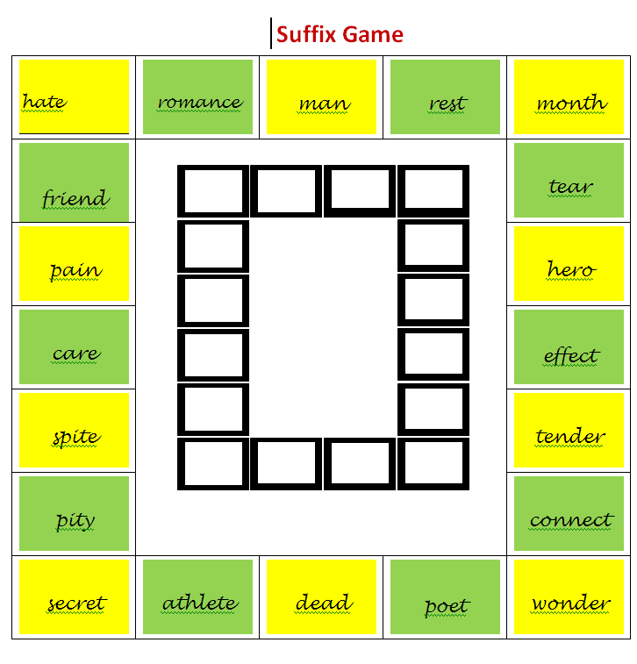
primaryeducationadvisors.co.uk

Slide 17
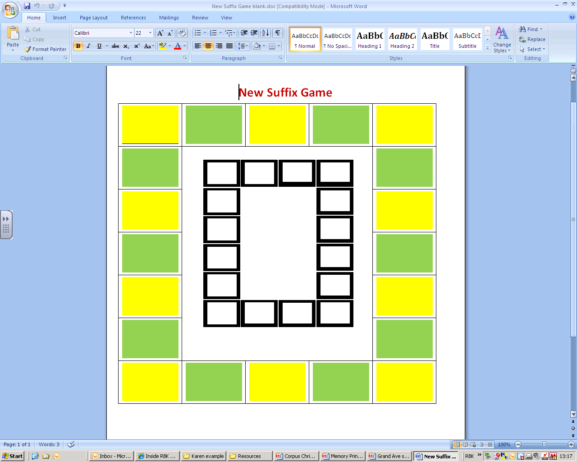
primaryeducationadvisors.co.uk

Slide 18
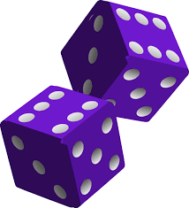
Roll the dice
Each number represents a prefix
dis
mis
re
pre
un
in
Find a root word that links with the prefix
What does your new word mean?
Roll and repeat
Say and write sentences applying real words formed.
Check for sense and correct spelling
primaryeducationadvisors.co.uk

Slide 19
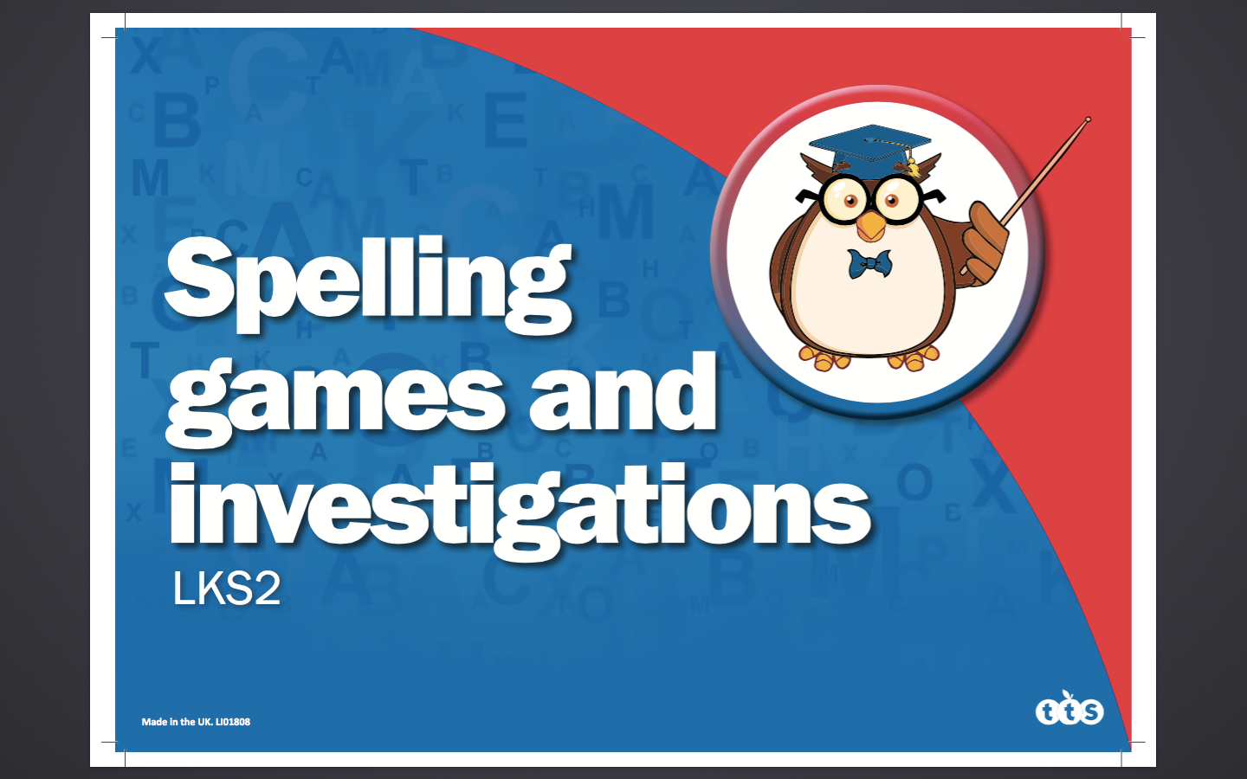
primaryeducationadvisors.co.uk

Slide 20
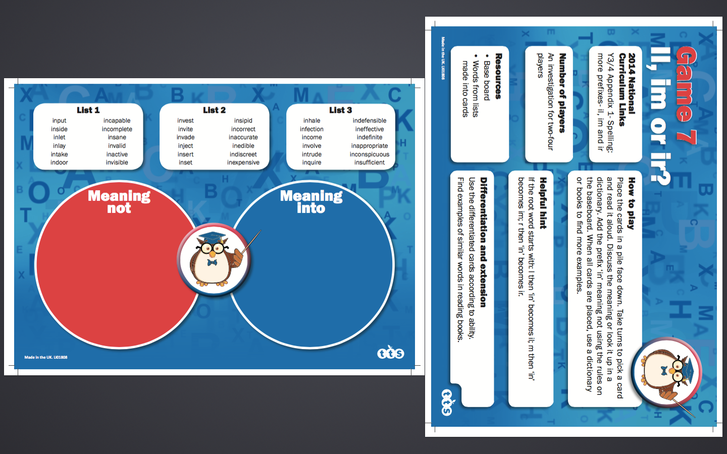
primaryeducationadvisors.co.uk

Slide 21
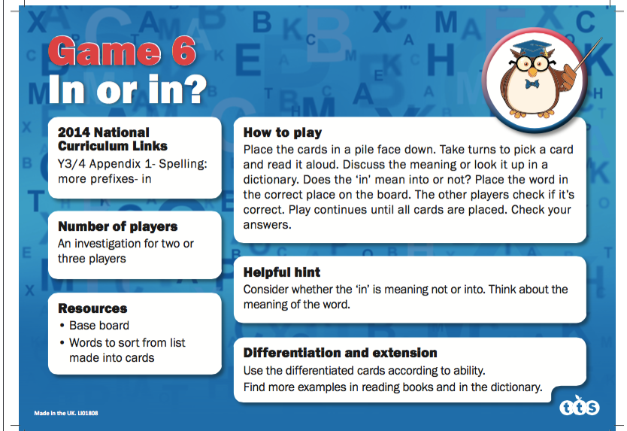
primaryeducationadvisors.co.uk

Slide 22
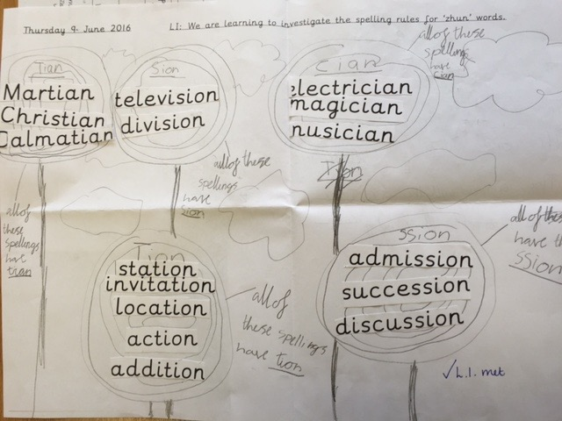
Spelling Investigation:
How could you group these ‘zhun-ending’ words?

Slide 23
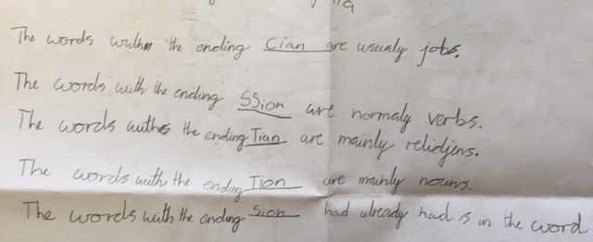
What have you noticed so far?
Formulating hypotheses….
AfL …….further investigate ’zhun’ rules, revise ‘ly’ suffix and ‘i’ handwriting join

Slide 24
If I know…
possible
finish
science
primaryeducationadvisors.co.uk

Slide 25
Find the past tense of….
throw swim go weep drive leave sit keep sing sit sleep hold fight put leave

Slide 26
Statutory harder words
e.g. accident, breathe, different, guard, knowledge, possible, separate, reign, various, weight
e.g. accommodate, awkward, committee, definite, lightning, necessary, pronunciation, rhythm, yacht

Slide 27
Statutory harder words
These are “word lists”
This is vocabulary, not just spelling
Learnt in isolation, they will quickly be forgotten
Learnt in isolation, they won’t be used in writing!

Slide 28

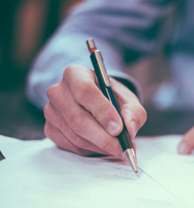
Statutory harder words
Find them in books
Talk about them
Try to imitate them in writing
Which bits are familiar?
Which bits are easy?
Where might you go wrong?

Slide 29
Hangman
…or Smiley Face Man…

Slide 30
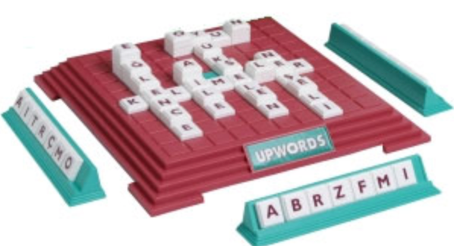
Upwords

Slide 31
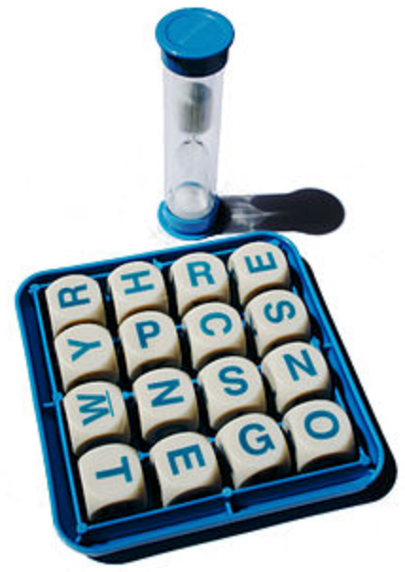
Boggle

Slide 32
Tricks for tricky bits
Because
Said
What
When
Separate
Definite
Necessary
Soldier

Slide 33
The point of teaching spelling is to improve
the quality of children’s independent writing.

