Slide 1

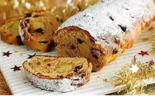
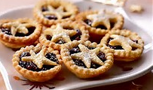
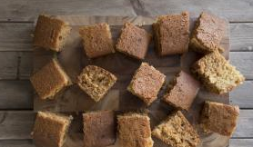
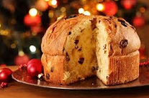
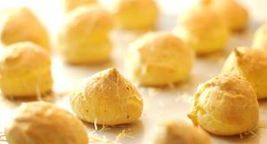
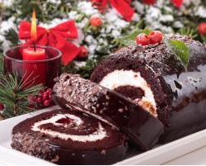
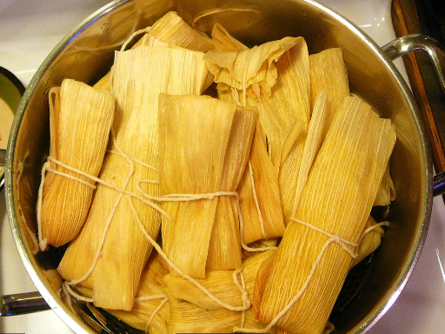
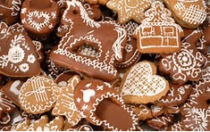
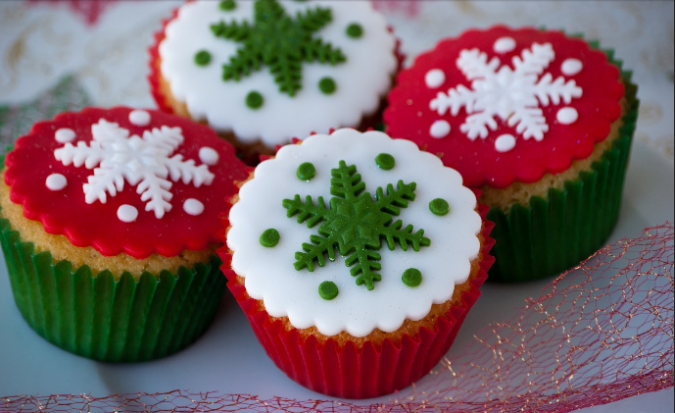
Stollen
Pain d’Epices
Mince Pies
International Christmas Food Stall
Bring in your baked sweet and savoury treats on 9th December
Please label the food you bring in so we can separate meat, veg and sweet. Only sealed food with nuts can be accepted and must be labelled – these will be kept on one end of the stall.
Panettone
Gougeres
Yule Log
Tamales
Cupcakes
Lebkuchen

