Slide 1
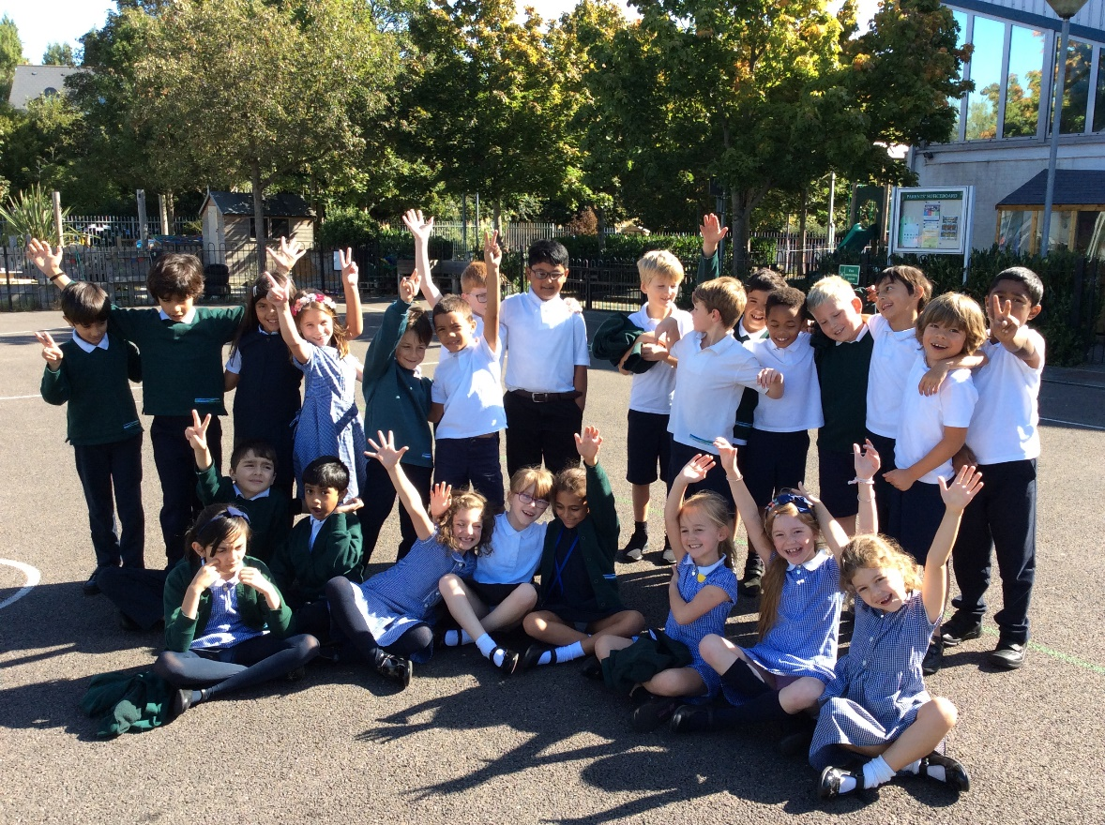

Welcome to Monkey Class’
Meet the Teacher
Year 3

Slide 2
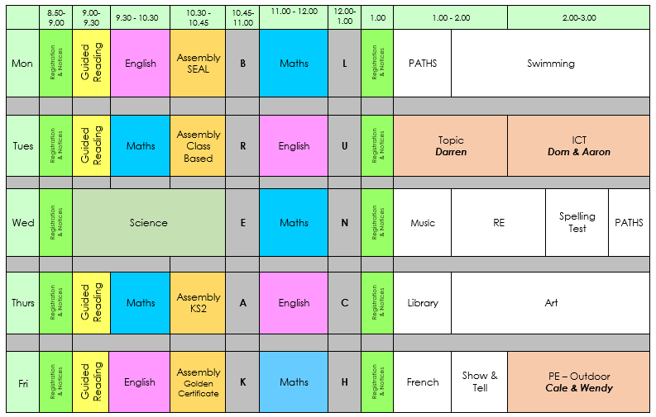
Monkey Class Timetable – Autumn 1

Slide 3
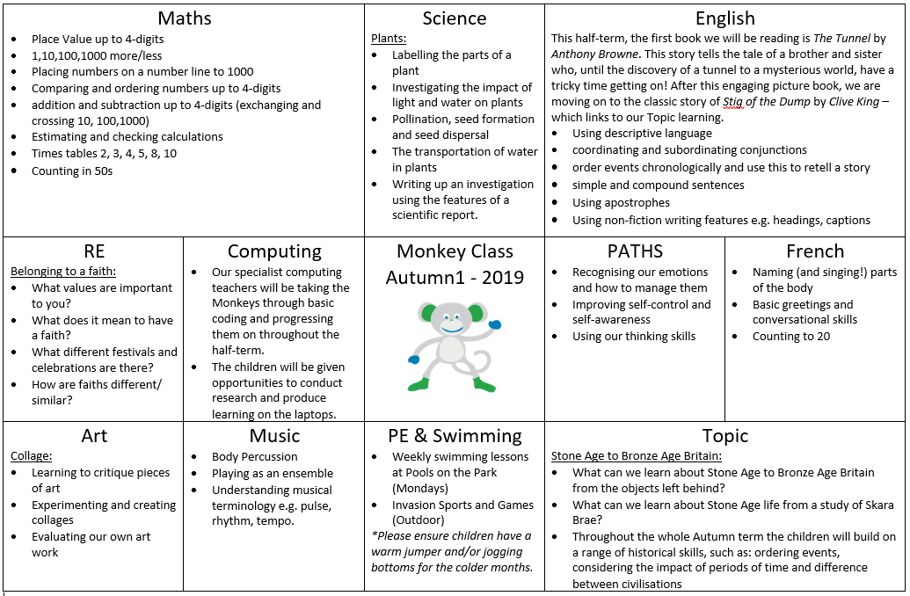
Curriculum Map – Autumn 1

Slide 4
What’s New in Monkeys
Some lessons taught with a different teacher:
Topic – Darren
Computing – Dom and Aaron
PE – Cale and Wendy
Swimming – Pools On The Park
Show and Tell
Barn Church – Carol Concert
French lessons
Times tables expectations
Mathletics for home learning
No free fruit at break time

Slide 5
Home Learning
Home Learning will go out on a Thursday, reading records will be collected on a Tuesday, spelling tests will be on a Wednesday.
Home Learning will include:
Spellings sent home weekly to be learned – tested Wednesday.
Times tables to be practised - tested weekly.
Children should complete the assigned Mathletics activity weekly.
It is very important that children continue to read at home on a daily basis for 20 minutes. Reading Records must be completed each day and given in on Tuesdays with Home Learning. If you would like an additional reading book, please ask in class and we can provide it once the first book has been read.
Creative home learning tasks.
If you wish to do additional work with your children use the KPIs on the school website.

Slide 6
Behaviour
Policy available on the website, please have a look.
We monitor and log all behaviour incidents
You will be contacted if your child is sent to a linked class or is involved in a serious incident.
Feel free to make an appointment with me or with Leadership if you have any concerns about a child’s behaviour.
Monkey Class Dojo system

Slide 7
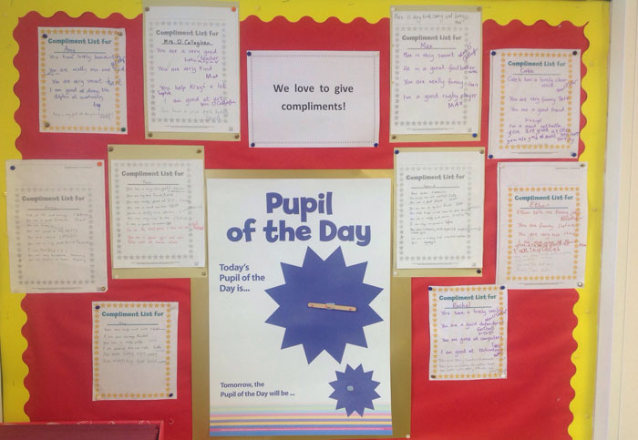
Focus on the positive

Slide 8

Also check the school websites for updates and links from the borough

Slide 9

Cakes on Birthdays
Due to allergies and time constraints, we ask that if you wish to give out birthday cakes or party bags on your child’s birthday you do
this after school on
the playground so
that parents/ carers
can give consent.

Slide 10
Any Questions?
Please do come and see me or make an appointment to discuss anything after school.

