Slide 1

Welcome to Meet the Teacher

Slide 2
Overview of the evening
Timetable
Topics & Trips
What’s New in Year 2
Home Learning
Behaviour
PATHS
E-safety
Cake notice
Useful websites & information
Home School Agreement
Handouts
Questions
Meet the teacher - September 2019

Slide 3
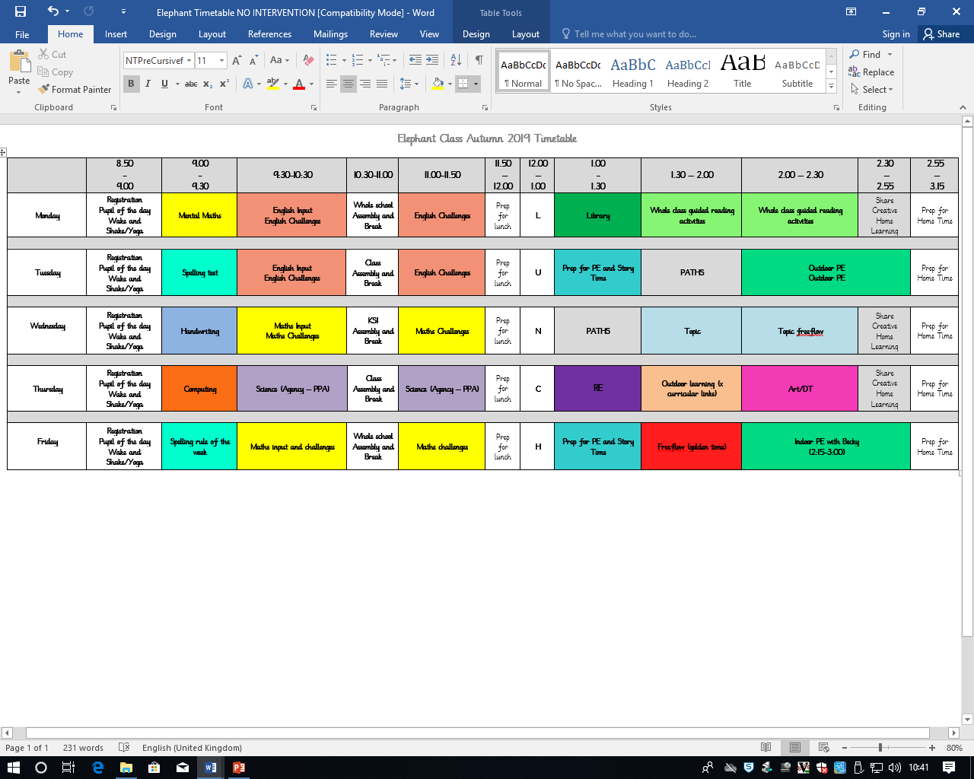
Timetable
Music: we will be learning new songs through KS1 Music assemblies, and will be listening to and appreciating music through cross-curricular lessons this half term.
Notes:
3

Slide 6
Topics and Trips
Term | Topic | Past Trips
Autumn | Great Fire of London | National Archives
Spring | Rainforests | Kew Garden
Summer | Plants | Kew Gardens (self led tour – by Becky ☺)

Slide 7
What’s New in Year 2
Children bring their PE kits in a bag and change at school (Tuesdays and Fridays)
Focused challenges in all subjects
New class topics and trips
Focus on joined up handwriting
SATs during the summer term

Slide 8
Home Learning
Maths
Children will receive a times table each week to practise. Children should know their times tables in and out of order.
Spellings
Children will be given 6 words each week. The children need to practice reading and spelling the words provided. Children can put these words into sentences as an extension activity. Encourage your child to use the ‘look, say, cover, write, check’ method when spelling. Children will be tested on these words the following week.
Reading
Children will bring home reading books each week – Oxford Reading Tree stories. The ORT books will range from stories, poems, non-fiction and play scripts to provide children with a wide coverage of texts. Children who complete the ORT system will then move onto our ‘Big Cat’ reading scheme. Please comment in your child’s reading record weekly. Check inside their reading record book to see which day your child’s books will be changed.
Creative
Children have the opportunity to undertake a creative piece of home learning based on our topic. This can be creating a poster or designing and making a model which the children can then share with the class as part of their show and tell.

Slide 9
Behaviour
Policy available on the website, please have a look.
We monitor and log all behaviour incidents
You will be contacted if your child is sent to a linked class or is involved in a serious incident.
Feel free to make an appointment with me or with Leadership if you have any concerns about a child’s behaviour.

Slide 10
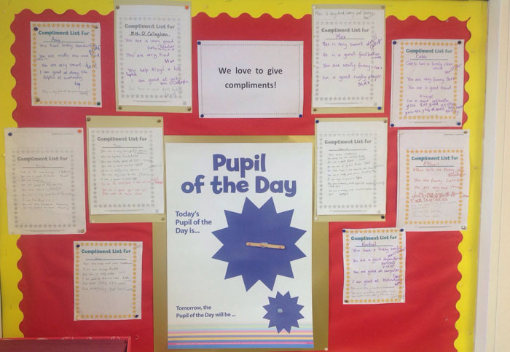
Focus on the positive

Slide 11

Internet Safety
Also check the school websites for updates and links from the borough

Slide 12

Cakes on Birthdays
Due to allergies and time constraints, we ask that if you wish to give out birthday cakes or party bags on your child’s birthday you do
this after school on
the playground so
that parents/ carers
can give consent.

Slide 13
Useful websites and information
BBC Bitesize
http://www.bbc.co.uk/bitesize/ks1/
Oxford Owl
https://www.oxfordowl.co.uk/
Daily 10 Maths challenges
https://www.topmarks.co.uk/maths-games/daily10
Phonics play
https://www.phonicsplay.co.uk/

Slide 14
Home School Agreement
To help my child get the most out of their time at Kew Riverside I will always try to:
See that my child comes to school each day by 8.55 am and is collected at 3.15 pm
Encourage my child to follow the Golden Rules
Encourage my child to read stories and fact books from school as often as possible
Support my child with their home learning
Make sure my child goes to bed at a reasonable time
Keep up-to-date with what is happening at school (e.g. by reading the bulletin)
Attend parents evenings and other sessions offered by the school to inform me about my child’s learning
Inform the school promptly if my child is unwell
Help my child wear the right uniform and have their PE kit ready on Mondays.
If you have any questions/concerns about your child’s learning please speak to Sarah the class teacher.
Signed………………………………………………. Date………………………
(Parent/Guardian)

Slide 15
Please find these on the class page
Presentation slides
Example of end of year 2 writing
High frequency words
Book list

Slide 16
Any Questions?
Please let me know if you would like to make an appointment to speak to me after school on a Tuesday.

