Slide 1
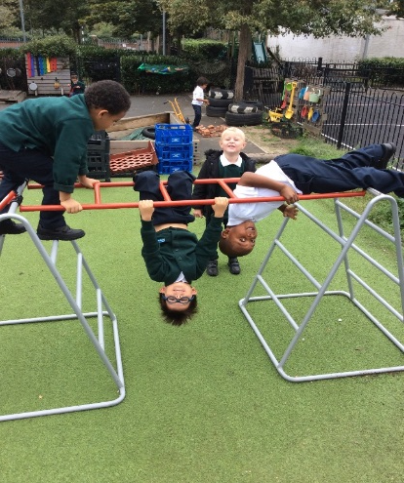
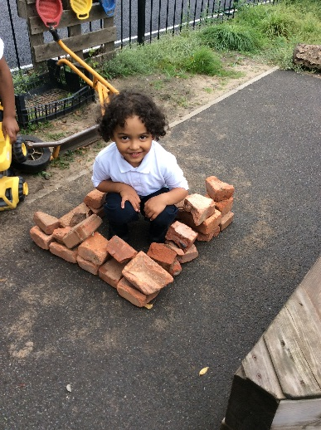
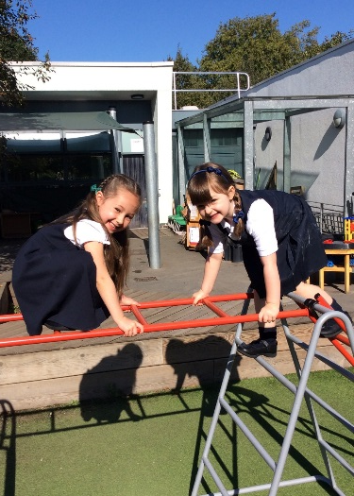
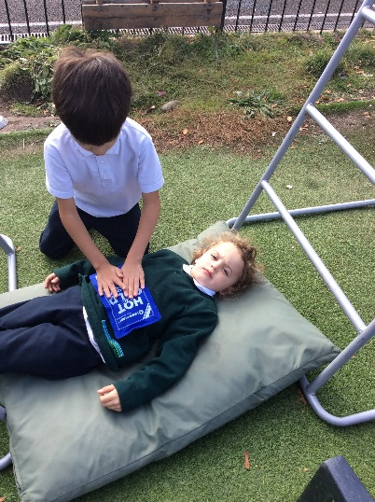
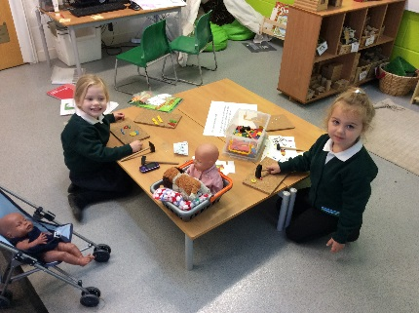
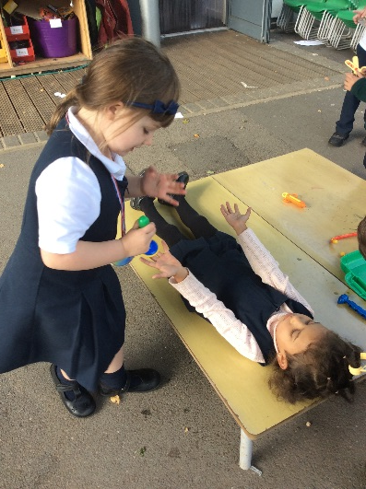
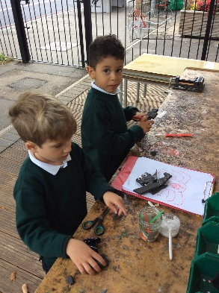
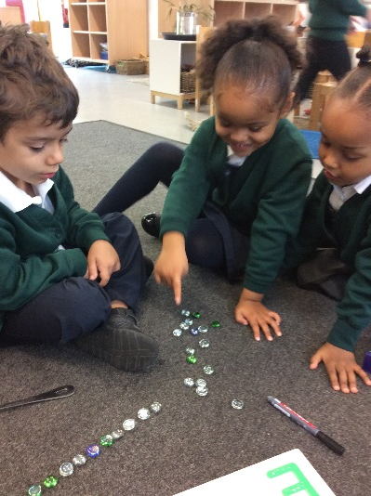
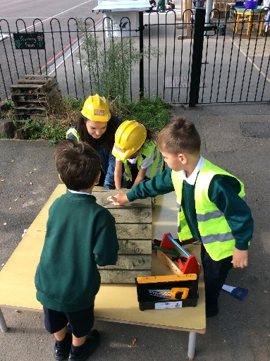

Welcome to Giraffe Class’
Meet the Teacher Evening

Slide 2
Overview of the evening
PATHS
Early Years Foundation Stage
Timetable
Assessment
Input from home
A ‘Good Level of Development’
Examples of Early Learning Goal Expectations
Home Learning
Phonics
Home School Agreement
Useful websites & information
Handouts
Questions

Slide 3
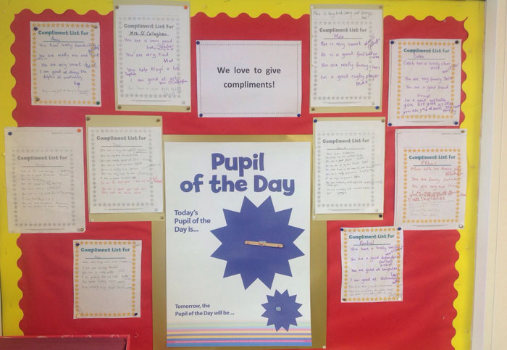
Focus on the positive

Slide 4

Cakes on Birthdays
Due to allergies and time constraints, we ask that if you wish to give out birthday cakes or party bags on your child’s birthday you do
this after school on
the playground so
that parents/ carers
can give consent.

Slide 5
Timetable – Full Day
 | 8.50 - 9.15 | 9.15 - 9.35 | 9.35 - 10.30 | 10.30 - 10.45 | 10.45 - 11.05 | 11.05 – 11.30 | 11.30 – 12.00 | 12.00 – 1.00 | 1.00 - 1.30 | 1.30 – 2.00 | 2.00 – 2.30 | 2.30 – 3.00 |  | 3.00 – 3.15
Monday | Self-registration & Activities | Phonics | Freeflow |  |  | Maths | Prep for lunch | L | Teaching Input | Freeflow |  | Reflection/Story/Prep for Home Time
Tuesday | Self-registration & Activities | Phonics | Freeflow |  |  | Maths | Prep for lunch | U | Teaching Input | Freeflow |  | Reflection/ Story | Prep for Home Time
Wednesday | Self-registration & Activities | Phonics | Freeflow | KS1 Assembly (after 1/2 term) | Freeflow | Maths | Prep for lunch | N | Teaching Input | Freeflow |  | Reflection/Story/Prep for Home Time
Thursday | Self-registration & Activities | Phonics | Freeflow |  |  | Maths | Prep for lunch | C | PE | PE | Freeflow |  |  | Prep for Home Time/ Home Learning
Friday | Self-registration & Activities | Phonics | Freeflow |  |  | Maths | Prep for lunch | H | Teaching Input (Circle Time) | Freeflow |  | Reflection/Story/Prep for Home Time
Notes:
PE on a Thursday with Neal. Please ensure your child wears their kit to school on a Thursday
Music will be taught by Holly

Slide 7
Local Early Years Focus of 2019/20
Talk
https://hungrylittleminds.campaign.gov.uk/#3
Reading everyday, 1 year increase by 8 compared to x2 weekly.
Ask me about stickers. Recall, C+L, next steps.

Slide 8
Early Years Foundation Stage(EYFS)
Builds on nursery experience (0-5)
7 Areas of Learning (communication and language, physical development, personal, social and emotional development, literacy, maths, understanding the world and expressive arts and design)
  Prime Areas (CL, PSED, PD)
  17 Aspects – Early Learning Goals
Notes:
Cross curricular activities,
Go over Prime Areas and Specific Areas
Curriculum areas reflected inside and out - Clothes can get messy!
Activities topics flexible, follow chns interests to ensure engagement
Build independence in the class, activities child initiated – focus groups with teacher and activities/challenges set up, chn choose learning activities
Observe and assess through observations of children and what they are able to do consistently and independently
Encourage input from home so have holistic picture of the child’s development – more information in Sept.

Slide 9
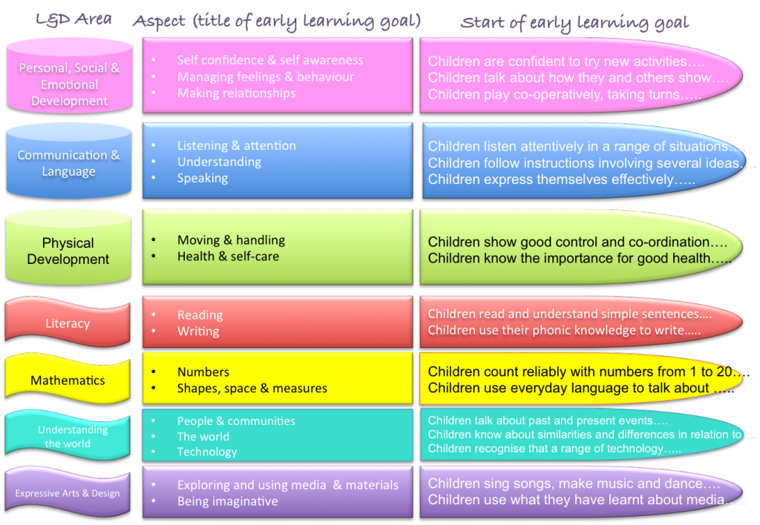
17 Aspects – Early Learning Goals

Slide 10
Teaching and Learning
Focus children not focus activities
‘Planning in the Moment’
Learning through play
Child-initiated, independent learning
Freeflow throughout the day
Skills-based
Builds on children’s interests
Story scribing
Notes:
Cross curricular activities,
Go over Prime Areas and Specific Areas
Curriculum areas reflected inside and out - Clothes can get messy!
Activities topics flexible, follow chns interests to ensure engagement
Build independence in the class, activities child initiated – focus groups with teacher and activities/challenges set up, chn choose learning activities
Observe and assess through observations of children and what they are able to do consistently and independently
Encourage input from home so have holistic picture of the child’s development – more information in Sept.

Slide 11
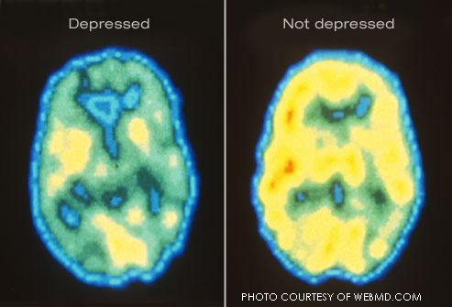
Engagement
Level 1
Level 5

Slide 12
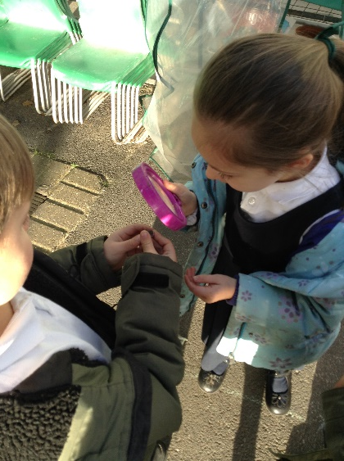
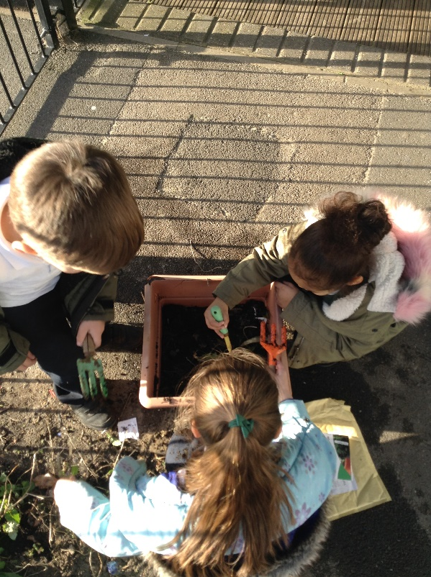
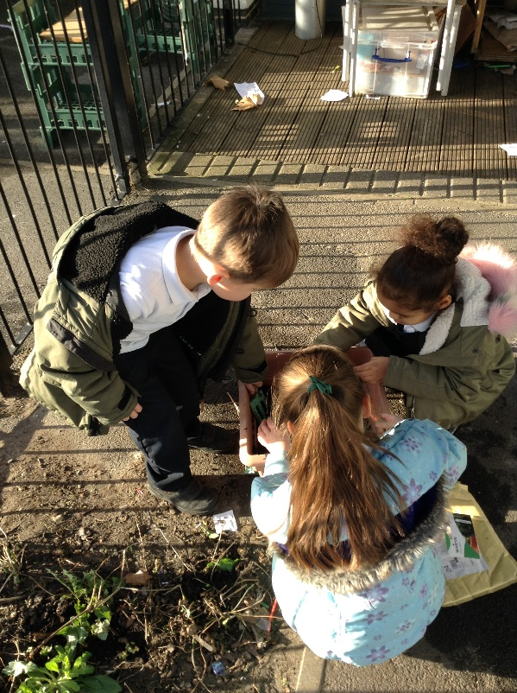
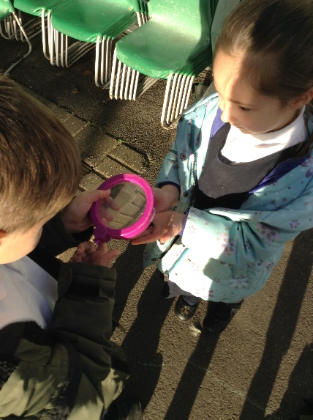
If we visited Giraffe Class – when, where & doing what, do you see this Level 5 involvement? • When & where do you not see this? What is stopping this from happening?
Notes:
Cross curricular activities,
Go over Prime Areas and Specific Areas
Curriculum areas reflected inside and out - Clothes can get messy!
Activities topics flexible, follow chns interests to ensure engagement
Build independence in the class, activities child initiated – focus groups with teacher and activities/challenges set up, chn choose learning activities
Observe and assess through observations of children and what they are able to do consistently and independently
Encourage input from home so have holistic picture of the child’s development – more information in Sept.

Slide 13
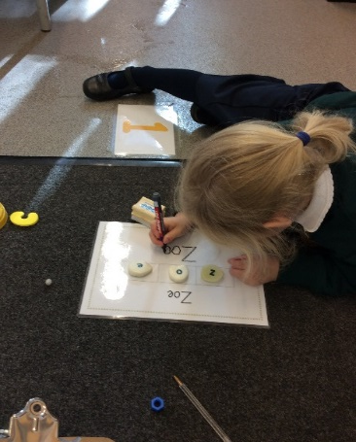
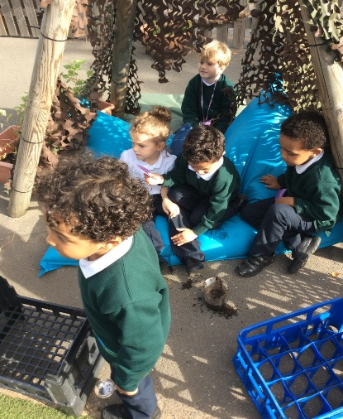
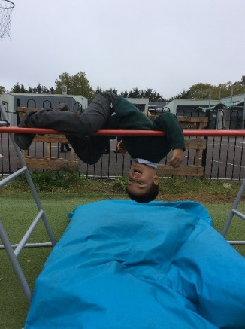
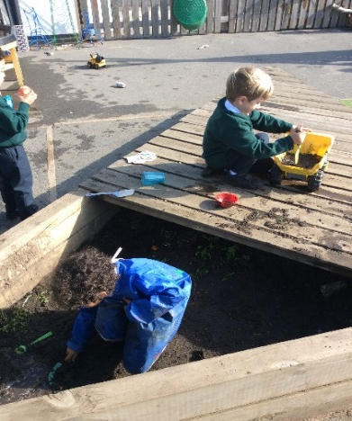
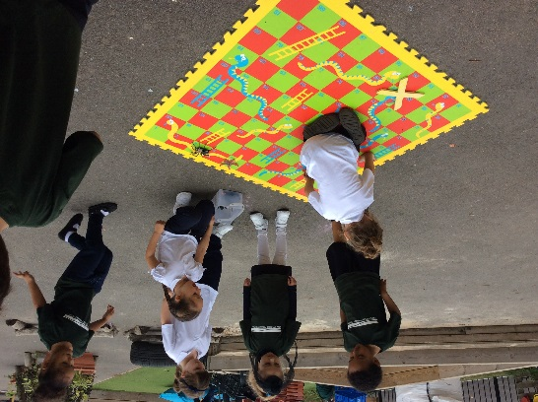
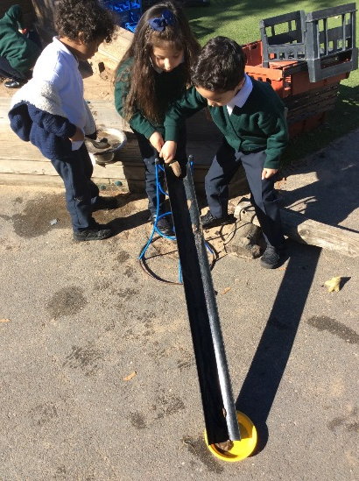
Prime Areas
Communication & Language
Physical Development
Personal, Social & Emotional Development
Notes:
Some examples of how the curriculum is delivered in Giraffes – Prime Areas

Slide 14
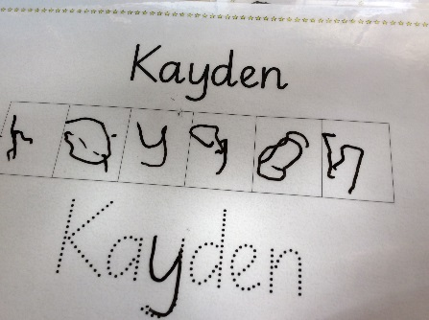
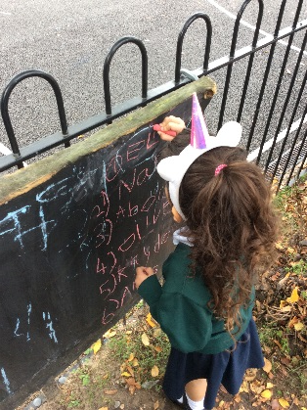
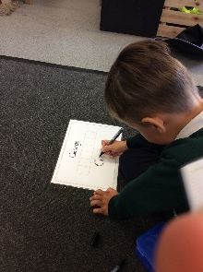
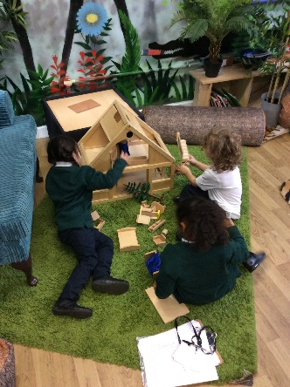
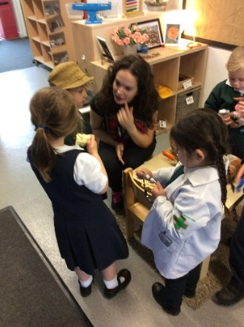
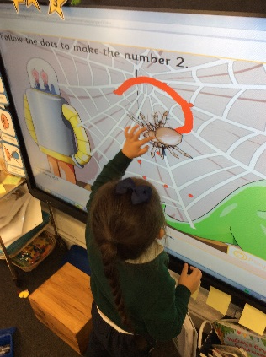
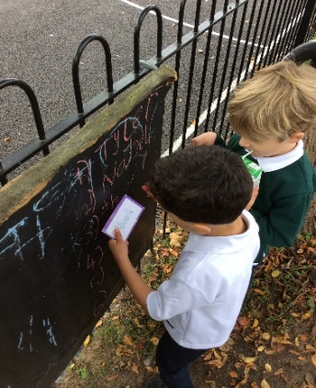
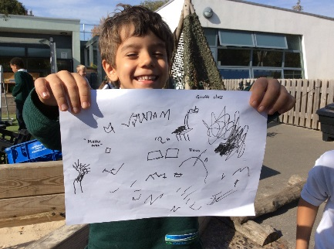
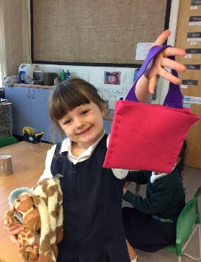
Specific Areas of Learning
Literacy
Understanding the World
Mathematics
Expressive Arts & Design
Notes:
Some examples of how curriculum is delivered in Giraffes – Specific Areas

Slide 15
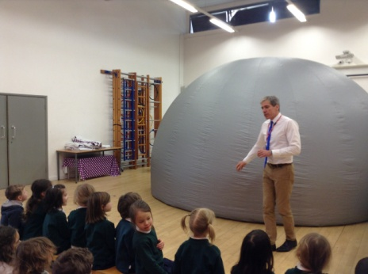
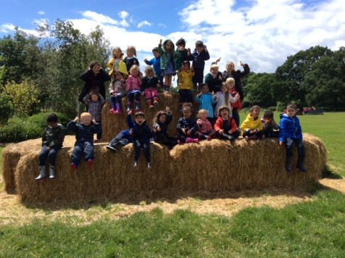
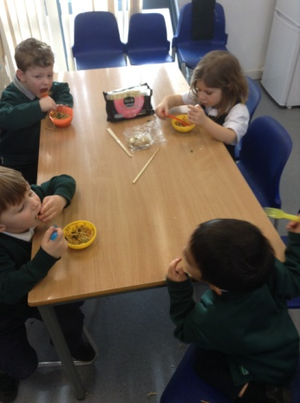
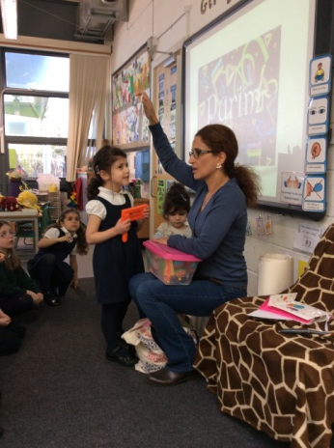
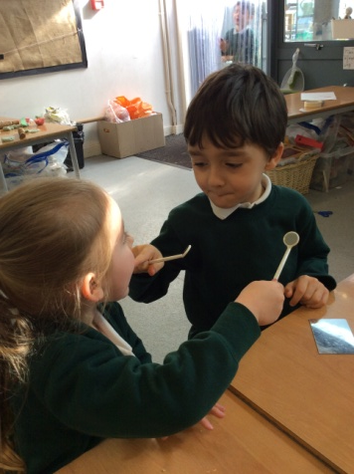
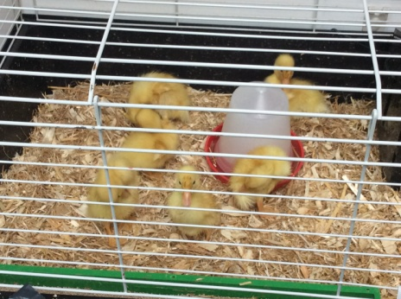
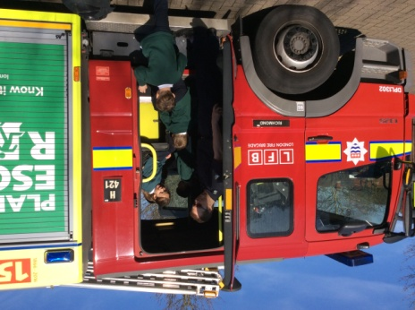
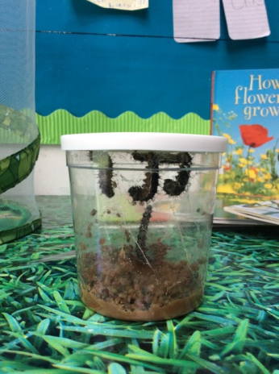
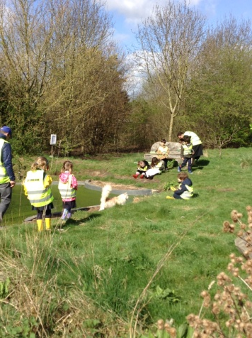
Enhancements

Slide 16

A Typical Day in Giraffes
Full - Time
8.50 Children arrive, self-register and choose activities from around the class
9.15 Carpet time (Phonics)
9.35 Freeflow (inside and outside learning) Focus obs
11.05 Carpet Time (Mathematics)
11.30 Lunch time
13.00 Carpet Time (PATHS, Circle time, etc)
13.30 Freeflow (inside and outside learning) Focus obs
14.45 Story & prep for hometime
15.15 Home time

Slide 17
Assessment
Observations of independent learning
  Tapestry Ipad app (observe and assess)
  Long observations
Work samples
Input from home

Slide 18
Observations
O – Tom, Billy and Emma playing on the bikes but can’t decide whose turn it is.
T – suggested writing their names in a list so that they could make the game fair and each have a go. Modelled finding their name card and copying the letters onto the chalkboard.
O – Children took turns write their name up, copying the letters, then continued to play using the rota they had made.
Making relationships
Literacy
Communication and language

Slide 19
Input from home
Green Leaves
Questionnaires (interests, learning at home)
Parental input via Tapestry

Slide 20

Good Level of Development
At the end of Reception a Profile is completed for each child to assess their progress against the 17 ELGs, and the 3 Characteristics of Effective Learning.
Children are assessed as emerging, expected or exceeding for each of the ELGs.
For children to achieve a ‘Good Level of Development’ at the end of the EYFS, they need to have been assessed as expected in:
Personal, Social and Emotional Development
Physical Development
Communication and Language
Mathematics
Literacy
Notes:
expectations for the end of the year – reports will assess the children as either emerging, expected or exceeding (this truly means exceeding as it means a child is working at the level of a seven year old) against the EYFS framework.

Slide 21
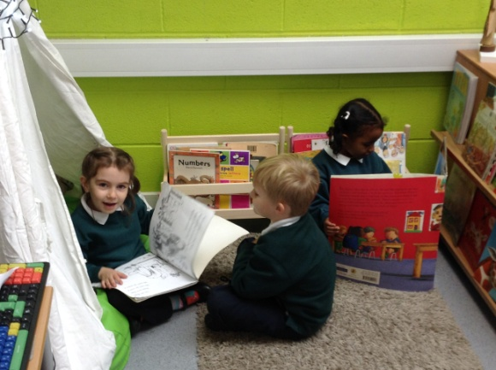
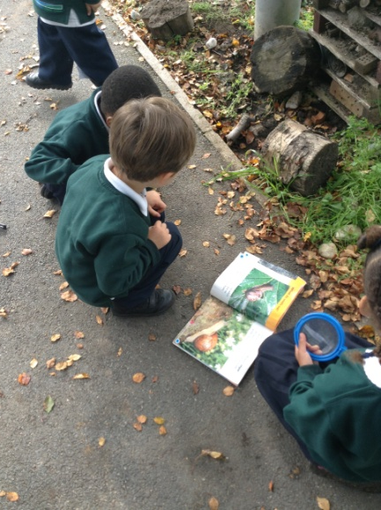
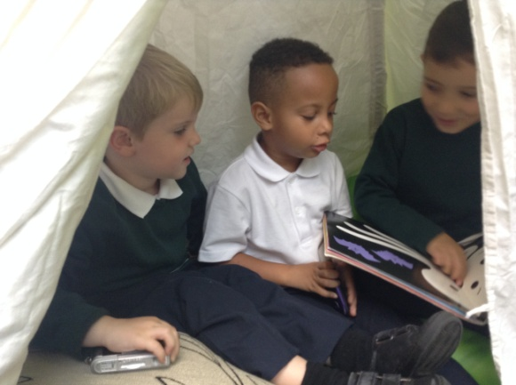
Reading
By the end of Reception we aim for children to be able to:
Read and understand simple sentences.
Use phonic knowledge to decode regular words and read them aloud accurately.
Read some common irregular words.
Demonstrate understanding when talking with others about what they have read.

Slide 22
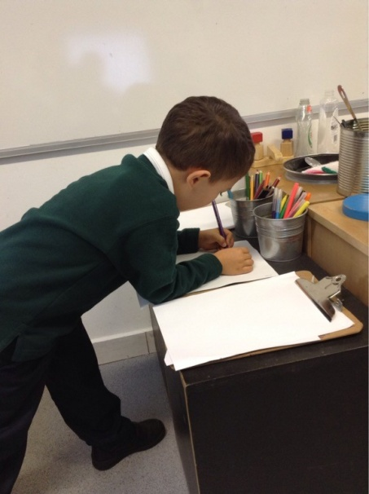
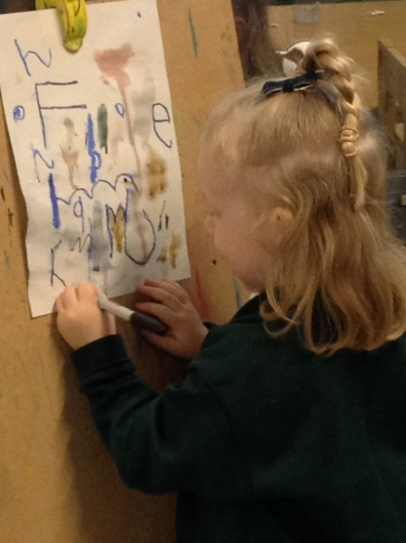
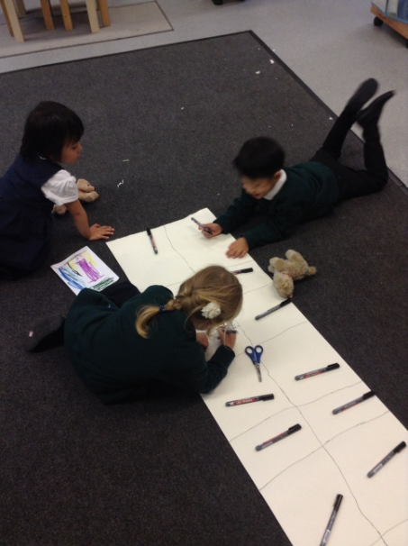
Writing
By the end of Reception we aim for children to be able to:
Use their phonic knowledge to write words in ways which match their spoken sounds.
Write some irregular common words.
Write simple sentences which can be read by themselves and others.
Spell some words are spell other which are phonetically plausible.

Slide 23
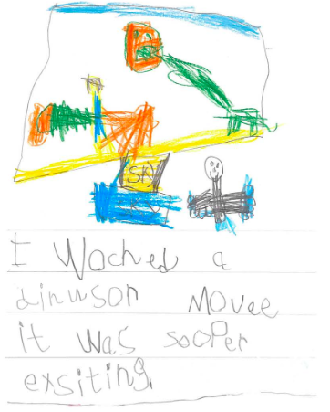
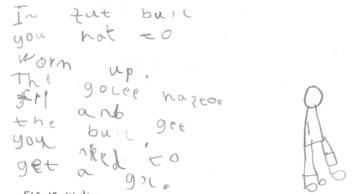
Examples of ‘Expected’

Slide 24
Maths
By the end of Reception we aim for children to be able to:
Numbers
Count reliably with numbers from one to 20, place them in order and say which number is one more or one less than a given number.
To use quantities and objects, to add and subtract two single-digit numbers and count on or back to find the answer.
To solve problems, including doubling, halving and sharing.
Space, shape and measure
To use everyday language to talk about size, weight, capacity, position, distance, time and money to compare quantities and objects and to solve problems.
To recognise, create and describe patterns.
To explore characteristics of everyday objects and shapes and use mathematical language to describe them.

Slide 25
Home Learning
Reading
2x reading books each week (Wide range of texts - stories, poems, non-fiction, play scripts).
1x picture books chosen from school library.
Please comment in your child’s reading record weekly.
Sounds and Spellings
Sound wallet containing letter sounds from their weekly phonics.
Words containing learnt sounds to practice reading and spelling (once initial sounds have been learnt).
Maths
Spring Term
Maths packs.
Summer Term
Maths challenges.

Slide 26
Phonics
Letters and Sounds
  Synthetic phonics
  Systematic and structured
Daily phonics lessons
  Initial sounds
  Long vowels
  Segmenting and blending
Notes:
Systematic, synthetic scheme
As they learn the sounds and graphemes, we will teach your child to blend by hearing the words in Fred Talk 1st. Once they know the graphemes they can sound-blend/Fred Talk to read words.

Slide 27
Phonics – order of teaching
Phase 2 | Letters and Sounds
Set 1 | s, a, t, p
Set 2 | i, n, m, d
Set 3 | g, o, c, k
Set 4 | ck, e, u, r
Set 5 | h, b, f, l
Phase 3 (i)
Set 6 | j, v, w, x
Set 7 | y, z, zz, qu
Set 8 | ck (revise), ff, ll, ss
Phase 3 (ii) | ch, sh, th, ng/nk
Phase 3 (iii) | ai, ee, igh, oa
 | oo, oo, ar, or
 | air, er, ou, oi
 | ire, ear, ure
Phase 4 | CVCC/CCVC words
 | Polysyllabic words
Notes:
Systematic, synthetic scheme
As they learn the sounds and graphemes, we will teach your child to blend by hearing the words in Fred Talk 1st. Once they know the graphemes they can sound-blend/Fred Talk to read words.

Slide 28
How can you help your child?
Phonics
http://www.oxfordowl.co.uk/home/reading-site/expert-help/phonics-made-easy
Knowing the letters and groups of letters (graphemes) used to read and write the sounds
Helping them to segment and blend words
Attend the Phonics Workshop
Maths
Practical
Count, count, count
Look at numbers in the environment
BUT...
Talk, talk, talk!
Continue to read daily with your child – language rich environment
Sing songs and rhymes
Look at print in the environment
Play games
https://bouncebackparenting.com/cant-miss-fun-for-your-4-6-year-old/

Slide 29
Home School Agreement
To help my child get the most out of their time at Kew Riverside I will always try to:
See that my child comes to school each day by 8.50 am and is collected at 3.15 pm.
Encourage my child to follow the Golden Rules.
Encourage my child to read stories and fact books from school as often as possible.
Support my child with their home learning.
Make sure my child goes to bed at a reasonable time.
Keep up-to-date with what is happening at school (e.g. by reading the Weekly Bulletin).
Attend parents evenings and other sessions offered by the school to inform me about my child’s learning.
Inform the school promptly if my child is unwell.
If you have any questions/concerns about your child’s learning please speak to the class teacher.
Help my child wear the right uniform and have their PE kit ready on Mondays.

Slide 30
Useful websites and information
Details of the Early Learning Goals:
http://www.foundationyears.org.uk/wp-content/uploads/2012/03/Development-Matters-FINAL-PRINT-AMENDED.pdf
A Parents Guide to Learning & Development – What to expect, When?
http://www.foundationyears.org.uk/files/2017/04/4Children_ParentsGuide_2017_FINAL_WEBv2.pdf
A Parents Guide to the EYFS
http://www.foundationyears.org.uk/files/2017/01/EYFS_Parents_Guide-amended1.pdf

Slide 31
Handouts
Presentation slides
Word list – First 100 High Frequency Words
Book list
Class timetable
Home/ school agreement - please return to school when signed by both yourself and your child

Slide 32
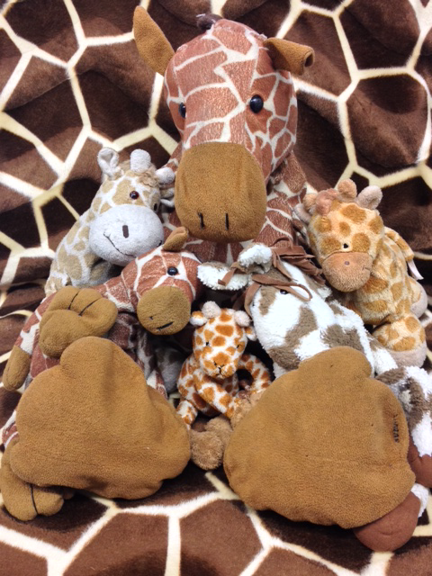
Any questions?

