Slide 1
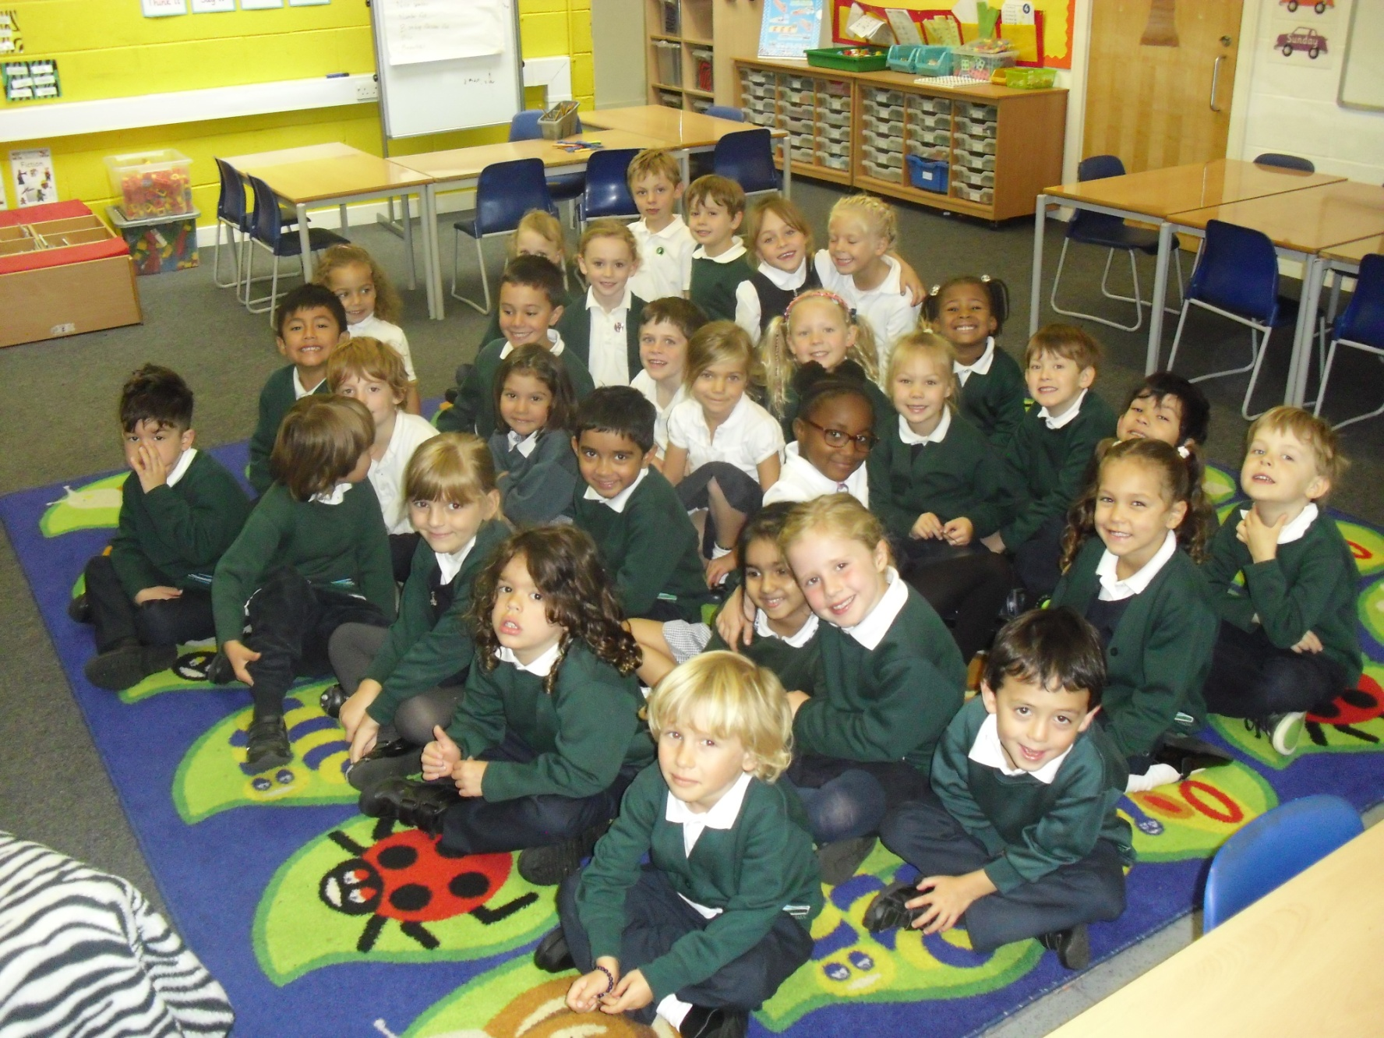
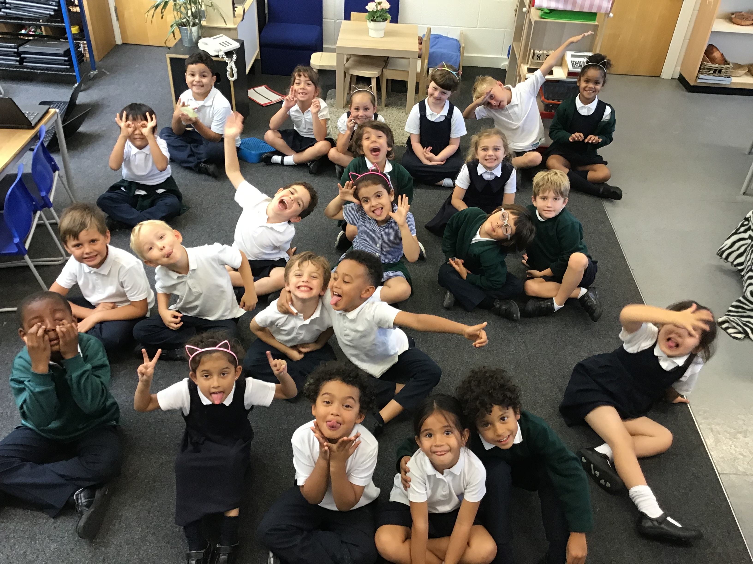

Welcome to Zebra’s Meet The Teacher Evening!

Slide 2
Overview of the evening
Timetable
What’s New in Year 1
Curriculum
Topics & Trips
English and Maths in Year 1
Phonics Screening Check
Decision Making and Behaviour
School Notices
Home Learning
Useful websites & information
Home School Agreement
Questions

Slide 3
Year 1
How is it the same?
Taking the approach from Reception into Y1- learning through play and ‘planning in the moment’
Tapestry
Observational assessment
Freeflow - long periods of uninterrupted time to explore and investigate independently
Work-shop style environment
Skills-based teaching
How is it different?
National Curriculum expectations/objectives
Group work – Writing, Reading, Maths
Teaching inputs – subject specific
Timetable
Longer-term projects

Slide 4
Curriculum
Core Subjects
English
Maths
Science
Foundation subjects
Art and Design
Computing
Design and Technology
Geography
History
Music
PE
RE (not compulsory)
PSHE/PATHS (not compulsory)

Slide 5
Class Timetable
 | 8.50 - 9.10 | 9.10 - 9.30 | 9.30-10.30 | 10.30 - 11.00 |  | 11.00 - 11.20 | 11.20 – 11.45 | 11.45 – 12 | 12.00 – 1.00 | 1.00 - 1.30 | 1.30 – 2.00 | 2.00 – 2.30 | 2.30 – 2.55 | 2.55 – 3.15
Monday | Self-registration & Activities | Phonics | Freeflow (Group Work) | Assembly |  | Maths | Freeflow (Group Work) | Prep for lunch | L | Carpet Time | Freeflow (Reading Group) |  | Music
Tuesday | Self-registration & Activities | Phonics | Freeflow (Group Work) | Break 10.45 |  | Maths | Freeflow (Group Work) | Prep for lunch | U | PE with Cale |  | Freeflow | Carpet Time
Wednesday | Self-registration & Activities | Maths | Freeflow (Group Work) | KS1 Assembly |  | Phonics | Freeflow (Group Work) | Prep for lunch | N | Computing (Sharron) | Freeflow Sharron (Reading Group) |  | Show and Tell
Thursday | Self-registration & Activities | Maths | Freeflow (Group Work) |  | Break 10.45 | Phonics | Freeflow (Group Work) | Prep for lunch | C | Carpet Time | Freeflow (Reading Group) |  | Library
Friday | Self-registration & Activities | Carpet Time | Freeflow (Reading Groups) | Assembly |  | Carpet Time | Freeflow (Reading Groups) | Prep for lunch | H | Carpet Time | Freeflow (Group work or OAK) |  | Carpet Time
Notes:
5
Science will be taught by our deputy-head, Sonia. Our first topic is “Earth, Sun and Moon.”
Music will be taught by Marinus on Thursday afternoons.
Children will be given some class time to work on Heads Awards, but will also need to work on them outside of school as well. Options follow on Friday Afternoon.

Slide 6
Topics and Trips 2017-18
2018 – 19 TBC
Term | Topic | Trips
Autumn | Seasons and… | TBC
Spring | Seasons and… | TBC
Summer | Seasons and… | TBC

Slide 7



English In Year 1
Children will complete regular Spelling and Phonics sessions (20 minutes each)
Guided reading sessions will support children to progress with their reading, developing their comprehension, fluency and expression
Children will be introduced to high quality texts (fiction and non fiction) to support their learning in English and engage them with different writing genres

Slide 8
English
By the end of Year 1 we aim for children to be able to:
Reading – word reading
Apply phonics to decode words
Respond speedily with the correct sound to graphemes for 40+ phonemes, including alternative sounds
Read words accurately by blending known GPCs
Read common exception words
Read common suffixes (‘s’, ‘es’, ‘ing’, ‘ed’, ‘er’ and ‘est’)
Read polysyllabic words containing known GPCs
Read contractions and understand use of apostrophe
Read books aloud accurately that allow application of phonics to build up fluency and confidence
Reading – comprehension
Listen and discuss a wide range of poems, stories and non-fiction which can’t yet be read by themselves
Link what they read or hear read to their own experiences
Retell key stories, fairy stories and traditional tales and comment on characteristics
Recognise and join in with predictable phrases
Recite some rhymes and poetry by heart
Discuss word meanings, linking these to words already known
Understand texts based on prior knowledge or provided information
Correct inaccurate reading by check for sense
Discuss the significance of title and events
Make inferences on the basis of what is said and done
Make predictions based on reading so far
Explain clearly understanding of what is read to them and discuss this with others

Slide 9
English (Cont.)
By the end of Year 1 we aim for children to be able to:
Writing
Spell words using the standard phonemes
Spell common exception words
Spell the days of the week
Name the letters of the alphabet in order and use letter names to distinguish between alternative spellings
Understand spelling rules for adding 's‘ or ‘es’
Use the prefix ‘un’
Use suffixes -ing, -ed, -er and –est
Apply simple rules and write simple sentences from memory dictated by the teacher
To hold a pencil comfortable using a functional grip
Begin to form lower-case letters correctly
Form capital letters
Form digits 0-9
Compose a sentence orally before writing
Sequence sentences to form short narratives
Read writing aloud audibly and clearly (to check it makes sense and to discuss it with peers or the teacher)
Leave spaces between words
Join words and clauses using 'and‘
Begin to punctuate sentences using a capital letter, full stop, question mark or capital letter
Use a capital letter for people, places, days of the week and the pronoun ‘I’

Slide 10
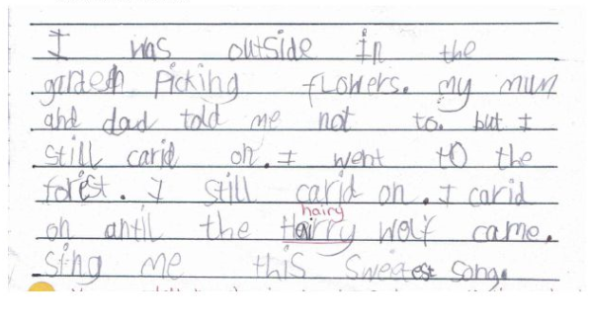
What does writing look like in Year 1?

Slide 11
Mathematics
Count to and across 100 from any number (forwards and backwards)
Count, read and write numbers to 100 in numerals and count in multiples of twos, fives and tens
Identify "one more" and "one less“
Find and show numbers using objects and pictures including the number line and use: equal to, more then, less then, most, least
Read and write numbers from 1 to 20 in numerals and words
Read, write and understand the symbols: +, - and =
Represent and use number bonds and related subtraction facts within 20
Add and subtract 1-digit and 2-digit numbers to 20, including zero
Answer problems that use addition and subtraction, including missing number problems, using objects and pictures
To answer multiplication and division questions using objects, pictures and other equipment
Recognise, find and name a half and a quarter as equal parts of an object, shape or amount
Compare, describe and solve practical problems for; lengths/heights, capacity, volume, time
Measure and begin to record length, mass, volume and time
Recognise and know the value of all coins and notes
Use language to sequence events in chronological order
Recognise and use language relating to dates, days of the week, weeks, months, years
Tell the time to the hour and half-past, including drawing clocks
Recognise and name common 2-D shapes
Recognise and name common 3-D shapes

Slide 12
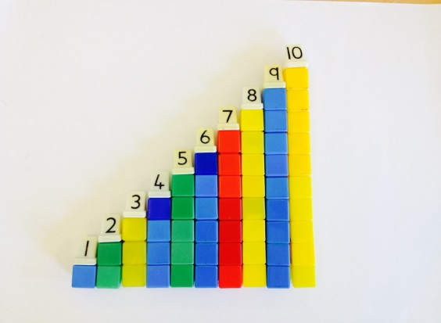
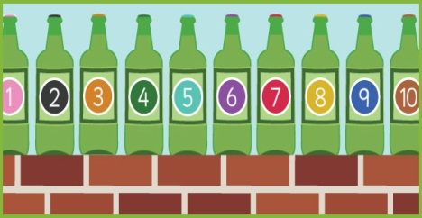
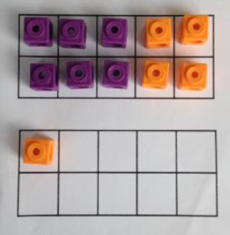




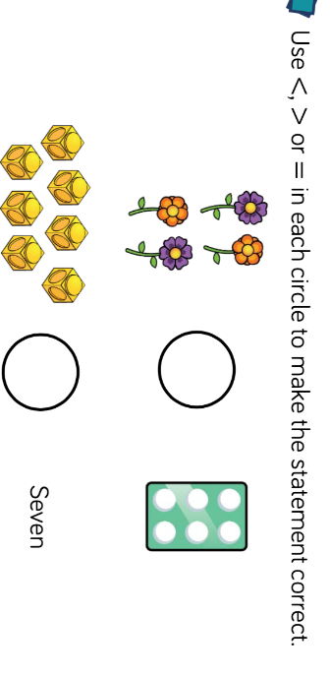
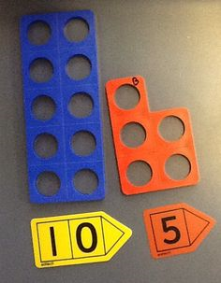
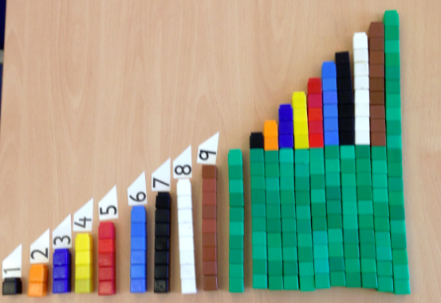
What does Maths look like in Year 1?
6+5, I can split 5 into 4 and 1 to bridge through 10, 6+4+1

Slide 13

End of Year 1 Phonics
Screening Check
All children must undertake a phonics screening check at the end of Year 1.
Light-touch assessment to confirm whether individual children have learnt phonic decoding to an appropriate standard.
The purpose of the phonics screening check is to identify children who may need extra help so we can put support in place to improve their reading skills.
The phonics screening check consists of 40 words - 20 real words and 20 non- words to test the children’s decoding skills.
Parent phonics and phonics screening workshops TBC

Slide 14

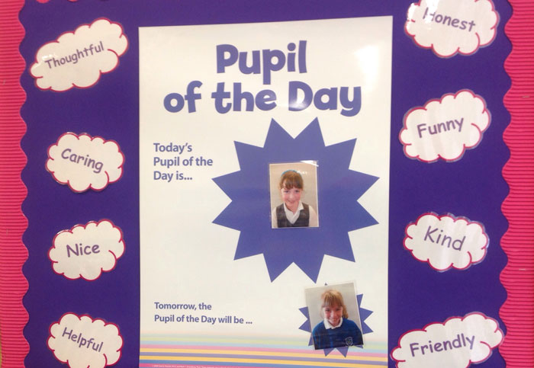
PATHS
Supports Social and Emotional Learning through the explicit teaching of:
Self-awareness
Self-management
Social awareness
Relationship skills
Responsible decision making
http://www.southwarkparkschool.co.uk/files/8914/4257/1460/Paths_parent_handout.pdf

Slide 15
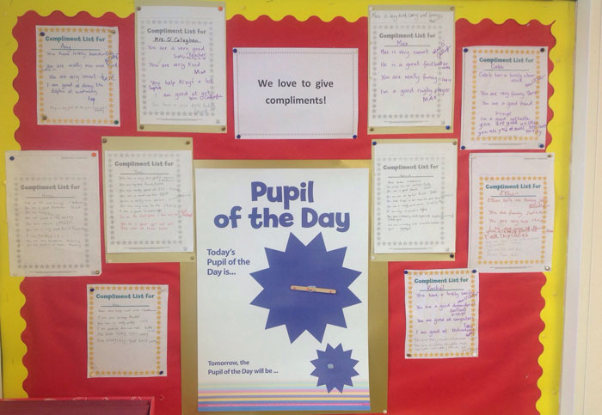
Focus on the positive

Slide 16
Behaviour
Policy available on the website, please have a look.
We monitor and log all behaviour incidents
You will be contacted if your child is sent to a linked class or is involved in a serious incident.
Feel free to make an appointment with me or with Leadership if you have any concerns about a child’s behaviour.

Slide 17

Cakes on Birthdays
Due to allergies and time constraints, we ask that if you wish to give out birthday cakes or party bags on your child’s birthday you do
this after school on
the playground so
that parents/ carers
can give consent.

Slide 18
Home Learning
Reading
Children will bring home 3 reading books each week – 2 Reading books and 1 picture book chosen from the school library. The reading books will range from stories, poems, non-fiction and play scripts to provide children with a wide coverage of texts. Please comment in your child’s reading record weekly.
Spellings and Sounds
Children will be given high frequency words/sounds from their Phonics and Spelling lessons each week. The children need to practice reading and spelling the words provided.
Maths
Details of the weeks learning will be sent home for you to consolidate at home. E.g. number bonds practice.
Creative Home Learning
At times throughout the year, children will have the opportunity to undertake a creative piece of home learning based on our class projects. This could be creating a poster or designing and making a model which the children can then share with the class as part of their show and tell.

Slide 19
Useful Websites and Information
For more information on the Phonics Screening Check: www.education.gov.uk
For activities and games to improve reading and phonics:
http://www.teachyourmonstertoread.com/
BBC Bitesize: Videos that support many parts of the curriculum
http://www.bbc.co.uk/education

Slide 20

Internet Safety
Also check the school websites for updates and links from the borough

Slide 21
Home School Agreement
To help my child get the most out of their time at Kew Riverside I will always try to:
See that my child comes to school each day by 8.55 am and is collected at 3.15 pm.
Encourage my child to follow the Golden Rules.
Encourage my child to read stories and fact books from school as often as possible.
Support my child with learning at home.
Make sure my child goes to bed at a reasonable time.
Keep up-to-date with what is happening at school (e.g. by reading the Bulletin).
Attend parents evenings and other sessions offered by the school to inform me about my child’s learning.
Inform the school promptly if my child is unwell.
If you have any questions/concerns about your child’s learning please speak to the class teacher.
Help my child wear the right uniform and wear their PE kit on Tuesdays.

Slide 22
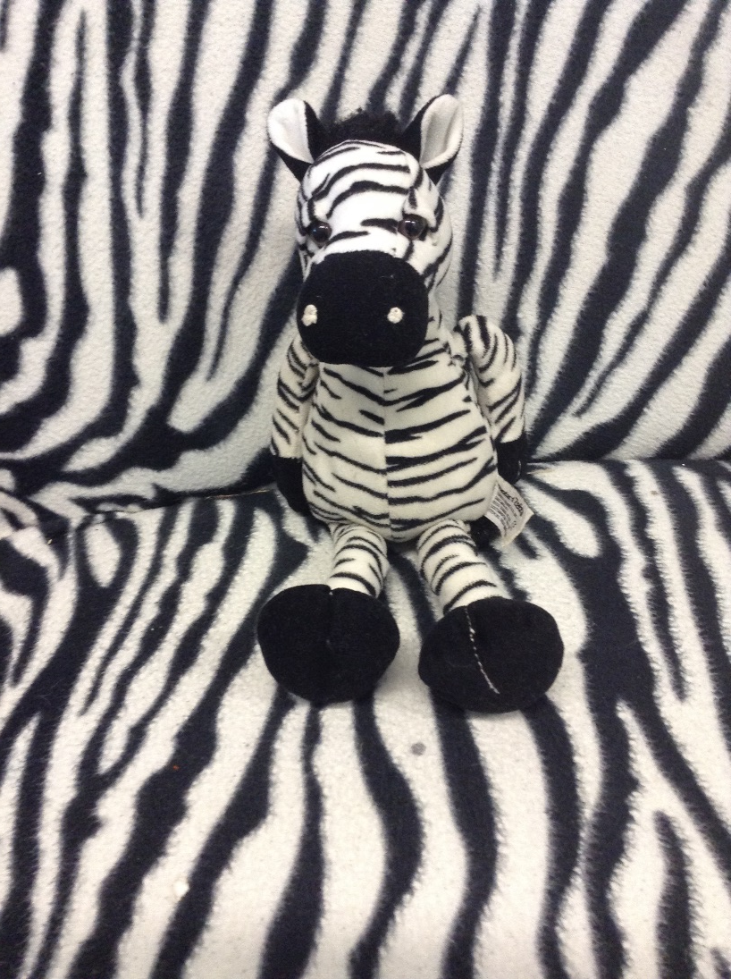
Any Questions?

